Slide 1
Faculty of Health Sciences
POSTGRADUATE ORIENTATION AND RESEARCH WORKSHOP
3 – 5 APRIL 2024
An Overview of the M&D Policy

Slide 2
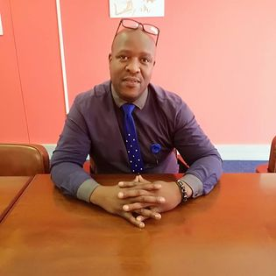
Faculty Academic Administration Postgraduate Consultant for all Hons, Masters and Doctoral candidates
Mr Siyabulela Mashalaba
Email: Telephone: Office details: | Siyabulela.Mashalaba@mandela.ac.za +27 (0)41 504 2109 Room 0123, First Floor Building 7 South Campus

Slide 3
Registration
In the initial year of study, prospective candidates for postgraduate degrees involving research only (that is Master’s by dissertation and Doctoral) are permitted to register throughout the year.
However, it should be noted that the first year of registration will only be recognised as a full academic year, in terms of the minimum/maximum period of study if registration takes place on or before the last working day of April of any given year .
Postgraduate candidates who register after the last working day of April will pay
fees on a pro rata basis for the first year of study.

Slide 4
Registration as a FULL TIME or PART TIME student:
A full-time candidate is defined as one of the following:
One who is available on a day-to-day basis to attend and participate in the postgraduate programme of the Faculty in which he or she is registered;
A candidate who does not fulfil the definition of a full-time
candidate, as defined above, will be automatically deemed by the
University to be a part-time candidate.

Slide 5
Continued Registration…
The continued registration of a postgraduate candidate is subject to a favourable annual progress report.
All master’s and doctoral candidates are required to renew their registration annually within the periods designated by the university (usually by mid March of each year) until completion of their studies.

Slide 6
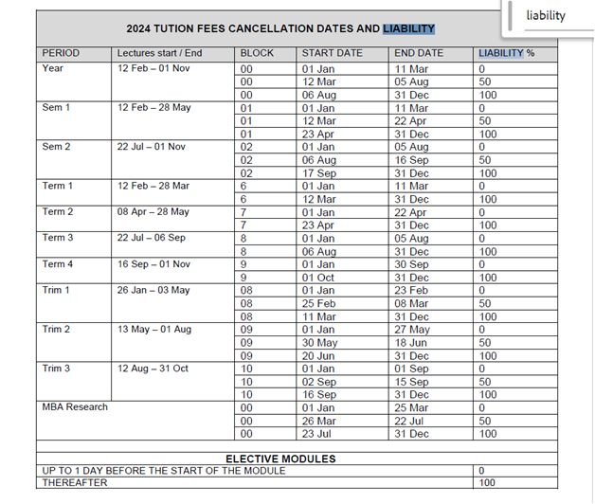
Important Dates:
2024 Tuition Fees Cancellation dates and Liability

Slide 7
Minimum and Maximum Period of Studies
Minimum period of study for a postgraduate degree on a full time basis:
Master’s degree: 1 year
Doctoral degree: 2 years
Maximum period of study for a postgraduate degree on a part time basis:
FULL TIME studies:
Masters degrees by Coursework or Full Research by Dissertation: 3 years
Doctoral studies: 4 years
PART TIME studies:
Master’s degree by Coursework or Full Research by Dissertation: 4 years
Doctoral studies: 6 years

Slide 8
Conclusion of a Learning agreement
Supervisors are required to enter into a specific supervisory agreement (or Memorandum of Understanding) with candidates which specifies the responsibilities and rights of both parties in terms of the supervision process. This agreement should be formally documented and should include the following aspects:
The minimum frequency of formal feedback consultations, as well as the responsibility for initiating such consultations and their format;
The nature, extent and circumstances of the commentary on work handed in by the candidate (e.g., verbal feedback, notes on a draft chapter, a letter in which methodological errors and erroneous assumptions are spelt out) and the time taken by the supervisors to provide such feedback.
NB: A learning agreement template will shared with all attendees.

Slide 9
Responsibilities of the Supervisor
The responsibilities outlined below are considered to be reasonable expectations of academics or any other persons who are undertaking the supervision of master’s and doctoral candidates.
Liaise and co-operate with the HOD/DOS and/or the Executive Dean and relevant academic support units to ensure that the student is able to access basic resources (such as library, laboratory space, chemicals, accessing bursaries and scholarships where the student meets the criteria, etc.) reasonably required by a postgraduate candidate.
Clarify respective roles of student, supervisor and co-supervisor (where relevant) to ensure that student and supervisor (s) are clear about channels of communication as well as expectations. Preferably such clarification should be contained in a supervisory or learning agreement.
Confer or make contact with the student regularly (minimum once an academic term) to provide academic guidance to ensure the development and mastery of research skills and competencies relevant to the discipline and the specific study, and to ensure adherence to university requirements and/or discipline standards.
Monitor progress of the student and submit reports on student progress as required by the university and by relevant scholarship funding bodies.

Slide 10
Responsibilities of the Supervisor continued…
5. Keep a record of supervision sessions and provide feedback, within the timeframe agreed upon, to enable student progress.
6. Supervisors must maintain an adherence to accepted safety and health standards, as well as ethical research practice as per Nelson Mandela University Code of Conduct for Researchers (IRC 404.01), Policy on Research Ethics (IRC 404.02), specific codes of the discipline (where applicable) and conventions regarding plagiarism as per Nelson Mandela Policy for the Promotion of Academic Integrity and Prevention of Plagiarism (IRC 305.04) and advise their students to maintain these standards as well.
7. Provide the relevant information to the student so that the candidate submits the treatise/dissertation/thesis for examination and final submission in accordance with university or faculty-specific rules.
8. Advise the student regarding the submission of declaration of manuscript at the time of approval of examiner reports for the purposes of awarding of doctoral degrees (for doctoral degrees only).

Slide 11
Responsibilities of the Student
Outlined below are reasonable expectations of all candidates enrolled for master’s and doctoral studies. As a postgraduate candidate, the student is expected to apply him- or herself to meeting the following reasonable responsibilities:
1. Complete all the required components of the academic programme as stipulated.
2. Plan and execute the research study as agreed to with the guidance of the supervisor (and co-supervisor, where applicable).
3. Ensure that the research proposal is submitted for approval within the stipulated timeframe in accordance with the university’s rules.
4. Adhere to the principles of accepted safety and health standards, ethical research practice as per Nelson Mandela University Code of Conduct for Researchers (IRC 404.01), Policy on Research Ethics (IRC 404.02), specific codes of the discipline (where applicable) and conventions regarding plagiarism as per Nelson Mandela Policy for the Promotion of Academic Integrity and Prevention of Plagiarism (IRC 305.04).
5. Make regular appointments with supervisor(s) to update supervisor(s) on progress or any difficulties encountered in executing the academic project as planned to ensure timeous remedial action where required.

Slide 12
Responsibilities of the Student continued…
6. Keep written record of supervision sessions and the decisions agreed to.
7. Submit regular outputs from the academic project to ensure effective guidance and input by supervisor(s).
8. Ensure that written work submitted has been proofread and of an acceptable academic standard.
9. Ensure that the necessary amendments or revisions decided upon with supervisor(s) are made regularly and resubmitted as agreed for further guidance.
10. Take responsibility for the final production of the treatise/dissertation/thesis for examination and final submission in accordance with university or faculty-specific rules.
11. Submit a manuscript to the supervisor prior to the time of the approval of examiner reports (for purpose of awarding the doctoral degree).
12. Renew annual registration for the academic programme within the periods as stipulated by the university/until the
completion of the degree.

Slide 13
Submission of Research Proposals
Postgraduate candidates who are enrolled for a master’s degree by research are required to submit a research proposal within 6 months of registration
Postgraduate candidates who are enrolled for a master’s degree by coursework are required to submit a research proposal within 6 months of registration after registering for the treatise module.
Doctoral candidates are required to submit a proposal within 12 months of registration.
Proposals are submitted at Departmental level first and thereafter submitted to the Faculty’s Postgraduate Studies Committee for approval.
Faculty Postgraduate Studies Committee (FPGSC) approves
low risk studies.
University Research Ethics Committee Human (REC-H)
approves medium-high risk studies.

Slide 14
2024 Faculty Postgraduate Studies Committee Meeting Dates
Please submit all FPGSC Proposal agenda items to Ms Zukisiwe Sifile (Zukisiwe.Sifile@mandela.ac.za) by the FPGSC agenda items closing date.

Slide 15
Studies in Abeyance
In extraordinary circumstances an application for abeyance for a defined period of time can be requested.
Faculty of Postgraduate Studies approves an abeyance in studies for one academic year.
In exceptional cases, PGSC may grant permission for studies to be placed in abeyance for an additional year but such abeyance may not be granted for more than a total of two years during the complete maximum period of study for the degree.

Slide 16
Extension in Studies Applications
Once maximum years of study has been exceeded
An extension of Studies Application is to be submitted for approval to complete your degree (register).
1st Application approved at faculty level: Faculty Postgraduate Studies Committee (FPGSC)
2nd Application approved by institutional
Post graduate Studies Committee (PGSC)

Slide 17
Intentions to Submit:
December/April graduation
When the treatise/dissertation/thesis nears completion, the student must inform Faculty Academic Administration (our offices) in writing of his/her intention to submit his/her treatise/dissertation/thesis for examination.
Such notice must be given by the deadline published in the University calendar (in April for December grad and in August for April graduation).
Deadline for assessment copies to be submitted for graduation
is usually the first Friday in August for December graduation
and the first Friday in December for April graduation.

Slide 18
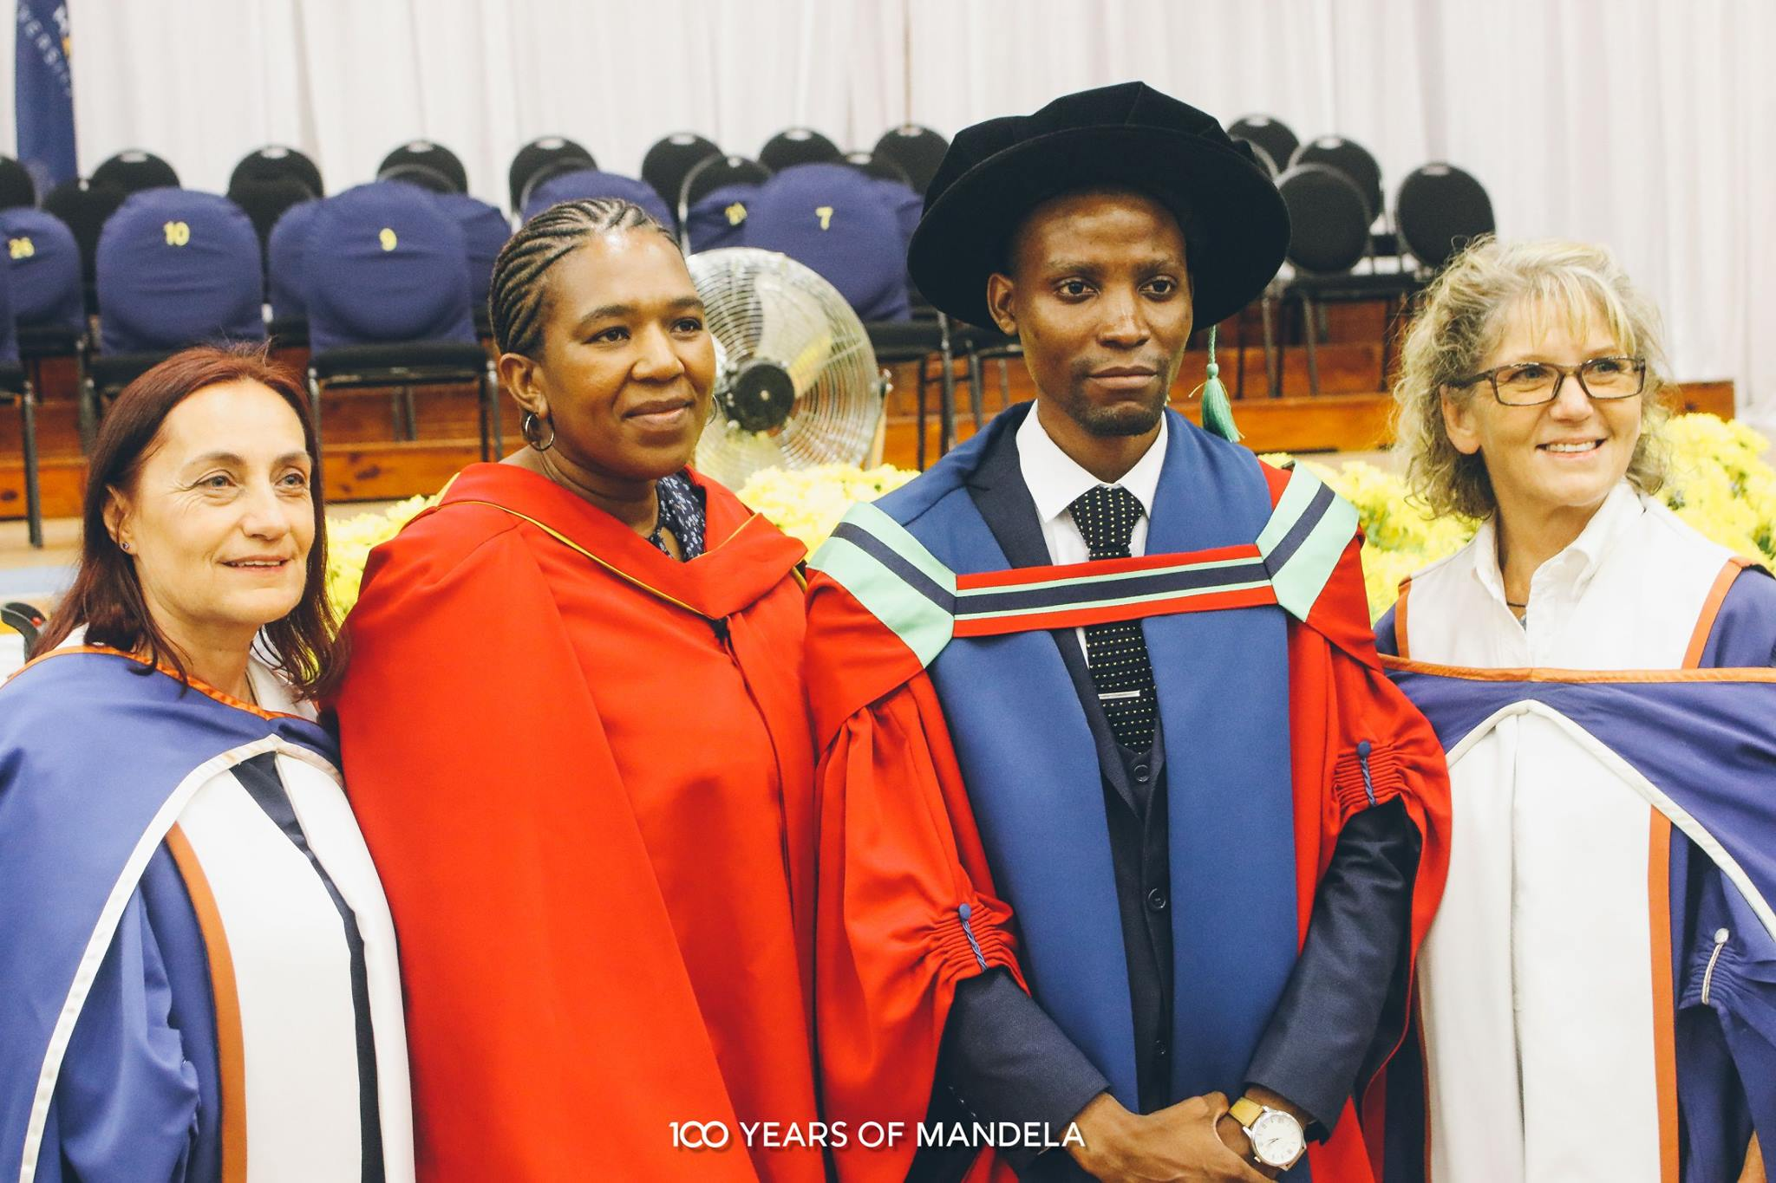
Graduation: Awarding of the degree
OUTCOME OF EXAMINATION
Your Faculty Academic Administration Postgraduate Consultant will be responsible for informing you in writing of the outcome of the examination process.
The Assessment and Graduation Section will inform your of arrangements for graduation.
AWARDING THE DEGREE
There is a clear examination outcome (positive) and
Final electronic copies of the treatise/dissertation/ thesis have been submitted by the deadline for December/April graduation.

Slide 19
Thank you for your kind attention.
The Faculty Academic Administration
Faculty of Health Sciences
Questions & Answers

