Slide 1
My PhD Journey
By Maryline Vere

Slide 2
A little bit about myself
2nd year PhD in Environmental Health Student
My area of research is Public Health
Specifically Neglected Tropical Diseases ( schistosomiasis and soil transmitted helminthiasis)
International student

Slide 3
My Journey to a PhD
Desire, dream and wish
BSc Honors in Biochemistry at the University of Zimbabwe in 2014
Internship at the African Institute for Biomedical Sciences and Technology
Research assistant Tackling infections to Benefit Africa (TIBA) (2019)
Masters in Biotechnology at the University of Zimbabwe for 2 years

Slide 4
How did I secure my PhD
Funded opportunity from my previous supervisor, Prof Mduluza
I applied, I was interviewed by my supervisors Prof Melariri, Dr Wilma and Dr Ochola
They accepted me, and I registered with the university

Slide 5
The process…
Admissions as an international
Acceptance and registration
Student Visa- but it was dependent on the SAQA process
SAQA verification during COVID 19 pandemic
My passport was taken by the Visa officials

Slide 6
Research journey
Undergraduate research topic:
Development of DNA and RNA ladders (Supervised by Prof Sithole-Niang)
Masters research topic:
Promoter single nucleotide polymorphisms in pro-inflammatory cytokine genes in S. haematobium infected individuals and the associated risk of prostate cancer development (Supervised by Prof T. Mduluza)
PhD research topic:
Prevalence associated risk factors and diagnostic biomarkers of schistosomiasis among school going children in Nelson Mandela Municipality (Prof Melariri, Dr Wilma ten Ham-Baloyi and Dr Ochola)

Slide 7
Coming to SA
After I got my Visa, I had to move to Port Elizabeth
February 2023
Accommodation, navigating college resources and amenities
The wind!!!

Slide 8
Progress in 2023
Developed my proposal
REC-H approval
Department of education
Gatekeepers

Slide 9
Progress in 2024
Sample collection September 2023-February 2024
Data compilation
Lab work

Slide 10
My supervisors
Critical
Honest and trust
Touch base
Mutual respect
Expectations
Responsibilities
Managing responsibilities

Slide 11
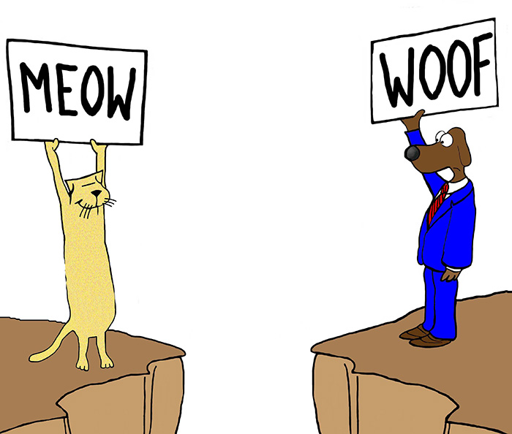
Challenges
Language barrier
Finding the cafeteria
Financial difficulties
Weather changes
Homesickness!!!

Slide 12
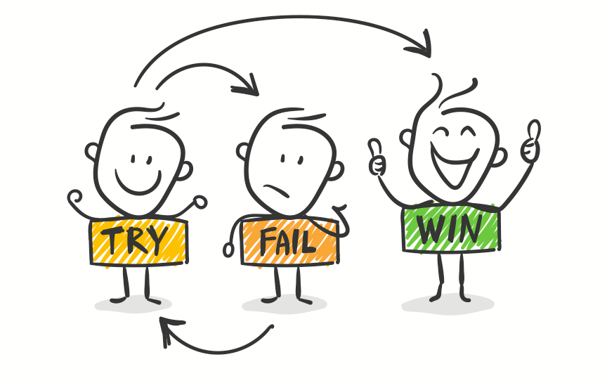
Remember
“Rome was not built in a day”
Gantt chart very useful
Mistakes are a part of the learning process

Slide 13
Questions ?

