Slide 1
Emthonjeni Student Wellness
Aamena Vawda
This Photo by Unknown Author is licensed under CC BY-SA

Slide 2
Who We Are
A team of trained mental health professionals :
Psychologists: Counselling, Clinical
and Research.
Registered Counsellors
Intern Psychologists who are in training
All staff registered with Health Professions Council of South Africa- HPCSA
Our administrative staff are discreet and confidential in all their dealings with students.
Notes:
At the moment we are understaffed, in the process of acquiring new staff

Slide 3
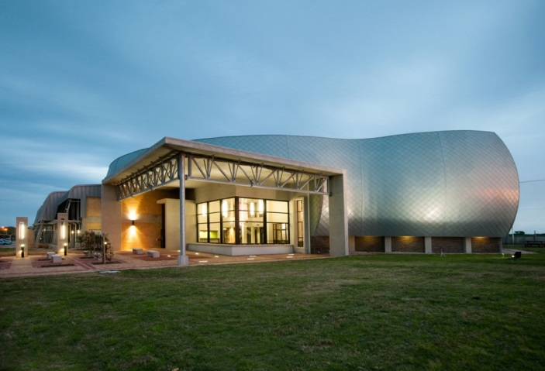
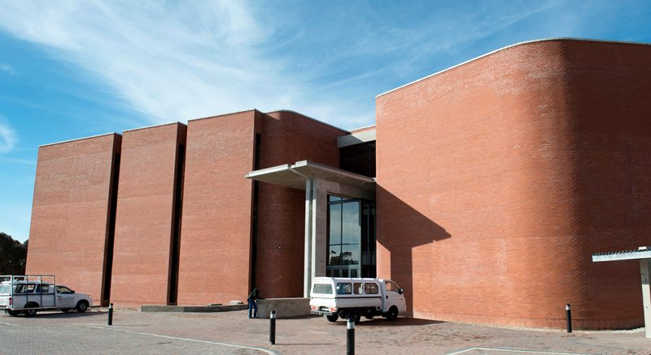
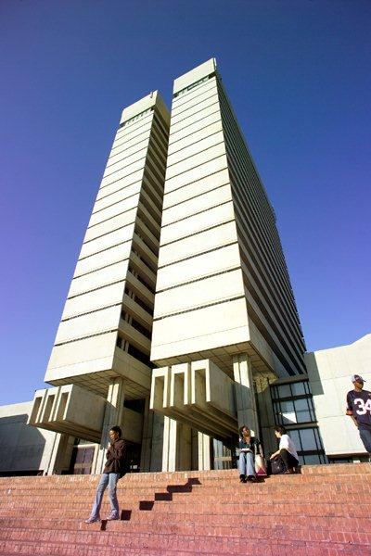
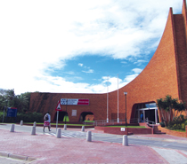
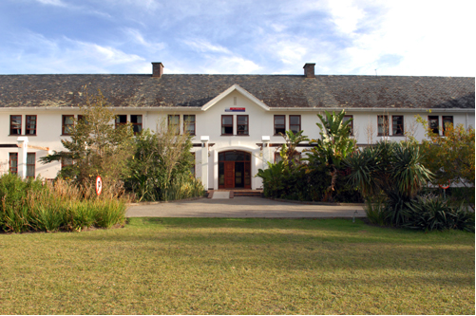
ESW has offices on 5 campuses
North
Second Avenue
Missionvale
George
South

Slide 4
2nd Avenue : Building 405 Old Ceramics Building
North Campus: D Block 002, Ground floor
Missionvale: Admin Building 502, Ground floor, Room 128
South: Embizweni: Ground Floor, 002

Slide 5
Aim of Emthonjeni
Emthonjeni Student Wellness provides the following services to students:
Free service
Provide support guidance professional counselling
in order to contribute to the students holistic success

Slide 6
CONFIDENTIALITY
Emthonjeni adheres to very strict confidentiality standards as prescribed by the Health Professionals Council of South Africa.
Only exceptions are in life threatening situations or when release is required by law.
Emthonjeni records are not part of a student’s educational record.

Slide 7
Format of Emthonjeni Services
Group
counselling
Individual counselling
Workshops
Pamphlets
Electronic
Media
Notes:
Counseling tends to be focused on one specific issue and considered a short-term treatment. You may learn coping techniques and problem-solve the issue together.
The counselling process involves a confidential , helping relationship between a counsellor and the student/client. It is aimed at
assisting the client/student towards greater self-awareness and greater understanding of self and others.
assisting client/student deal with life obstacles that they are facing, be it academic or personal.
identify issues to explore and clarify feelings, to focus on personal resources and to decide on options for change.
Supplemented by self-help programmes and workshops.
A wide variety of pamphlets are available on our website
Website address: https://counselling.mandela.ac.za/
Our services are free to all Nelson Mandela University students!!!

Slide 8
Service Areas
Psychology of Wellbeing
Career
Psychology of Learning

Slide 9
Notes:
We consist of a team of trained professional staff registered as psychologists with the Health Professions Council of South Africa.

Slide 10
Top 10 Reasons for Referral
Family challenges
Anxiety symptoms
Depressive symptoms
Relationship - intimate
Stress-related issues
Improving academic performance
Bereavement
Motivation
Emotional development
Trauma
Notes:
WHY USE EMTHONJENI SERVICES?
Seeking assistance from Emthonjeni does not imply weakness.

Slide 11
Peer to peer support
Peer helpers support students with psycho-social problems challenges such as:
Stress;
Relationship difficulties;
Adjustment challenges.
They are also knowledgeable on the resources and support on campus to make appropriate referrals.
Supervised.
Peer helpers

Slide 12
REQUESTING COUNSELLING: INTAKE BOOKING SYSTEM
When you visit our office, you can attend an intake system during an intake slot at any campus from Mondays- Thursday’s.
A dedicated intake counsellor will warmly welcome you and spend approximately 15 minutes engaging in the intake session
This initial interaction allows our counsellor to listen attentively to your concerns, needs, and preferences. Based on this valuable conversation, they will then assist you in choosing the most suitable support options available.
WORKING HOURS , Monday- Friday , 08:00-16:30

Slide 13
Intake Slots Per Campus
Counselling request email: counselling @mandela.ac.za If unable to attend any of these slots or require virtual intake)
Campus | Monday | Tuesday | Wednesday | Thursday | Friday
South Campus | 10:00 -12:00 14:00-16:00 | 10:00 -12:00 14:00-16:00 | 10:00 -12:00 14:00-16:00 | 10:00 -12:00 14:00-16:00 | None
George Campus | 8-10am | None | None | 2-4pm | None
Missionvale Campus | 08:30-09:45 | 11:00-12:45 | 11:00-12:45 | 11:00-12:45 | 11:00-12:45
North campus | 8:00-10:00 | none | none | 14:00-16:0 | None
2nd Avenue campus | 11h30-12h30 | 15:00-16:00 | 11h30-12h30 | 14h30-15h30 | None
Notes:
To facilitate your access to this new request system, we have scheduled daily intake slots across our campuses.

Slide 14
EMERGENCIES
During working hours, any of our campus sites can be contacted from 08:00 -16:30
• Emergency referrals can be made via the counselling@mandela.ac.za email address
• The counsellors on Emergency duty will be notified and the student will be scheduled on the day for a face to
face or virtual session.
• For emergencies during evenings, weekends, and public holidays, student can be referred : - Higher Health 24-hour Tollfree Mental Health Helpline 0800 36 36 36 or SMS 43336
Suicide Emergency Lines: 0800 21 22 23 (08:00-20:00) / 0800 12 13 14 (20:00-08:00) / 0800 567 567 or sms 31393
Substance Abuse 0800 12 13 14 or SMS 32312 WhatsApp chat line 08:00-17:00 7 days a week 087 163 2025
Cipla 24hr Mental Health Helpline 0800 456 789
Gender-based Violence Support 0800 428 428 or SMS for call back *120*7867#
Life Line: 0861 322 322 (Counselling available 24/7) or www.lifelinesa.co.za

