Slide 1
FHS: Postgrad Library and Information Services and Resources

Slide 2
Contact Details
Nobuzwe Bavuma Faculty Librarian: Health Sciences South Campus Tel: 041 504 2284 Email: nobuzwe.bavuma@mandela.ac.za

Slide 3
Content
Library Membership
Library Website
Evidence Synthesis Research
Consulting role of Librarian
Finding eBooks
Online Databases
EndNote Reference Tool
Publishing Support

Slide 4
Library Membership

Slide 5
Library registration
Student cards are compulsory for library access and the use of all Nelson Mandela University library facilities
You must be a registered library user (you are required to register every year) and create a PIN.
When you create a PIN, you will be able to do the following:
Access online databases from home
Request items via Interlibrary Loan service
Activate your reading history to record all library items borrowed by you
View and renew your library items out on loan

Slide 6
Borrowing Rights
Patron type | No. of books | Loan period
Masters and Doctoral students | 20 | 60 days
Library books may be renewed:
via phone
online via the Classic Catalogue
in person at the library Circulation Desk
Library books can be renewed twice unless another patron has booked the item

Slide 7
Interlibrary Loans (ILL)
Interlibrary Loans (ILL) allow postgrad students the convenience of requesting items (journal articles and book chapter from eBook) from another institution if you cannot find fulltext access
There is no charge for this service

Slide 8
Library website

Slide 9
The Library website is the gateway to finding the most relevant information for your research
Important links to remember:
Classic Catalogue
Online Databases
Google Scholar
Publish Support
LibGuides
Please visit the Library website to explore these platforms:
http://library.mandela.ac.za

Slide 10
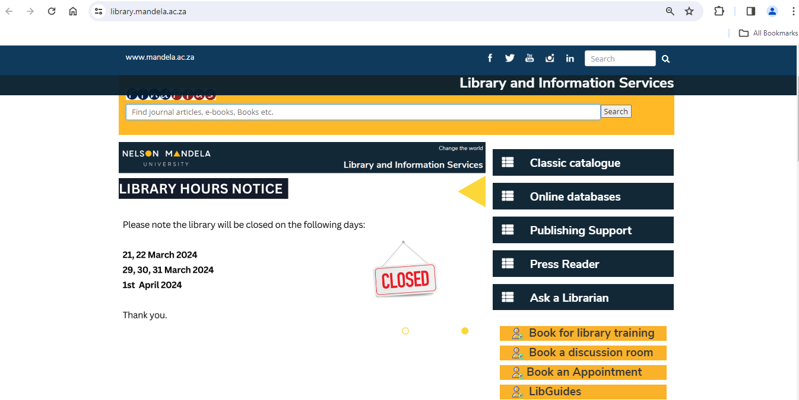
Library Website
Databases
A-Z List of electronic resources
LibGuides
FindPlus
GoogleScholar
OpenAccess
Accredited Journal lists
Notes:
Databases:
Access a wealth of academic resources.
Search for scholarly articles, research papers, and more.
A-Z List of Electronic Resources:
Browse a comprehensive list of digital materials.
Conveniently organized for quick access.
LibGuides:
Your research roadmaps.
Subject-specific guides for effective research.
FindPlus:
Streamlined library search.
Find books, articles, and more in one place.
Google Scholar:
Explore scholarly literature.
Search for academic articles and publications.
OpenAccess:
Access free, open-source research.
Promotes knowledge sharing and collaboration.
Accredited Journal Lists:
Trustworthy academic sources.
Journals meeting quality standards.
The following indices are regarded as accredited journals by the Department of Higher Education and Training (DHET).
Journal lists for articles with publication date of 2023
International Bibliography of the Social Sciences (IBSS)
Web of Science Journals
List of approved South African journals as maintained by the DHET
Scopus​
DOAJ (Only applies from the submission in the year 2022 and onwards)
Academic Library Support: Access to Databases, Journals, and Digital Repositories:
Academic libraries serve as a lifeline, offering critical support in overcoming resource discovery challenges.
Databases: Curated collections of scholarly articles, reports, and data from various fields, searchable through specialized platforms.
Journals: Access to peer-reviewed publications, keeping researchers updated on the latest advancements.
Digital Repositories: Curated collections of research outputs, data sets, and historical materials, fostering exploration.

Slide 11
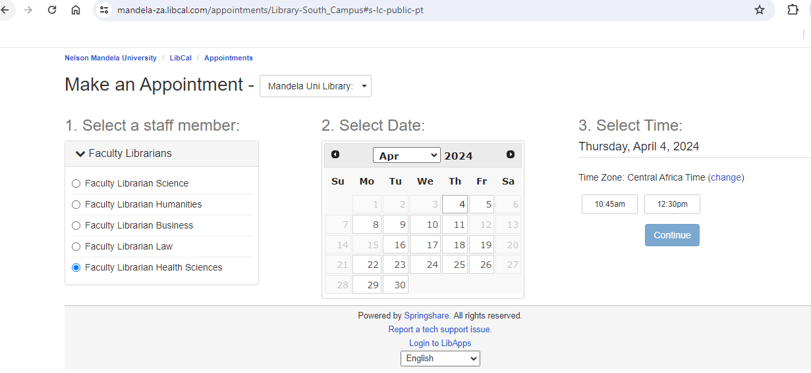
Consult with Librarians: Book an appointment
Notes:
Schedule a personalized consultation or orientation session to learn about library services and resources
Subject Databases and Research Data Management
Endnote and RDM Libguide, Figshare
Plagiarism, Copyright, Endnote
Citation Styles | Open Access | Where to Publish – Transformative agreements, Journal Impact Factors, Accedited Journals, Endnote
Researcher IDs and Profiles: Journal Rankings (including Journal Impact Factors)Impact Measures Evaluate a Journal Publish or Perish Impact Lookup Tool
Various training sessions are available, LibCal

Slide 12
Important Links
Click on the Classic Catalogue to find open shelve books and ebooks
Click on Online databases to find e-books and journal articles for your assignment
Click on Letter of Introduction the form to request access to other universities
Click on Digital Commons to find Theses and Dissertations

Slide 13
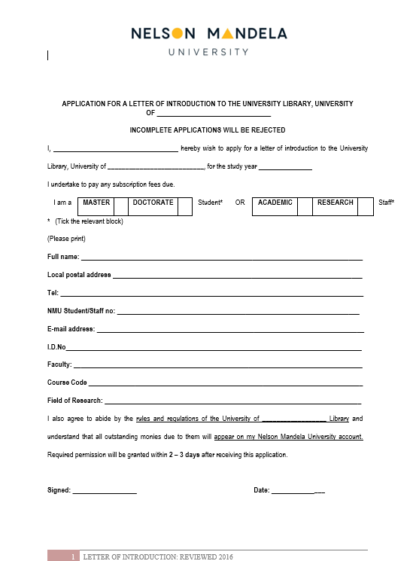
Application for Letter of Introduction

Slide 14
LibGuides
Click on LibGuides the most relevant information for your research

Slide 15
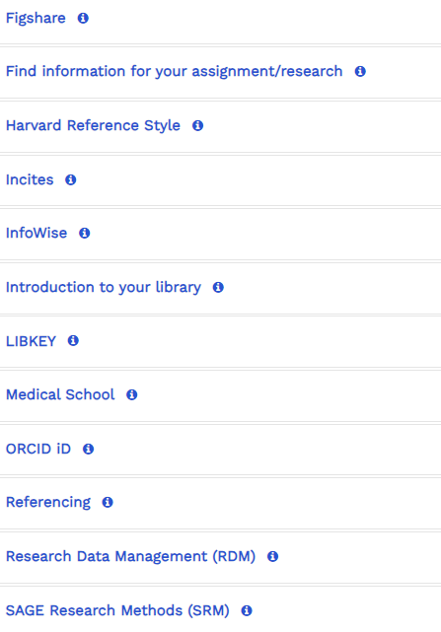
LibGuides

Slide 16
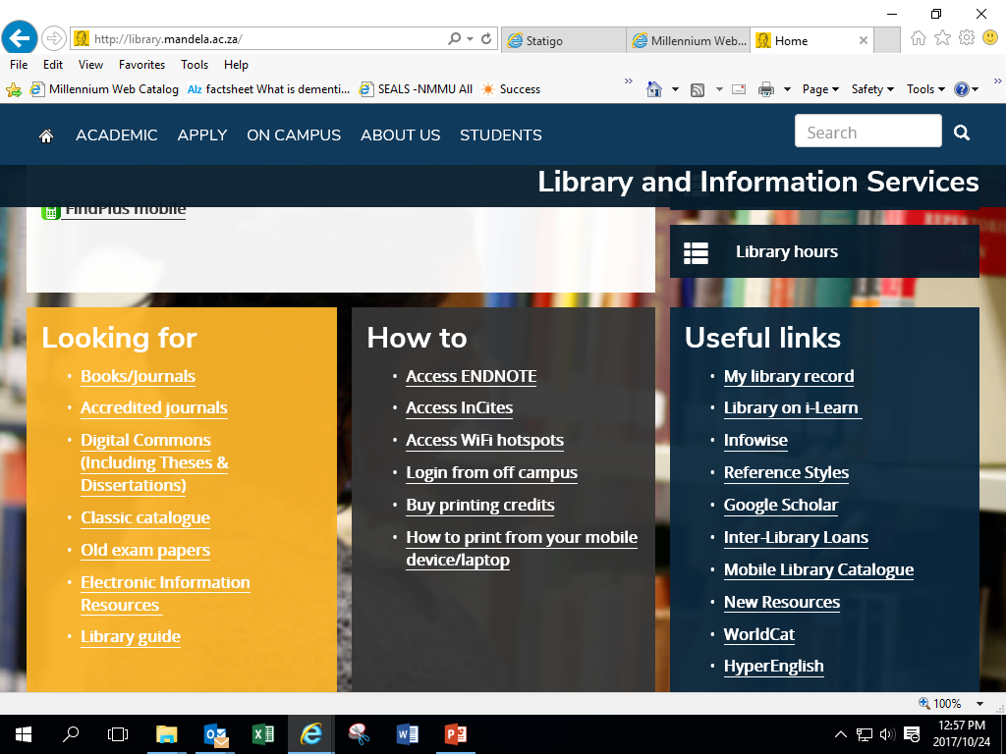
DIGITAL COMMONS (Theses & Dissertations)
Eastern Cape

Slide 17
Type in Author’s name or the Title

Slide 18
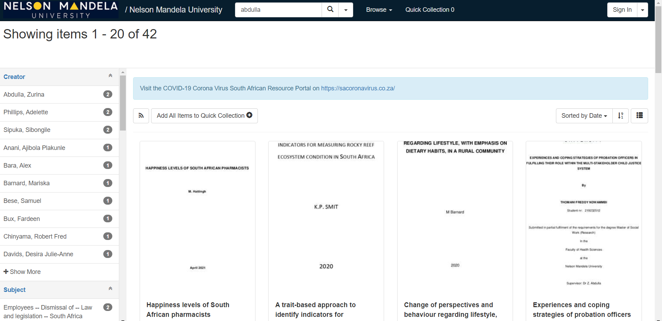

Slide 19
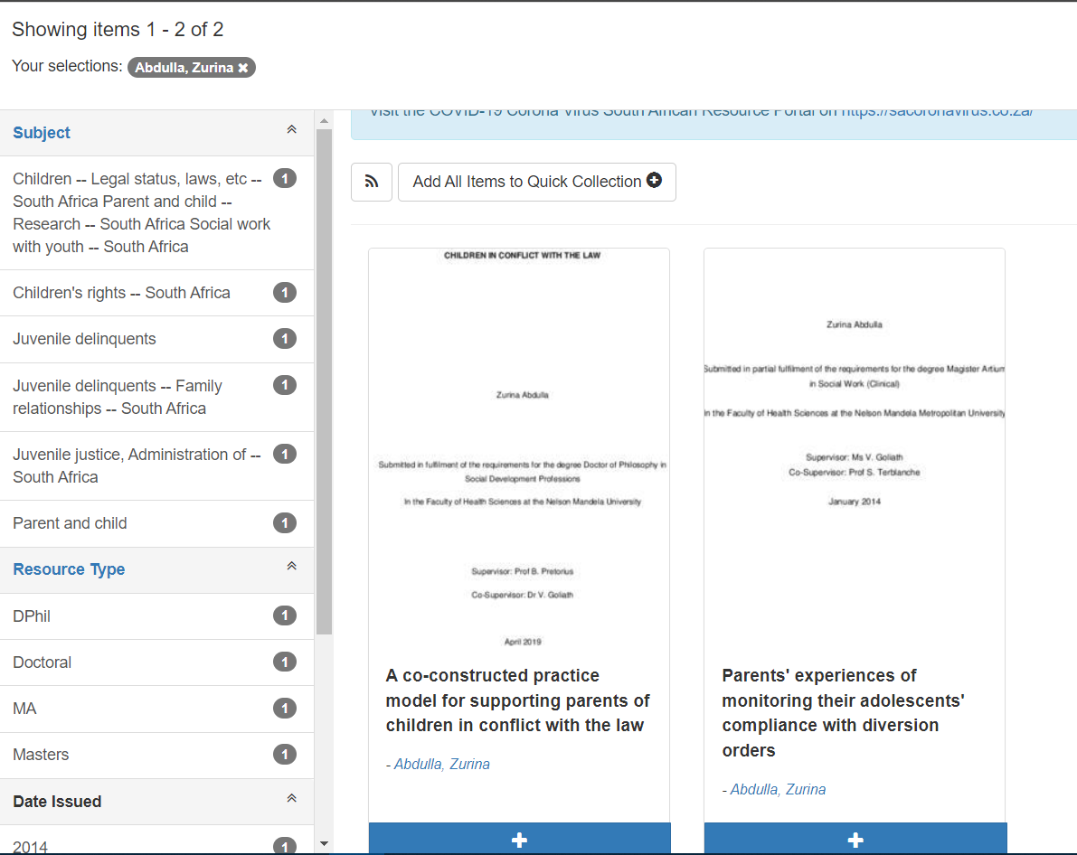

Slide 20
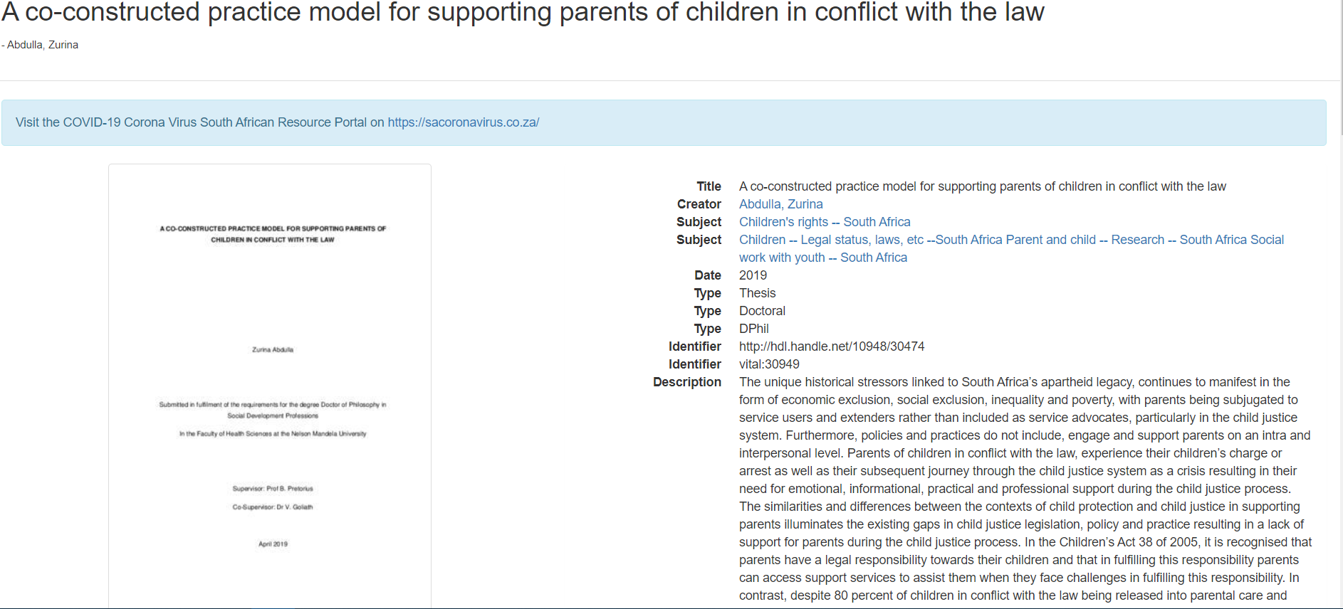

Slide 21
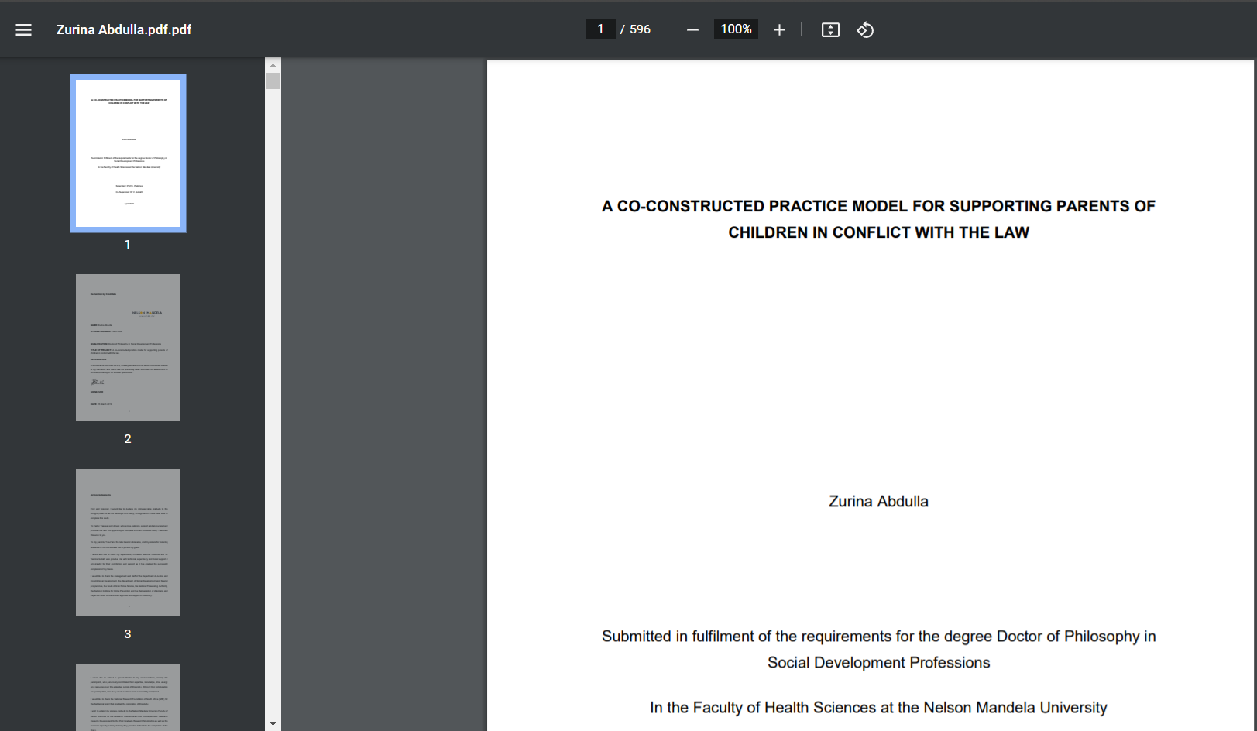

Slide 22
Evidence Synthesis Research

Slide 23
What is Evidence Synthesis Research?
Evidence Synthesis refers to the process of bringing together information from a range of sources and helps us make informed decisions by looking at a comprehensive range of information available on a subject.
Evidence Synthesis approach a well formulated research question in a methodical and comprehensive way, to make an informed decision based on a wide range of evidence.

Slide 24
Types of Evidence Synthesis
Narrative Literature reviews
Scoping reviews (topic based)
Systematic reviews (can include meta-analysis)
Rapid reviews
Integrative reviews
Bibliometric reviews

Slide 25
Consulting Role of the Librarian

Slide 26
Consulting Role of the Librarian
Assist with the development of the PICO/PCC statement
Determining terms and the logic of the question using Boolean operators
Consult on the search strategy
Assist in the selection of databases and other resources for searching
Assisting users with Reference Management Tool – EndNote
Emphasize the documentation process which can be replicated
Not involved in Screening and Selection of Articles

Slide 27
Finding eBooks

Slide 28
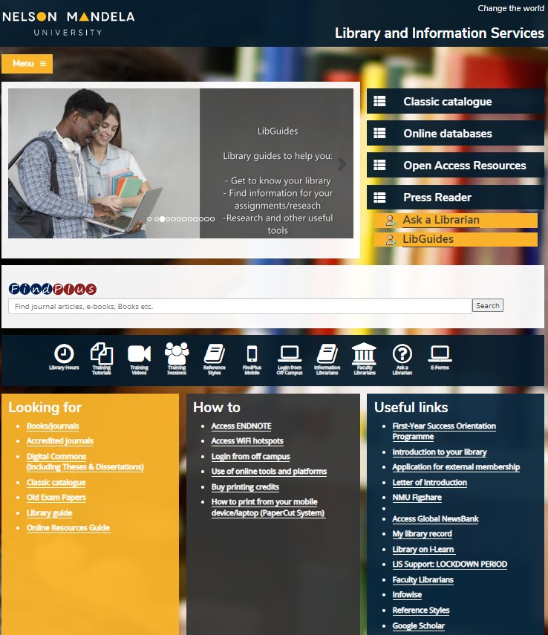
Click on the Classic Catalogue to find open shelve books and ebooks

Slide 29
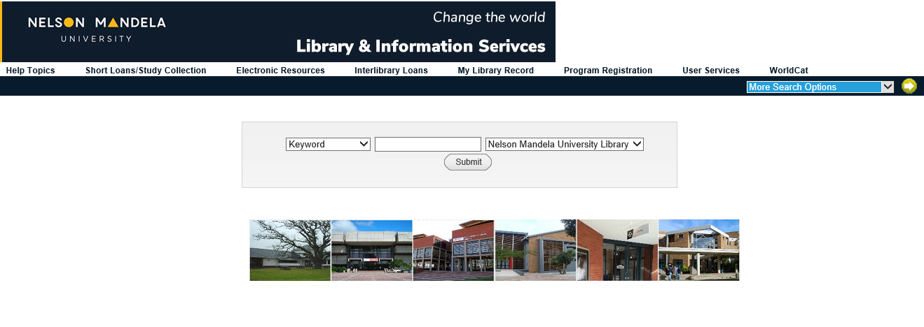
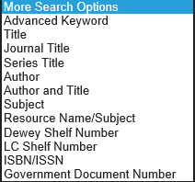
Advanced Keyword Search

Slide 30
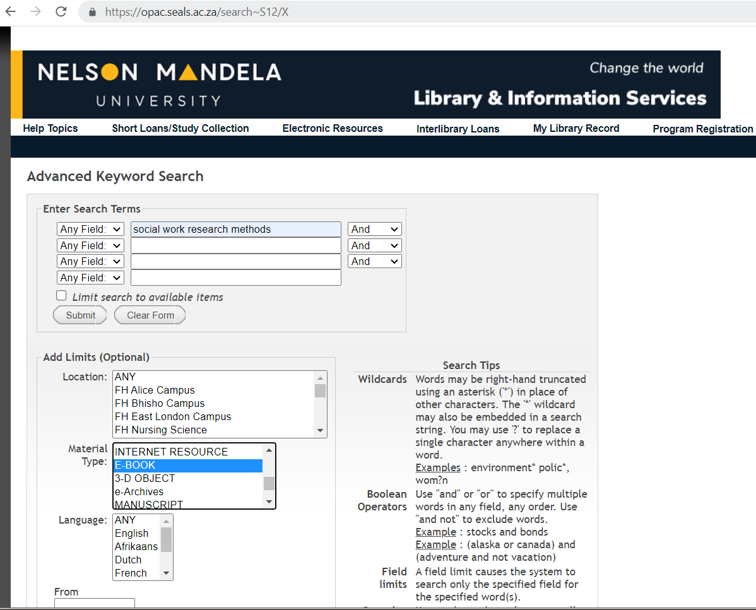
Type in Keyword/Title
Scroll down and Select EBOOK on Material Type

Slide 31
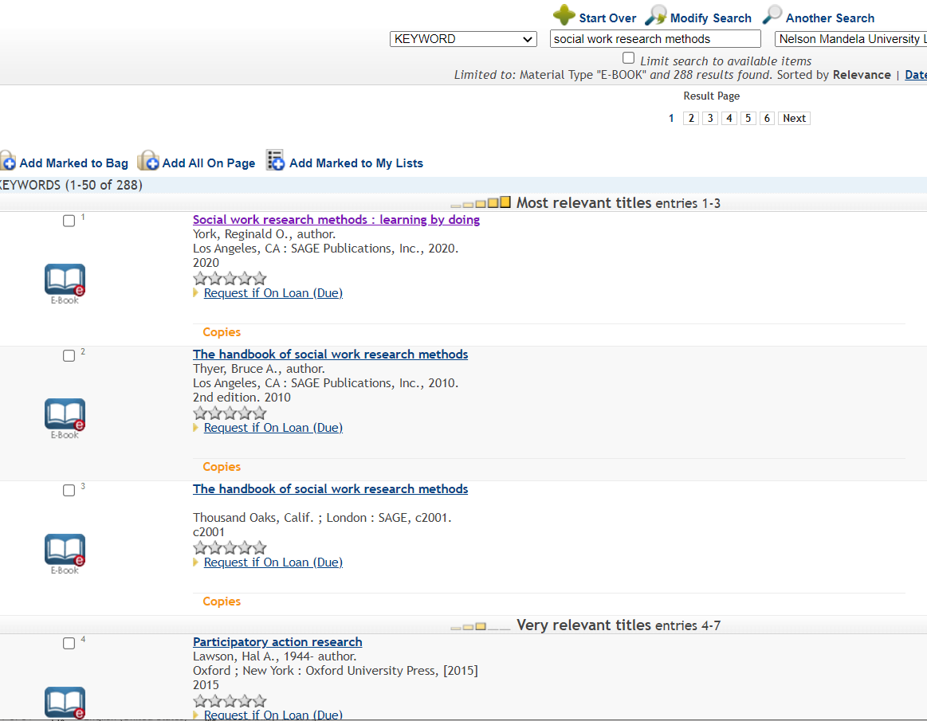
Click on the Title of the book

Slide 32
Click on the link to view the full book

Slide 33
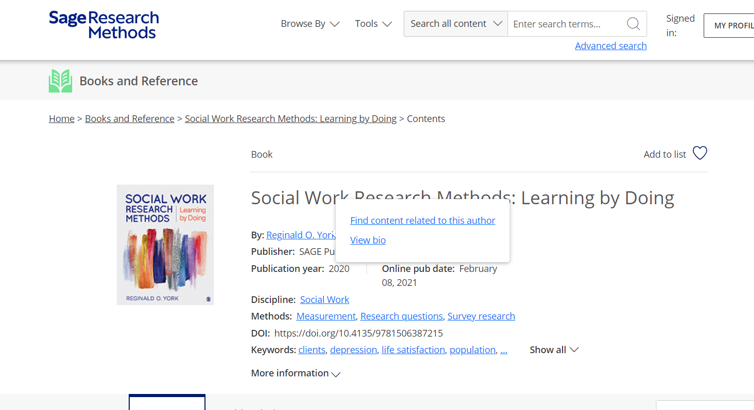

Slide 34
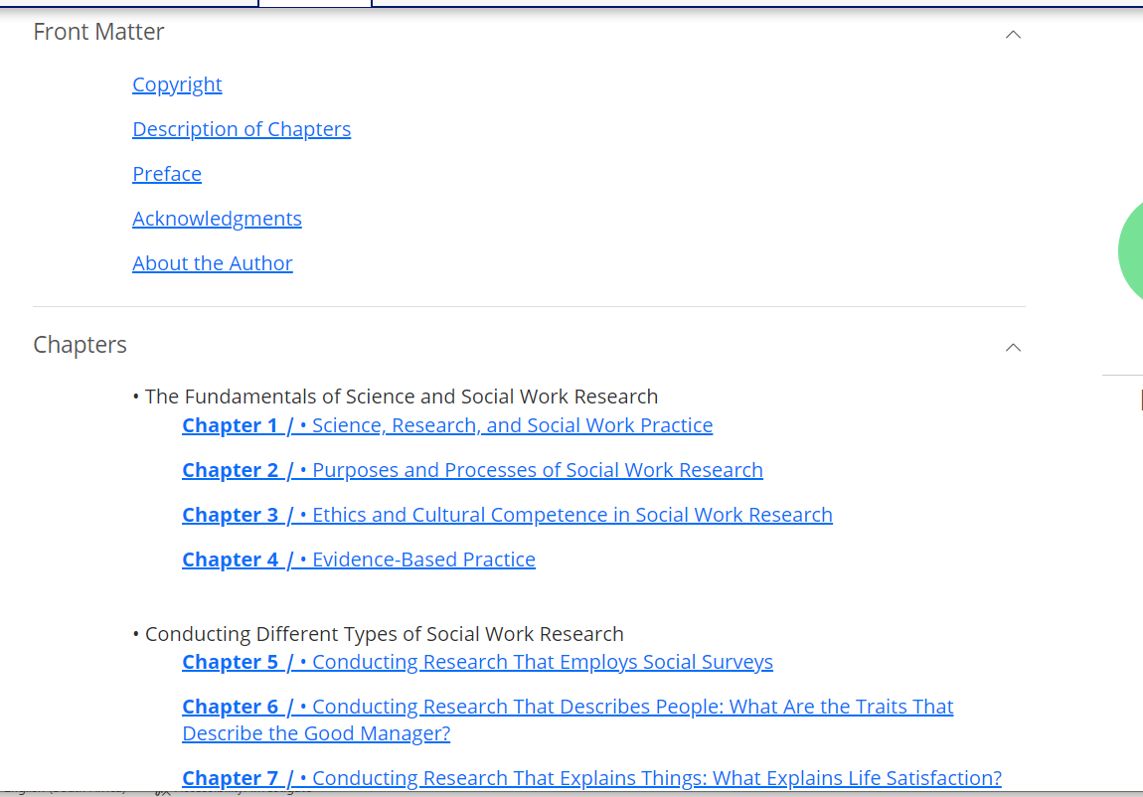
Click on the Chapter of the book to open the full text

Slide 35
Online Databases

Slide 36
Click on the Online Databases to find journal articles

Slide 37
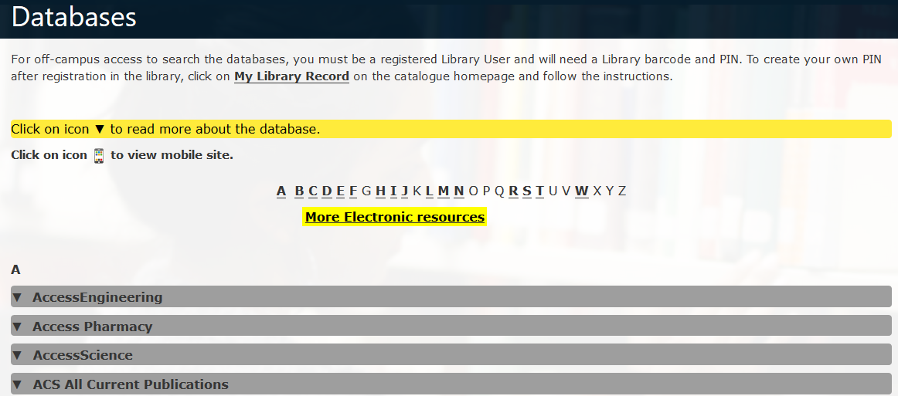

Slide 38
List of Relevant Databases for Health Sciences
EBSCOhost
PubMed
SABINET Online
SAGE journals
SAGE Research Methods
ScienceDirect
Scopus
Taylor & Francis Online
Web of Science
PressReader - unlimited access to 6,000+ newspapers and magazines from around the world
Google Scholar

Slide 39
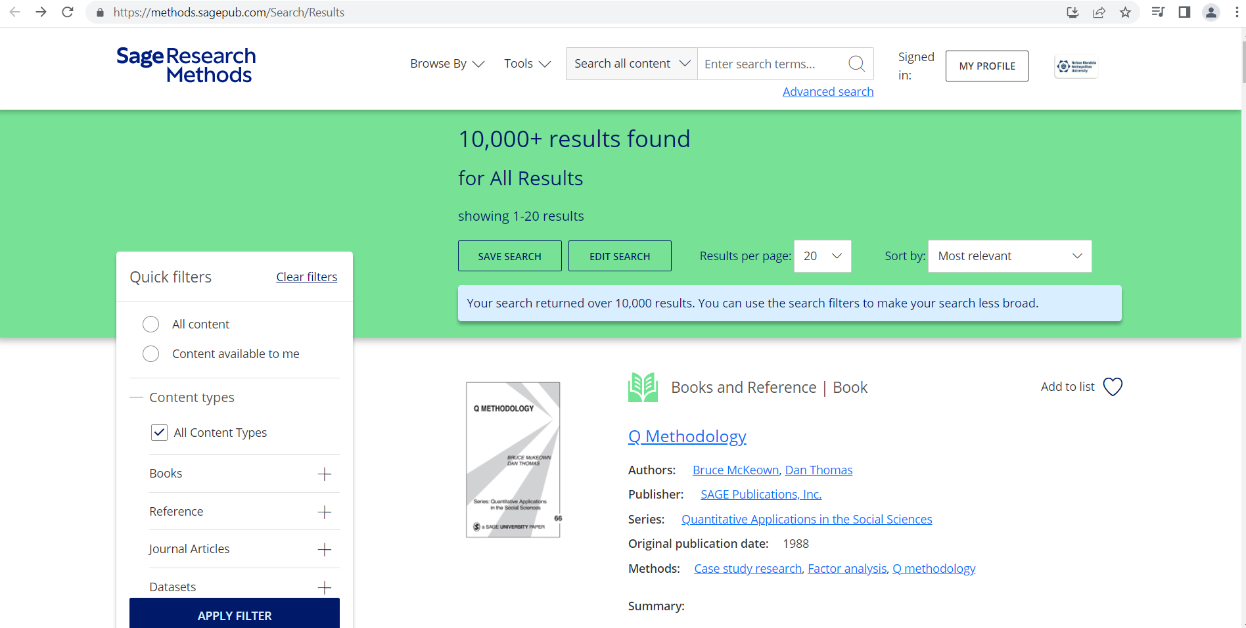

Slide 40
Under Tools you will find Project Planner

Slide 42
EndNote Reference Tool

Slide 43
EndNote
Is a customized private library which stores and manages all your bibliographic references
You can export references from Google Scholar and library online databases into your EndNote Library
EndNote has a plugin for MS Word that allows for easy inserting of references (citations) while building a bibliography in your selected reference style
To Download and Install Endnote on your PC or Laptop go to Library website https://library.mandela.ac.za/

Slide 44
Citing Sources: EndNote 20
Tools for effective citation:
Endnote: A powerful tool for managing citations and references.
Organizes and formats references.
Streamlines the citation process, saving time and ensuring accuracy.
Endnote 20 LibGuide
Referencing LibGuide

Slide 45
Interface of Endnote

Slide 46
Insert and Create Citations and Bibliography into MS Word
Click on the EndNote 20 to insert citation
First select a specific Citation you want to insert from EndNote Library. Click on Insert Citation

Slide 47
Publishing Support

Slide 48
Transformative Agreements
Transformative Agreements (TA) are negotiated licence agreements in which former subscriptions are repurposed and channelled to support Open Access Publishing.
Agreements assist our researchers and emerging researchers with article processing charges (APCs) when choosing to publish eligible articles Open Access in the included journals at no cost or discounted charge to the researcher.
Eligibility for publishing under one of TA is usually established when the corresponding author uses their NMU email institutional affiliation during the article submission process.

Slide 49
How do the Agreements factor into selecting a journal?
The Transformational Agreements can be used as an additional tool for assessing journals that you have identified as relevant to your research area:
Assess the quality of the identified journals
Check Current Transformational agreements for journal and article eligibility in the identified journals
Select your preferred journal
Submit your article, utilising an agreement if eligible

Slide 50
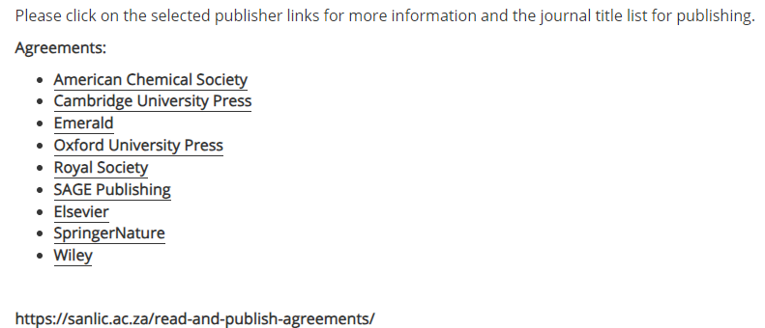
NMU Transformational Agreements
We have NINE signed TAs at NMU, each publisher has its own business model.

Slide 51
Thank You

