Slide 1

QUALITATIVE
DATA ANALYSIS

Slide 2
INTRODUCTION
  Qualitative – assumptions believes values and practices that go with this paradigm
    Non-positivist
    More than one version of reality
    Closely linked to context
    Interested in process and meanings rather than cause and effect
    Critical and questioning approach to life and knowledge – why, how
  It is iterative – concrete data vs abstract concepts
    Messy, immersive yet creative process
  3 basic forms or frameworks
    Looking for patterns
    Looking at interaction
    Looking at stories

Slide 3
SUBJECTIVITY AND REFLEXIVITY
      We operate in a subjective, interpreted world, offering a version of reality – as does the researcher
      Identify own assumptions and bracket them so that they don’t shape the research
      Researcher examines the influence of their role = we are not neutral
      We give a sense of coherence and comparability
      Analysis happens because of subjectivity not despite it
      Engagement in the data but guided by:
      Research question
      Questions we ask participants
      Questions we ask the data
      We do this from a theoretical orientation

Slide 4
ORIENTATION
    Theoretical orientation informs how we look at the world, and the nature of reality (ontology), theories about knowledge (epistemology) and values of the researcher (axiology)
    Your orientation will be determined by your research questions and the problems you are interested in addressing
    The greater the move away from positivism, the greater the complexity
    Experiential orientation (describing reality of others) vs critical orientation (looking at the social structures beneath this)
    Realist vs relativist position

Slide 5
  Your data analysis method is influenced by:
    Research questions (as well as aims and objectives)
    Paradigm – epistemology (interpretivist/constructivist) and ontology (realist/relativist)
    Methodology (exploratory-descriptive/IPA/GT/Narrative/Ethnography etc)
    Views about language
    Braun and Clarke’s reflexive thematic analysis is a flexible options, that fits with many orientations within the qualitative paradigm
    it is not tied to an ontology or epistimology

Slide 6
BRAUN AND CLARKE (2006)
6 steps to conduct the analysis.
familiarize yourself with your data;
assign preliminary codes to your data in order to describe the content;
search for patterns or themes in your codes across the different interviews;
review themes;
define and name themes and produce your report.

Slide 7
CONSTRUCTING NOT DISCOVERING

Slide 8
  ANALYSIS
Some analysis methods require the researcher to do their own transcription
We want to create themes = meaning based patterns that are achieved through interpretation of the data
A good analysis doesn’t just summarise according the research questions, but analyses the data
CODING
Process of identifying aspects of the data that pertain to your research question
  Selective coding = only code that is relevant to the RQ
  Complete coding = code everything that may be relevant and later become selective
  (no themes at this point)

Slide 9
Interviewer: How strongly do you identify with your culture?
Participant: ***** example of data redacted

Slide 10
  ANALYSIS
CODES
A word or brief phrase capturing the essence of a segment of data
Reduces the data into small chunks of meaning
The way you develop codes can be:
  descriptive
  verbatim
  emotion, values, versus, evaluation
  axial (looking at relationships between codes)
  data-derived (semantic) and researcher-derived (latent, theoretical)

Slide 11
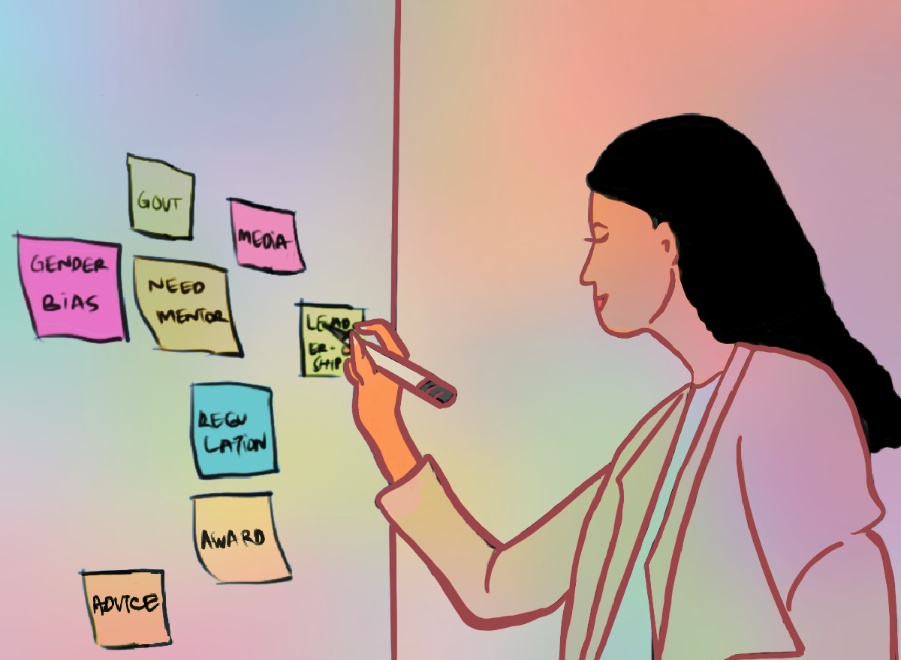

Slide 12
  ANALYSIS
CATEGORIES
Cluster related/similar codes
Have a propositional statement (an assertion about the phenomenon)
Helps establish relationships to form the narrative
THEMES (AND SUB-THEMES)
Patterned meaning across a dataset that captures something important or interesting about the data in relation to RQ, organised around a central concept

Slide 13
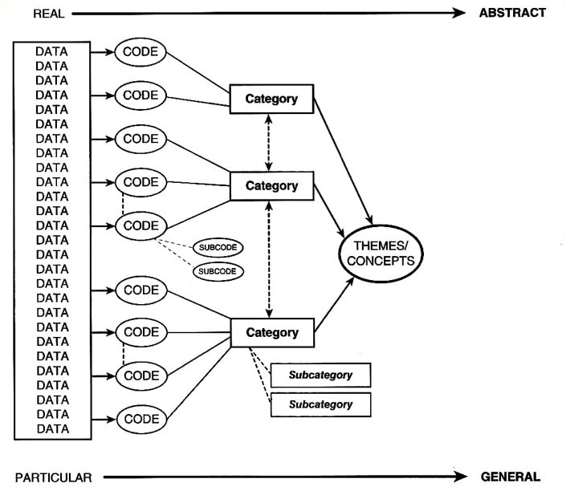

Slide 14
  ANALYSIS
sub-themes – captures and develops one notable specific aspect of a theme
  Questions to bare in mind
  Do the themes make sense?
  Does the data support them?
  Am I trying to fit to much into a theme?
  Do themes overlap?
  Are there themes within themes?
  Are their other themes in the data?
  NB to
  be flexible and iterative
    revisit your themes and subthemes as new insights emerge
  stay true to the data – let it guide you
  maintain reflexivity
  keep detailed records of your decisions

Slide 15
  GENERAL PROCESS OF QDA
CONSTRUCT POSSIBLE ANSWERS
TELL A COHESIVE STORY
Keep in mind your RESEARCH QUESTIONS
Data, codes, categories, subthemes, themes

Slide 16
Object Relations in Middle Childhood and Adolescence | Object Relations in Adulthood
Generalised interests | Overinvolved and hardworking
Entitlement and Grandiosity | Being detailed and particular
Smothering, control, and the lack of independence | Grandiose projects and dreams
Poor health and illness | Control
Interaction style | Manipulation and entitlement
Parents | Rebelliousness and vengeful tendencies
 | Lack of guilt
 | Atypical sexual behaviour
 | Reconstructing reality
 | Shifting importance in relationships
 | Distrust and paranoia
 | Black and white thinking
 | Health, obsessive compulsive behaviours, and agoraphobia
 | Jekyll-and-Hyde
 | Aggressive and reckless behaviour
Table: Object Relations Patterns in the Life of Hughes. This table illustrates the themes (patterns of object relations) evident in the life of Hughes.

Slide 17
DATA TRUSTWORTHINESS

Slide 18
  What is Data Trustworthiness
Concerns around bias and subjectivity
Principles to implement when engaging with data analysis, to enhance the trustworthiness of your data
It enhances the level of confidence you can place in your data
Credibility (internal validity)
Transferability (external validity)
Dependability (reliability)
Confirmability (construct validity)

Slide 19
  Credibility
The question here is whether the findings make sense, are believable and accurate (Miles & Huberman, 1994)
Do the findings answer the identified research questions (Amankwaa, 2016)
Is considered by Lincoln and Guba (1985) the most NB criterion (Connelly, 2016)
How do you ensure this?
  Consult relevant published data
  Prolonged engagement with emergent data (Amankwaa, 2016)
  Consider possible alternate explanations for events or behaviours (strive to avoid
  biased conclusions – Yin, 2009) Reflect on interpretations to reduce bias
  Triangulate data to verify (Amankwaa, 2016)

Slide 20
Appendix B: Extract of Triangulated Data Sources
Porter, 2010 Bartlett and Steele
Whetton, Wadsworth and Thain 2012 Higgam
Schumacher, 2008 Hack, 2007
Newman, 1993. Charles River Editors
Sheridan (2011)
Stopped carrying cash on him. Confirmed says he didn’t think about money confirmed no cash
For a while had bodyguards, and added extra security at home.
Rather than cutting on expenses, he sent Dietrich to Toolco to find out why it was doing so poorly
Started dating around
HH married Jean Peters inTonopah, Nevada on 12 January. – middle of the desert. He was interested in the silver mines there. He saw her as a beauty queen. She is described as outgoing, and “he was at a point in his life that he didn’t want to socialize any more than he absolutely had to” (we who knew HH, 37%),
Married under assumed names
Described as “forbidding landscape” and “unromantic” p. 693 married there to escape the media. Married in a civil ceremony.
Bench said that staff would go with HH on his plane trips, and that the pattern was that they lasted longer than initially planned
Back in Los Angeles, he slept with Jean 5 nights before saying he needed privacy. Got a separate bungalow for her at the hotel.

Slide 21
  Transferability
This is the ability to generalise findings to the general population.
This is often problematic in qualitative research as samples generally are not reflective of the broader population, or are too small to draw general conclusions from
So how do you ensure transferability?
  Rich descriptions for reader to understand findings in depth and assess relevance to their context
  Purposeful sampling – a diverse sample would enhance generalisability
  Some studies allow you to aim for analytic generalisation. Findings are generalised back to theory
  Reflexivity – being transparent about your perspective also allows the reader to assess relevance to their context

Slide 22
  Dependability
(reliability)
How consistent, stable and replicable are the findings (Amankwaa, 2016)
Refers to the reproduction of the process to achieve the same results (Yin, 2009)
To what degree is it possible to repeat?
How do you ensure this?
  adhere to consistent methods to minimise results from variations in the research process
  triangulation – comparing different sources of data that then confirm each other
  audit trail (detailed records), can show how decisions were made along the way
  member checking – so that participants can ensure that accuracy of interpretations as grounded in their perspective
  peer review – for feedback on research design and methods or enlisting someone to evaluate the quality of data collection and analysis (Amankwaa, 2016)

Slide 23
  Confirmability
(construct validity)
It assists to that researcher bias does not impact the research process
It ensures the degree to which findings are shaped by the participants rather than the researcher
How do you ensure this?
  Vigilant conceptualisation of studies constructs and variables
  Maintain an audit trail (detailed records), details steps taken in the study
= this allows for transparency
  Use data triangulation
  Practice reflexivity (Amankwaa, 2016) such as inclusion of extracts from a research diary
= this allows you to become aware of your own biases and assumptions, so that they can be bracketed away
  Peer debriefing – discussing with colleagues who provide feedback and challenge assumptions
  Member checking – return to participant to verify accuracy and relevant of interpretations made from data

Slide 24
Appendix A: Extracts from Diary
05.2013
This is the third week that I am seriously writing on my proposal. I have noticed a change in my attitude toward HH already. Before I thought he was arrogant and I was appalled by his audacity. Somewhere, I began to pity him. I found him almost pathetic. I wonder if things would have been different for him had he lived in currently times; with much focus on ethical awareness, I wonder if there would have been a greater impetus for others to step in and assist someone who was clearly mentally ill. The lack of responsibility towards him is something that strikes me, and I guess parallels society even today, where the vast majority of particularly western society seems focused on their own domain of influence, and less focus on involvement in others. Or perhaps that is merely my own projection.
It is interesting how my attitude to HH has changed so much already. This is something I will need to keep an eye on.

Slide 25
  Sources
(Amankwaa (2016)
Braun and Clarke (2006)
Connelly (2016)
Lincoln and Guba (1985)
Miles and Huberman (1994)
Van de Venter (2022) * slides drawn heavily from this source
Yin (2009)

