Slide 1
Timelines and budget: Planning your research from proposal to examination
Faculty of Health Sciences: Postgraduate Orientation Workshop
Tracey Hutton

Slide 2
Introduction – The Budget
Novice investigators may find creating a proposal budget intimidating.
A basic understanding of the budgeting process and a good working relationship with relevant institutional stakeholders can alleviate much of the stress.
Proper budgeting and expenditure is ultimately the responsibility of the investigator.
Notes:
The university business and sponsored programs offices can assist in identifying potentially problematic direct costs.

Slide 3
The Budget – Definition
A line item (tabular) description of the expenses associated with a research project.
Calculated by using your best estimates (not guesses).
Derived from the project description (methods section of the proposal).
Budget considerations should be kept in mind when preparing the methods section e.g. considering the cost, and sensitivity and specificity of a particular measure, when choosing a method to measure a variable.
Notes:
An investigator examining this variable may select from skin fold measurement, underwater weighing, or whole body DEXA scanning. The decision to use a particular method should be balanced between the specificity required to address the research question and the cost of the particular measurement method.

Slide 4
The Budget – Definition
Expenditure should be given in units (hours, kilometres, pages, each etc.)
For example, salaries can be calculated against full time equivalents (FTEs) or per hour according to qualifications.

Slide 5
The Budget
Cost estimates need to be as accurate as possible (rands and cents).
The realistic appraisal of costs will help you assess the feasibility of the planned research.
Spend time contacting relevant parties or service providers to obtain accurate figures.
Accuracy and detail is especially important if you plan to apply for funding, as funding agencies may require detailed narrative descriptions of each line item.
Furthermore, the more detail provided the more credible you budget will be.
Can serve as a great, convincing overview of the project.
Notes:
Cost estimates – look it up on the web or phone suppliers etc.

Slide 6
The Budget
“You need to show how spending that money will help you to answer your research question.”
Source: https://researchwhisperer.org/2014/10/07/simple-research-budget/

Slide 7
The Budget – Types of costs
Allocable costs are clearly associated with the particular project.
Reasonable costs would generally be accepted as necessary per a “prudent” person’s review. For example, the purchase of a laptop computer for field research by a graduate student researcher on the project would generally be accepted as reasonable, while the purchase of a laptop for non-project related coursework by a graduate student researcher would not.
Allowable costs are permitted by institutional and sponsor regulations.
Unallowable costs: some costs which are specifically prohibited from being charged to certain sponsored projects, such as alcoholic beverages, advertising or entertainment charges.

Slide 8
The Budget – Personnel
Consultants such as data capturers, statisticians, graphic designers, independent coders, translators etc. (hourly rate x projected hours required).
Research assistants/fieldworkers (hourly rate x projected hours)
For research assistants/fieldworkers - consult your supervisor/promoter or relevant stakeholder for guides on what research assistants/fieldworkers are generally paid in your context.
Furthermore consult your supervisor/promoter to determine the level of experience required.
Will transport and/or meals and beverages be provided to research assistants/fieldworkers? If so, factor this in the cost.
Research assistants/fieldworkers may require training – this should be reflected in the budget.

Slide 9
The Budget - Travel and accommodation
Travel should be planned in advance – to attend conferences or to travel to data collection sites.
How many trips?
Destination?
Visa requirements?
Length of stay?
When will you be travelling (peak seasons)?
Mode of travel – air tickets?
Car hire/petrol, accommodation and subsistence?

Slide 10
The Budget - Equipment
All equipment required to undertake the project.
Costs related to the office (laptop, printer, extra external hard drive for storage, filing cabinet etc.).
Costs related to research work (e.g. portable scales to weigh infants in their homes, voice recorders for interviews, tablets for surveys).
List each item by type, model number, and manufacturer.
Include equipment related costs if relevant (such as shipping, demonstration costs or insurance).
Some funders may not cover certain aspects of travel and equipment e.g. a laptop – adjust budget accordingly.

Slide 11
The Budget – Supplies and material
Consumables (reoccurring expenses) such as stationary.
Photocopying, printing, pencils, pens, paper, markers, clip boards, lever arch files, lab materials, data costs etc.
May be a ‘best guess’ however consumable items are often the lower priced items in the budget.
May also include software – include subscription or purchase fees.

Slide 12
The Budget – Other
Participant support costs (will snacks be provided during the focus group discussion?)
Venue costs.
Teaching Relief funding.
Publication costs.

Slide 13
The Budget – Other
In the proposal, mention how the project will be funded or funding streams that you will be targeting.
OR mention that you are planning to personally fund your project.
If you are planning to publish – mention the target journal and the specific publication costs if applicable.
Often journals will request language editing – reflected in the budget.

Slide 14
The Budget – Other
Will you be making use of a language editing before submitting the dissertation/thesis for examination?
Language translation costs – keep in mind the language of the target population. Information to the participants and data collection instruments may need to be translated into various languages.
Hidden costs – mobile data costs, administrative costs etc.

Slide 15
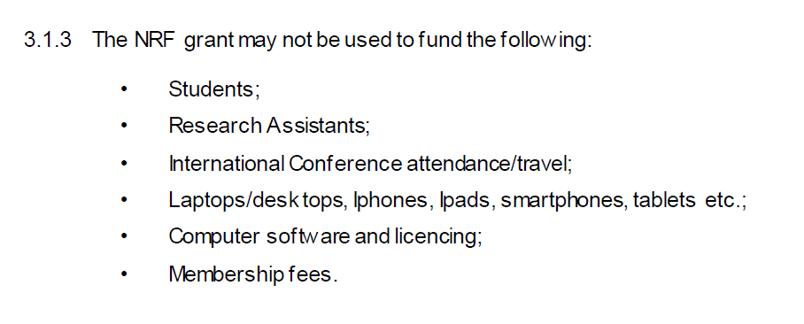
The Budget
Discuss funding strategies with your supervisor or promoter.
Often supervisors or promoters are aware of / have access to funding.
The timeline and budget must align - for example if the timeline states data collection will commence in year two, this must be reflected accurately in the budget.
Certain funds do not cover/fully cover certain aspects – this needs to be reflected and alternative funding needs to mentioned.

Slide 16
The Budget - Justification
The budget must align with the methods section of your proposal, for example if an independent coder is mentioned in the methods section this should be reflected in the budget.
The methods section provides in-depth information/clarification of the items listed in the budget.
The methods section also provides the justification of items in the budget that may not be immediately clear to the reviewers.
Information in the budget may have ethical ramifications, for example the ethics around reimbursing participants or potential conflict of interest due to funder.
Notes:
Use the same nomenclature everywhere. If you list a Thingatron X32C in your budget, then call it a Thingatron X32C in your budget justification and project plan. In an ideal world, someone should be able to flip from the project plan, to the budget and to the budget justification and back again and always know exactly where they are.

Slide 17
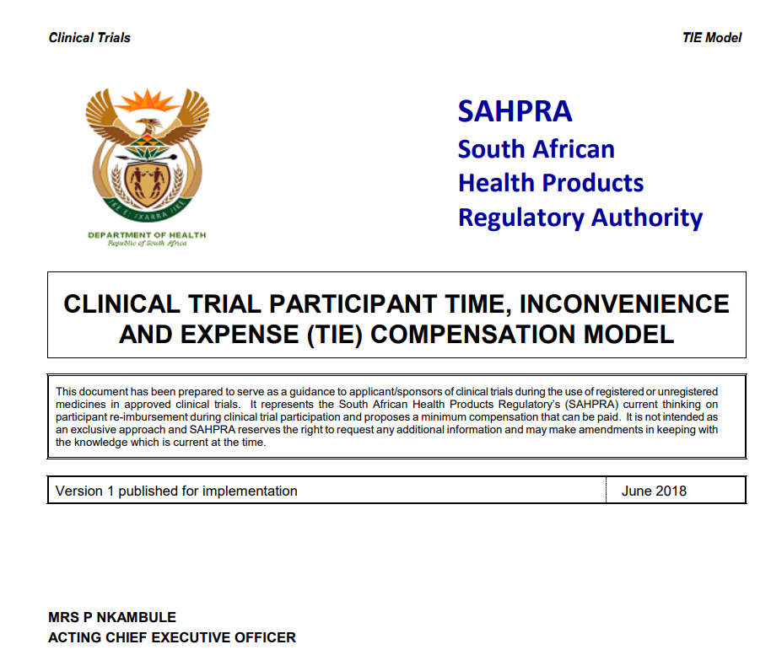
The Budget - Justification
Guides from governmental and other organizations which help guide/justify certain costs e.g.
Available: https://www.sahpra.org.za/wp-content/uploads/2020/02/7_Clinical-Trial-Participant-Time-Inconvenience-and-Expense_TIE_Compensation_Model_May18_v1-1.pdf

Slide 18
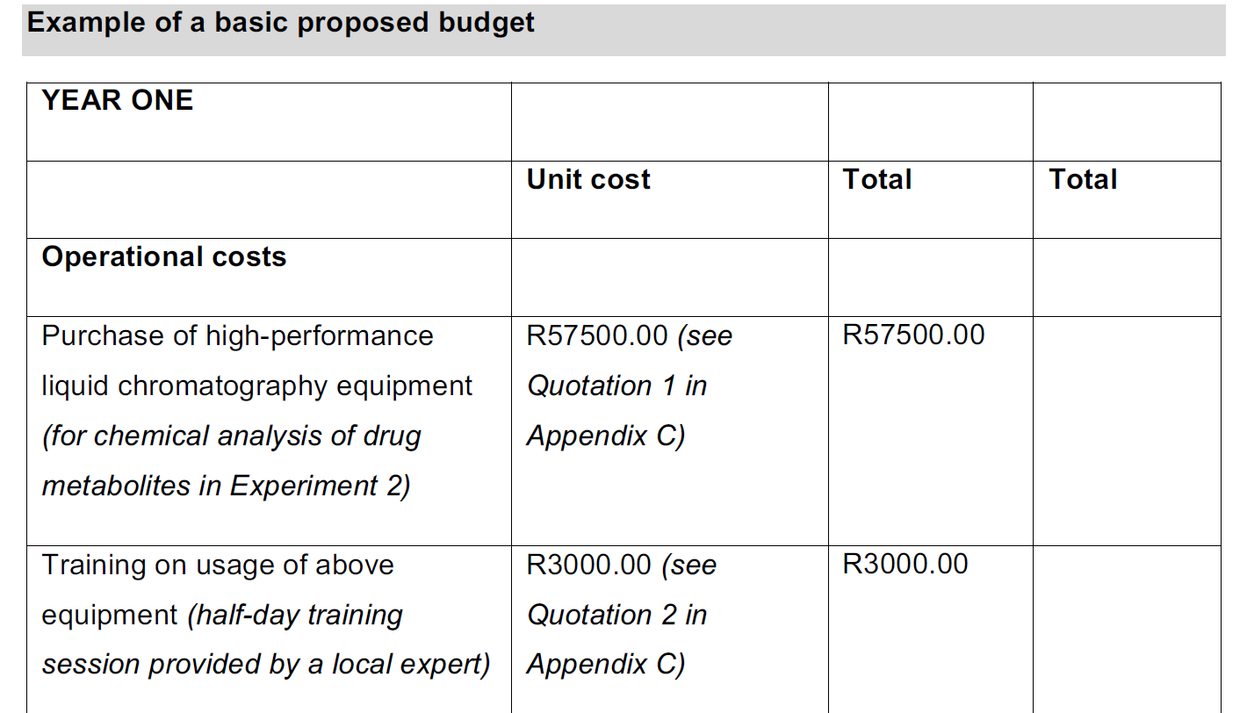
The Budget - Justification
Where appropriate you may provide short justifications in the budget (see below).
You may also refer to specific appendices which show the quotes obtained (see below).
(Cassim, 2021: 120)

Slide 19
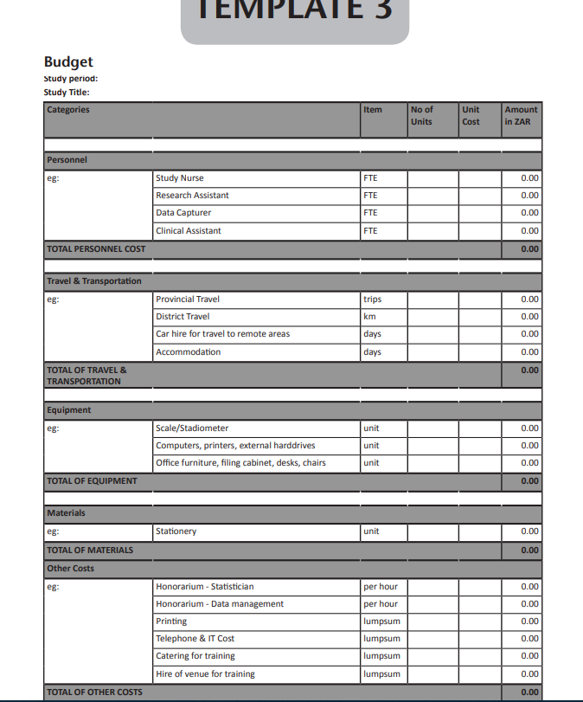
The Budget - Template
(Gie & Beyers, 2014: 110)

Slide 20
The Timeline
Key activities and millstones in your research project and target completion dates.
Appears in chronological order.
Provides a broad overview of the project at a glance.
Take the methodology and turn it into a step-by-step plan.
May be presented in a simple table format or as a Gantt chart.
May include start dates and/or start and end dates.

Slide 21
Timeline - Gantt chart
(Cassim, 2021: 114)

Slide 22
The Timeline – Important considerations
Allow sufficient time to familiarise yourself with the topic (review the literature broadly – especially at PhD level).
Time is needed for conceptualising your topic, developing the research questions etc.
Take note of dependencies e.g. situations where one task cannot begin until another task is complete.
Important to consider the timing and process associated with the ethics review procedure.

Slide 23
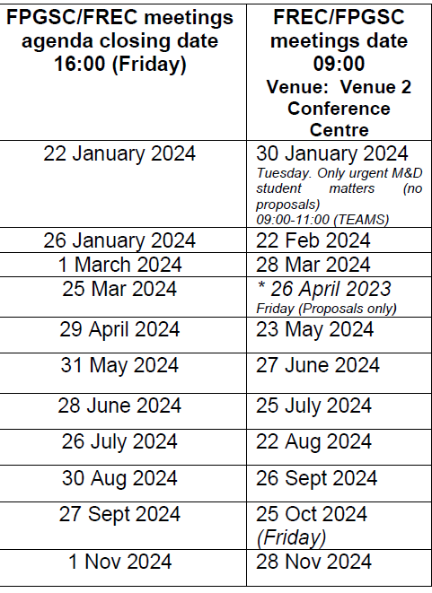
The Timeline – Important considerations
Know the set dates of the Department, Faculty and Institution.
Submission agenda closing dates for the Faculty Postgraduate Studies Committee (FPGSC) and Research Ethics Committee: Human (REC-H) meetings.
Intention to submit notifications and exam submission dates.
Deadline for addressing examiners’ feedback.

Slide 24
The Timeline – Important considerations
Factor in time to address reviewer comments – Departmental Research Committee, FPGSC and Rec-H.
Back and forth communication between you and the allocated liaison person.
Also factor in that the committees may request re-submission of the proposal.
Often gaining permission to conduct research from the relevant organisations (such as the Department of Health) takes time.

Slide 25
An example of a one year project
Activity | Timeframe
Review the literature and consider your research idea. | January
Develop your research question. Consult with a biostatistician. Write your research proposal. Develop your data collection tools. | February
Submit your research proposal to FPGSC. | March
Respond to FPGSC reviewer comments and submit to Rec-H committee (if applicable). | April
Respond to Rec-H reviewer comments (if applicable) and gain ethics approval. | May
Gain permission to collect data. | June
Data collection | July - August
Intention to submit documentation for assessment (examination) (April graduation) | August
Data analysis | September
First draft of dissertation. Respond to supervisor’s comments. | October
Complete writing of dissertation. | November
Submit dissertation for examination | December
Respond to examiner comments | January
Submit final copies of dissertation for possible graduation in April. | February/March
Adapted from Gie and Beyers (2014)

Slide 26
Key takeaways
We may be tempted to view the budget and timeline as ‘afterthoughts’ to the proposal, however they are important.
Budget:
Check and re-check your calculations (reviewers will flag inconsistencies).
It is important that you justify your budget well.
Try to be as accurate as possible when formulating your budget (get quotations or estimations from service providers and refer to relevant guides).
A well-justified budget can enhance the evaluation of the research proposal by reviewers and funding agencies.

Slide 27
Key takeaways
Timeline:
Check the timeline against your budget.
With regards to ethical approval be aware that there are often delays in the process – account for this in your timeline.
Be guided by your supervisor/promoter as they are familiar with institutional policies and timeframes.
Be realistic and make sure the timeframe fits in with your current situation.
While you are ‘waiting’ for approval, make use of the time in other ways (start on the literature review chapter or draft a journal manuscript based on your proposal).

Slide 28
References
Cassim, L. 2021. Postgraduate toolkit [e-book]. 4th ed. Johannesburg: Layla Cassim ERS Consultants CC.
Gie, R. & Beyers, N. 2014. Getting started in clinical research: Guidance for junior researchers. Cape Town: Department of Paediatrics and Child Health, Faculty of Medicine and Health Sciences, Stellenbosch University. [Online]. Available: http://www.sun.ac.za/english/faculty/healthsciences/paediatrics-and-child-health/Documents/TA28112_Research%20Booklet_04_15%20Okt%202014_WEBweergawe.pdf [16 July 2022].
Higdon, J. & Topp, R. 2004. How to Develop a Budget for a Research Proposal. Western Journal of Nursing Research, 26(8): 922-929. DOI: https://doi.org/10.1177/0193945904269291

Slide 29
References
Obelleiro, K. 2019. Preparing a Proposal Budget Toolkit. [Online]. Available: https://research.ucdavis.edu/wp-content/uploads/Preparing-a-Proposal-Budget-Toolkit.pdf
Patil, S.G., 2019. How to plan and write a budget for research grant proposal? Journal of Ayurveda and Integrative Medicine, 10(2): 139-142. [Online]. Available: https://doi.org/10.1016/j.jaim.2017.08.005 [16 July 2022].
South African National Department of Health & South African Health Products Regulatory Authority. 2018. Clinical Trial Participant Time, Inconvenience and Expense (TIE) Compensation Model. Pretoria: Department of Health. [Online]. Available: https://www.sahpra.org.za/wp-content/uploads/2020/02/7_Clinical-Trial-Participant-Time-Inconvenience-and-Expense_TIE_Compensation_Model_May18_v1-1.pdf [5 September 2021].

