Slide 1
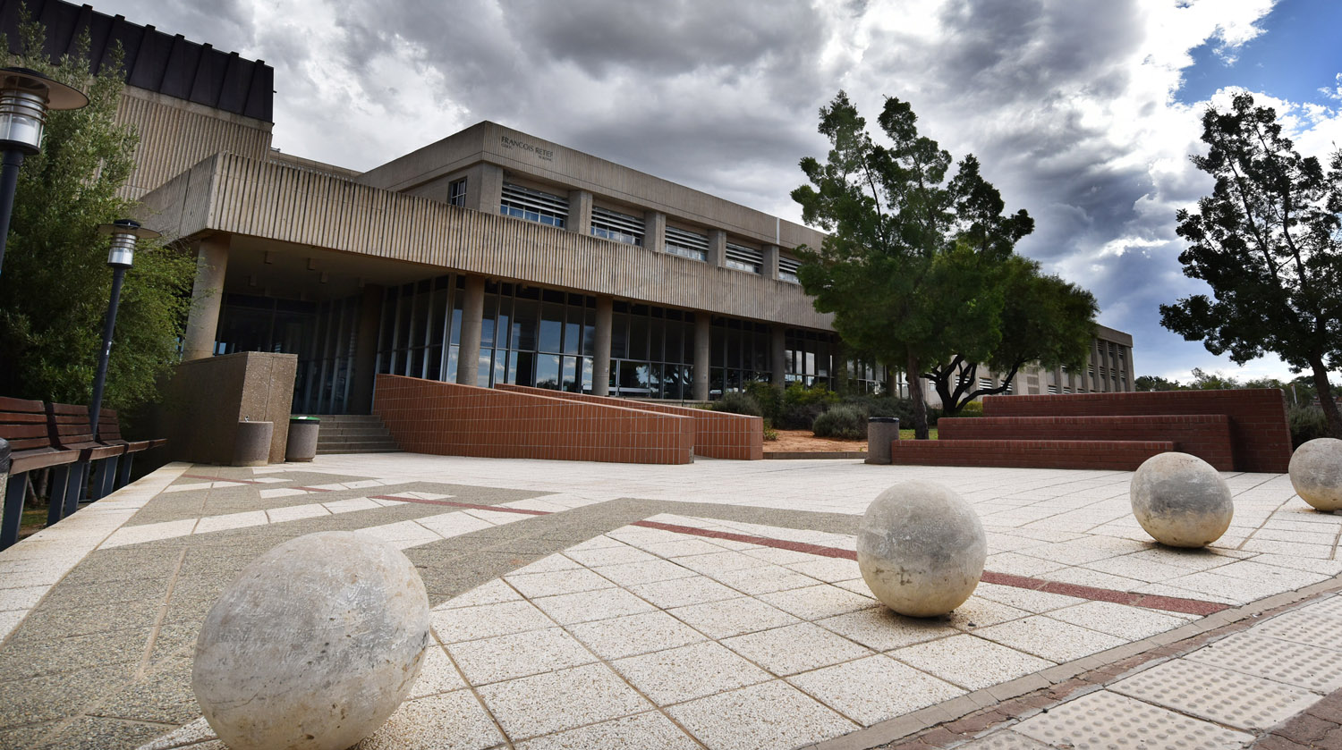
Reviews
T: +27 51 401 9111 | E: info@ufs.ac.za | www.ufs.ac.za
Prof C Nyoni

Slide 2
Purpose of this session
General understanding of the framework of conducting reviews
Describe the framework of reviews relative to systematic reviews
Discuss when to engage in a systematic review
Share available resources for conducting good reviews

Slide 3
What do we know about reviews
What do you know about reviews?
Lets talk
Notes:
Highlight that the focus is on engaging with the literature and finding out about a specific subject.
There are various approaches to do this depending on purpose and they are currently 48 different types of conducting a review

Slide 4
General framework for a review
Identifying the research question
Developing and aligning an inclusion criteria
Searching the evidence
Selecting the evidence
Evaluating the quality of the evidence
Extracting the evidence
Analysis of the evidence
Presentation
Peters et al. 2024

Slide 5
Identifying the research question
You first need to have a justification of why you want to do a review
Clear review question needs to be in place
The review question including the structure of that question can be linked with the type of literature review you can use

Slide 6
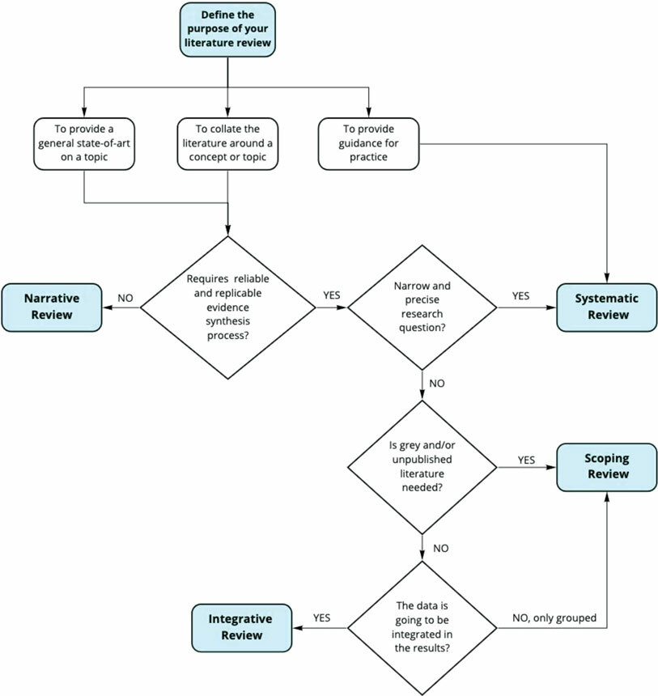
Guidelines for the review question
The JBI online has some flow chats that will support you in deciding on the appropriate review for your study
The formulation of the review question then takes various forms supported by acronyms

Slide 7
Guidelines for the review question
PCC- Population Concept and Context
PICO – Population Intervention Comparison and Outcomes
PICOT (S)- Timeframe (setting)
SPIDER- Sample Phenomena of Interest Design, Evaluation Research Type
Etc
Notes:
Population Concept and Context
Population Intervention Comparison Outcome
Population Interven

Slide 8
Inclusion criteria
Purpose is to influence your decisions regarding which articles come in and out
Type of papers
Research methods
PICO elements
Context
Timelines as well

Slide 9
Searching the literature
Search string
Data bases or Sources
Inclusion and exclusion criteria
Notes:
Priliminary search string

Slide 10
A search string
(graduate* n2 and (undergraduate* or baccalaur* or bachelor*) or (health or nurs* or medic* or “physiotherap* or "physical therap*" or "occupational therap*" or biokinetic* or dietician* or dietetic* or nutrition* or pharmac* or optometr* or paramedic* or radiograph* or “speech patholog*” or “veterinar^{*” or} “clinical associate*” or “health science*” or “health* profession*” or “health* occupation*” or “physician* assistant*”)
(characteristic* or attribute* or aptitude* or attitude*)) or “core competen*” or “exit level outcome*” or “core professional skill*” or “non-technical competen*” or “non-cognitive competen*”)
(teach* or educat* or facilitat* or instruct* or assess* or evaluat* or demonstrat* or coach* or mentor* or examin* or grade or grading or test or testing or measur* or train*)

Slide 11
Data bases
Dependent on the university access
Different databases have different functions
Need to be carful in selection

Slide 12
Selecting evidence
Pre liminary
Get your criteria clear with your team
Resolution process
Step 1
Abstracts and Titles
Screen against criteria and review question.. Blindly
Step 3
Access full text articles
Discuss
Then discuss the choices
Repeat step one

Slide 13
PRISMA flow diagram

Slide 14
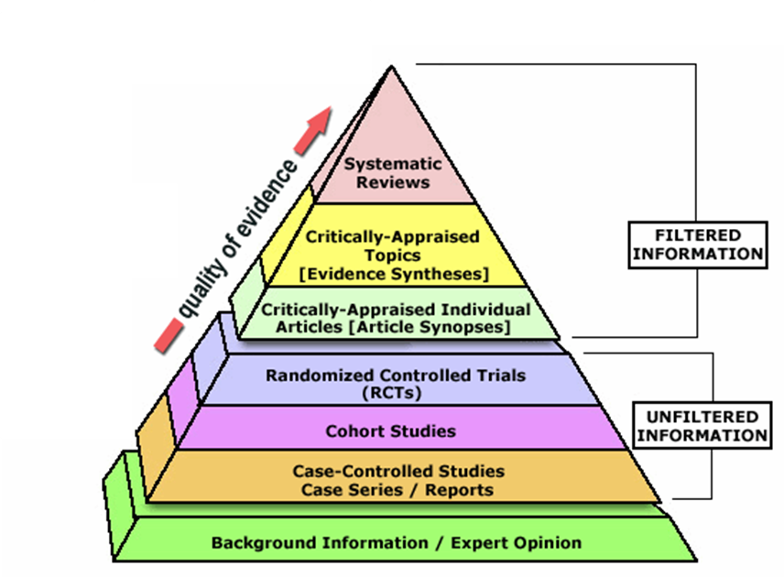
Evaluating the evidence
Critical appraisal tools for specific designs
Classify the quality of the articles
Reporting – JBI tools, CASP checklists, MMART for mixed methods

Slide 15
Extracting the data
Author(s)
Year of publication
Origin/country of origin (where the source was published or conducted)
Aims/purpose
Population and sample size within the source of evidence (if applicable)
Methodology / methods
Intervention type, comparator and details of these (e.g. duration of the intervention) (if
applicable).
Duration of the intervention (if applicable)
Outcomes and details of these (e.g. how measured) (if applicable)
Key findings that relate to the review question/s.
Specific elements that needs to be taken out of the article that are related to the research question

Slide 16
Analysis of evidence
- The research question is primary
- Dependent on purpose and type of research
- Quantitative research- data
- Qualitative analysis

Slide 17
Presentation
Characteristics which can be based on frequencies
Themes in some studies
Cumulative effect

Slide 18
Systematic review process

Slide 19
Why do a systematic review?
To engage the literature and determine the effectiveness of an intervention on a population group on specific outcomes

Slide 20
Systematic Review
Elements of the Framework | In the SR
The review question | PICO
Eligibility Criteria | Formulation is similar
Searching the evidence | Search string, databases,
Evaluating the studies | This may be used to eliminate studies – poor studies
Extracting data | PICO
Data analysis | Statistical synthesis and narrative synthesis
Notes:
What is the effectiveness of paracetamol compared to aspirin on pain management in burn children?
Inclusion that you may focus only on RCT, or quantitative studies etc you may consider the hierarchy of evidence to make the decision {statistical would require high level of methodological homogeneity –which may need input from a statistician… effect sizs, dicohomous data, continuous data
Narrative summary is the overall outcome which is often descriptive and comparing outcomes

Slide 21
Resources to think about
Registering your review (osf; figshare etc)
Ethics clearance
Librarian or information specialist
Access to various data bases
A statistician
Rayaan.ai
Google form

Slide 22
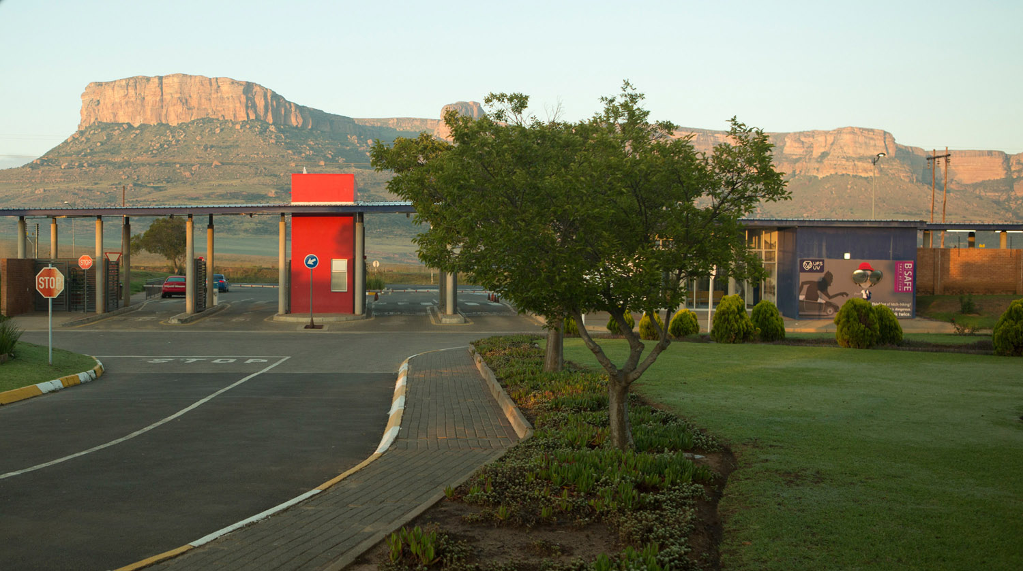
Thank you nyonic@ufs.ac.za
T: +27 51 401 9111 | E: info@ufs.ac.za | www.ufs.ac.za

