Slide 1
Writing up the Literature Review (Background) and Problem Statement

Slide 2
Literature Review (Background) of a Proposal
A literature review or background:
Is a key section of any proposal
It helps provide a background to the problem that is being researched
It is a comprehensive summary of previous research on the topic under investigation.
It surveys scholarly articles, books, and other sources relevant to a particular area of research.
It enumerates, describes, summarizes, objectively evaluates and clarifies this previous research.
Should give a theoretical base for the research and help determine the nature of the research.
Drawn from Bloomsburg University, 2020

Slide 3
Literature Review (Background) of a Proposal
The literature review acknowledges the work of previous researchers, and in so doing, assures the reader that the researcher’s work has been well conceived.
It is assumed that by mentioning a previous work in the field of study, that the researcher has read, evaluated, and assimilated that work into their proposal.
Drawn from Bloomsburg University, 2020

Slide 4
Literature Review (Background) of a Proposal
A literature review creates a "landscape" for the reader, giving them a fuller understanding of the developments in the field.
This landscape informs the reader that the researcher has indeed assimilated all (or the vast majority of) previous, significant works in the field into their research.
Drawn from Bloomsburg University, 2020

Slide 5
Finding sources for the background
What am I searching for?
You may be looking for statistics (globally/locally)
You may be looking for literature for context/background information
You may be looking for trends or patterns
You may be looking for theories

Slide 6
Finding sources for the background (con)
You may looking for statistical methods
You may be looking for examples of the research approach you are using
You may be looking for data gathering techniques
You may be looking for questions for your questionnaire

Slide 7
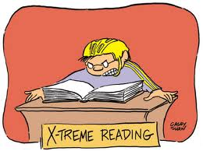
Critical Reading
It is also important to adopt a questioning and analytical approach towards the material.
To read critically and analytically, try answer the following questions:
What’s the author’s central argument or main point, i.e. what does the author want you, the reader, to accept?
What conclusions does the author reach?

Slide 8
Critical Reading (con)
What evidence does the author put forward in support of his or her arguments and conclusions?
Do you think the evidence is strong enough to support the arguments and conclusions, i.e. is the evidence relevant and wide reaching enough?
Can these assumptions be challenged?
What is the context in which the text is written?
Does the cultural and historical context have an effect on the author’s assumptions, the content and the way it has been presented?

Slide 9
Mind mapping / spider diagram
Sometimes it is helpful to create a mind map to arrange one’s ideas regarding the overall topic
The exercise of mind mapping relies on the researcher’s existing knowledge – both theoretical and experiential

Slide 10
Mind mapping / spider diagram

Slide 11
Mind mapping / spider diagram

Slide 12
Mind mapping / spider diagram
One can then take these main points and arrange them in a linear format
The headings then help you to arrange your ideas in a logical fashion

Slide 13
Mind mapping / spider diagram

Slide 14
Mind mapping / spider diagram
When you start writing, each heading can then be populated with your ideas
Try writing without literature to start off with
Thereafter search for literature to support your ideas.
But keep in mind the process is cyclical and so you will keep going over what you have written and refining it.
As you read you will adjust your ideas, add to your ideas or even remove your ideas.

Slide 15
Simple Checklist for Background Section of my Proposal
Are most of my sources academic journal articles?
Are most of my articles/books less than 5 years old?
Does paragraph one introduce the reader to the topic?
Does paragraph two explain what the topic is about? It is sometimes important to describe the main concept e.g. birth before arrival (BBA); multi-drug resistance
Does paragraph three place the study in a global context? (extent of the problem)
Does paragraph four place the study in a national/local context? (extent of the problem)
Does paragraph five explain the cause of the problem?
Does paragraph six explain the effect of the problem?
Does each paragraph have a topic sentence?
Does one paragraph flow to the next?
Does each paragraph have at least two references?
Have I used an argumentative style?
Does my background convince the reader that this is a study worth doing?
Does my background indicate that there are gaps in the literature?
Does my background demonstrate that I know my topic well?
I have read extensively around the topic?

Slide 16
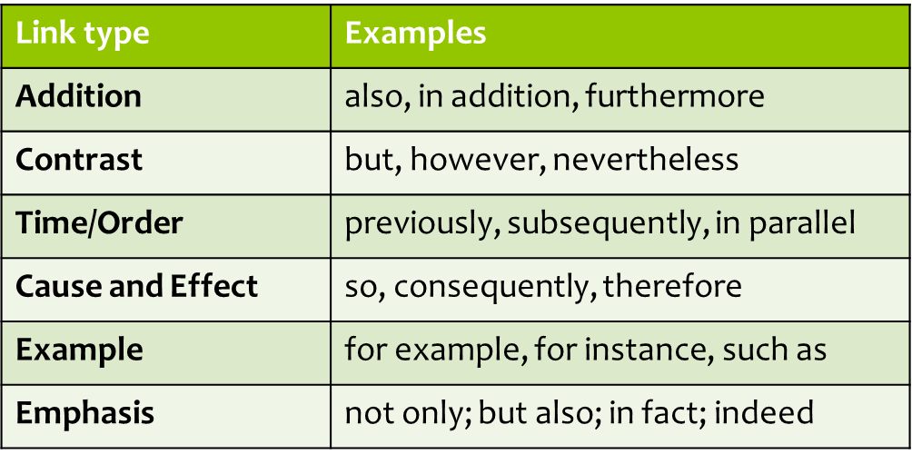
Useful Linking Words
Some useful linking words to help your writing to flow and to demonstrate your understanding of your writing.

Slide 17
Problem Statement
A research problem is a definite or clear expression or statement about an:
area of concern,
a condition to be improved upon,
a difficulty to be eliminated, or
a troubling question that exists in scholarly literature, in theory, or within existing practice

Slide 18
Problem Statement
This problem points to a need for a meaningful understanding and deliberate investigation.
A research problem does not state how to do something, offer a vague or broad proposition, or present a value question
A problem statement helps a researcher to avoid researching something simply because it is interesting

Slide 19
Problem Statement
A well-chosen problem should satisfy as many as possible of the following criteria:
1. Be timely;
2. Relate to a practical problem;
3. Relate to a wide population;
4. Relate to an influential or critical population;
5. Fill a research gap;

Slide 20
Problem Statement
6. Permit generalization to broader principles of social interaction or general theory;
7. Sharpen the definition of an important concept or relationship;
8. Create or improve an instrument for observing and analysing data;
9. Provide possibilities for a fruitful exploration with known techniques
10. Have implications for a wide range of practical problems (relevance)

Slide 21
Writing the Problem Statement
A problem statement looks to answer the “W” questions:
What is the problem about that you wish to investigate?
Who is involved with the problem?
Where is the problem taking place?
When did the problem take place?
Why are you interested in researching this problem? (to position the researcher in relation to the problem)

Slide 22
Problem Statement Example
Consider the following scenario as a potential problem that a researcher might wish to address through a formal research project.
Joubert & Ehrlich (2007, p. 56)
The following slide converts the above diagram into a problem statement of two paragraphs. The first presenting the ideal situation and the second presenting the problem that the researcher wishes to investigate.

Slide 23
Problem Statement Example
Caring for children in under resourced areas is often a major challenge for mothers. Ideally children should have access to fresh potable drinking water. They should have access to basic sanitation and live in communities where waste is carefully managed. In addition, they should have access to nutritional food sources with zinc and Vitamin A that will ensure they develop optimally, and mothers should ideally breast feed their children. Conditions such as diarrhoea could be avoided if the above factors are in place.
However, the researcher, who is a professional nurse working at a primary health care clinic [name of area] in a deep rural district in the Eastern Cape has observed high numbers of children being brought to the clinic with diarrhoea. According the District Health Barometer, in 2020, diarrhoea was the fourth leading cause of death in [name of district]. The clinic statistics also reveals that diarrhoea incidence for young children to be 2.2 episodes per year. The researcher has also discussed the problem with fellow nurses at the clinic and they expressed frustration that children are often brought to the clinic very late requiring them to be referred to the district hospital. This led the researcher to ask the following research question:

Slide 24
All the best with your literature review!
david.morton@mandela.ac.za

Slide 25
References
Bless, C., Higson-Smith, C. & Kagee, A. 2006. Fundamentals of Social Research Methods: An African Perspective. Cape Town: Juta.
Bloomsburg University. 2020. Literature Review. https://guides.library.bloomu.edu/litreview
Joubert, G. & Ehrlich, R. (eds.). (2007). Epidemiology. A research manual for South Africa. 2nd Edition. Cape Town: Oxford University Press.
Ridley, D. 2008. The literature review. A step-by-step guide for students. London: Sage Publications.
University of Southern California. https://libraries.usc.edu/

