Slide 1
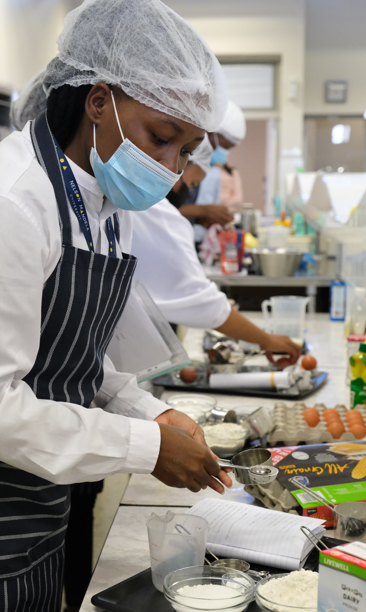
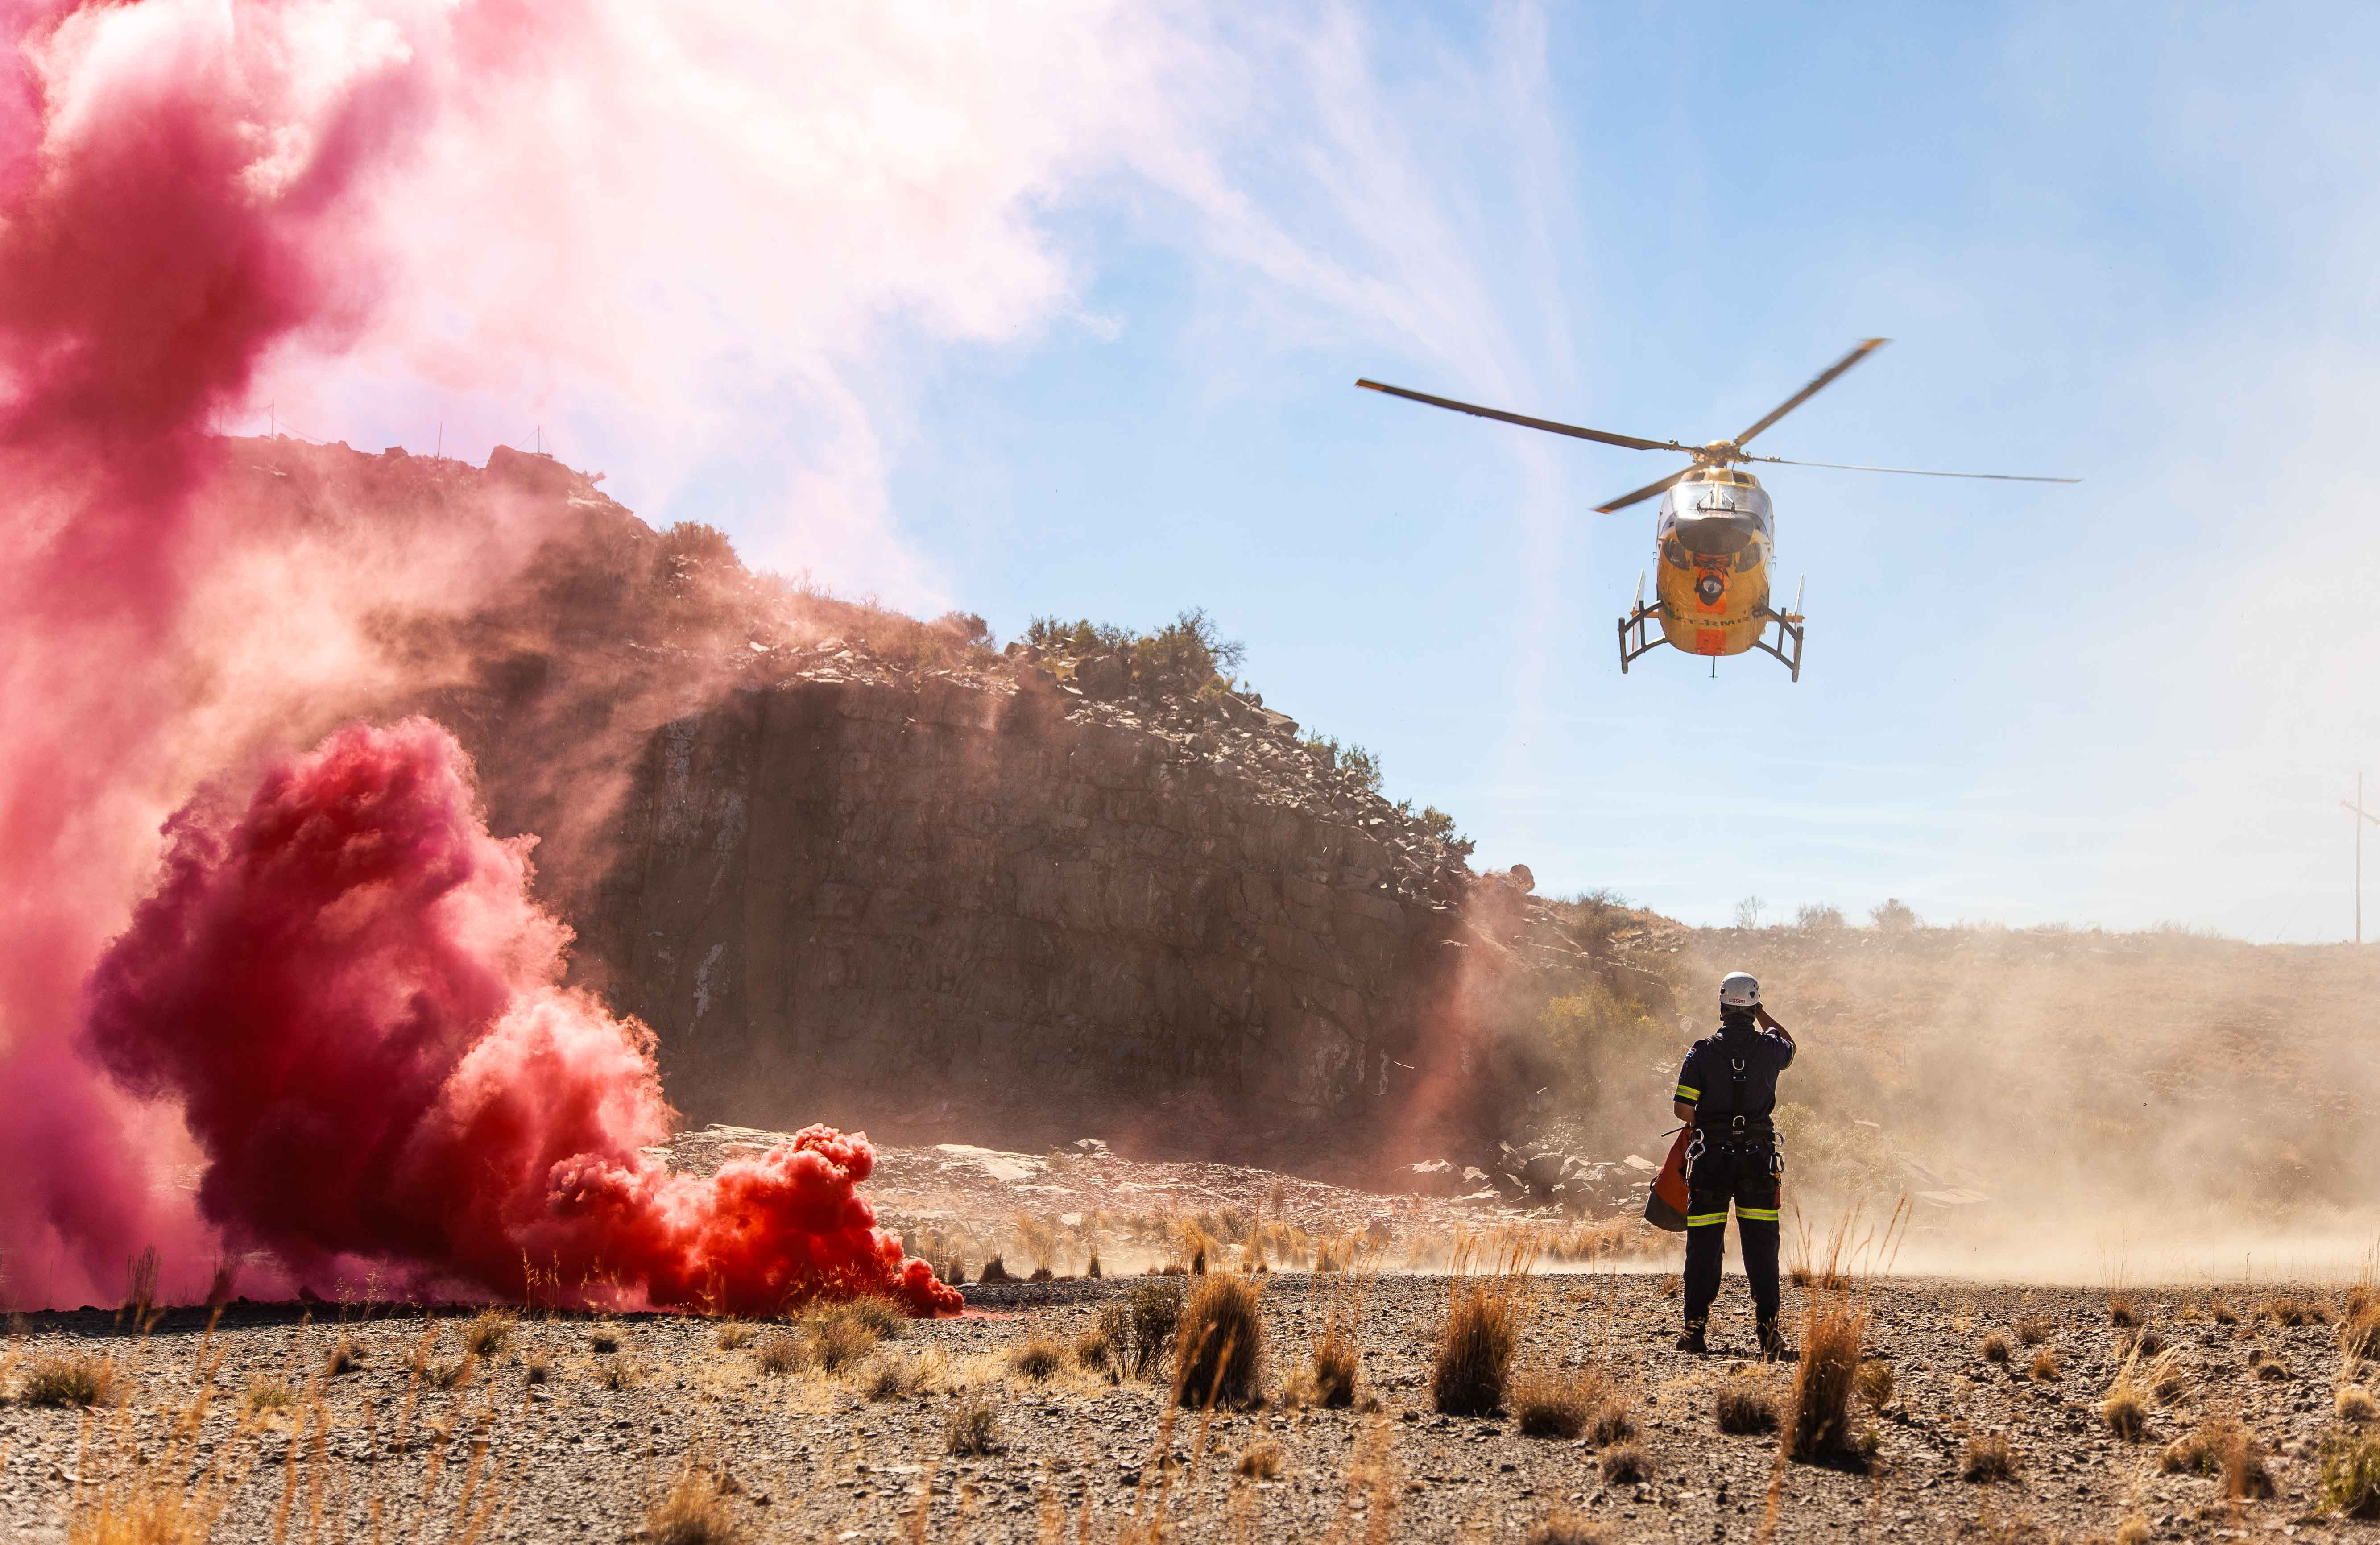
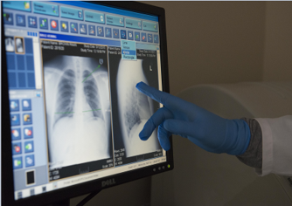
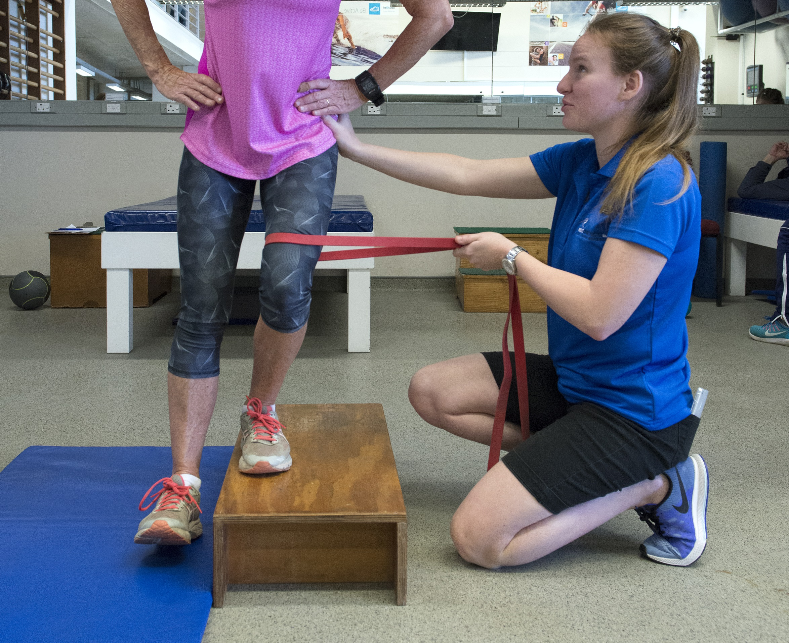
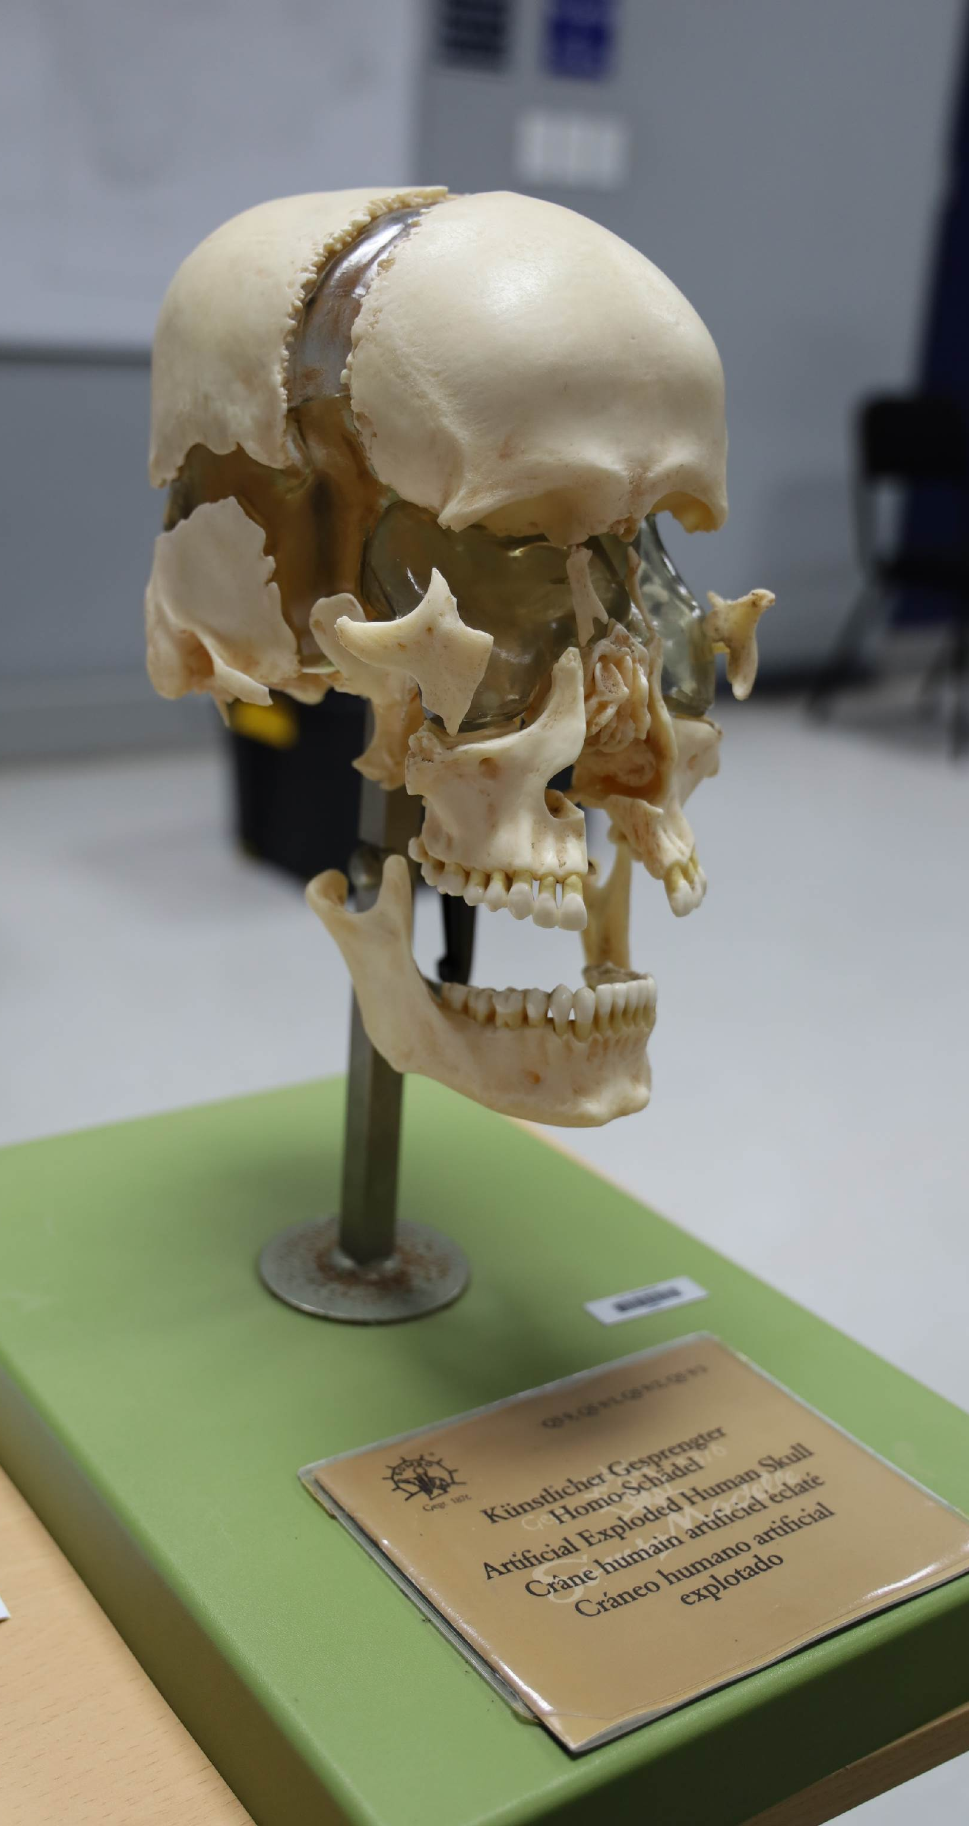
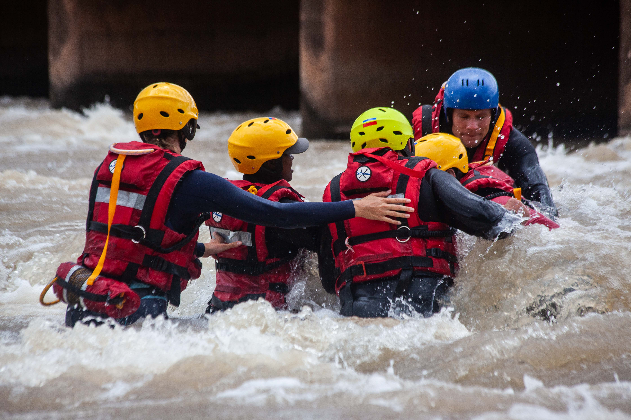
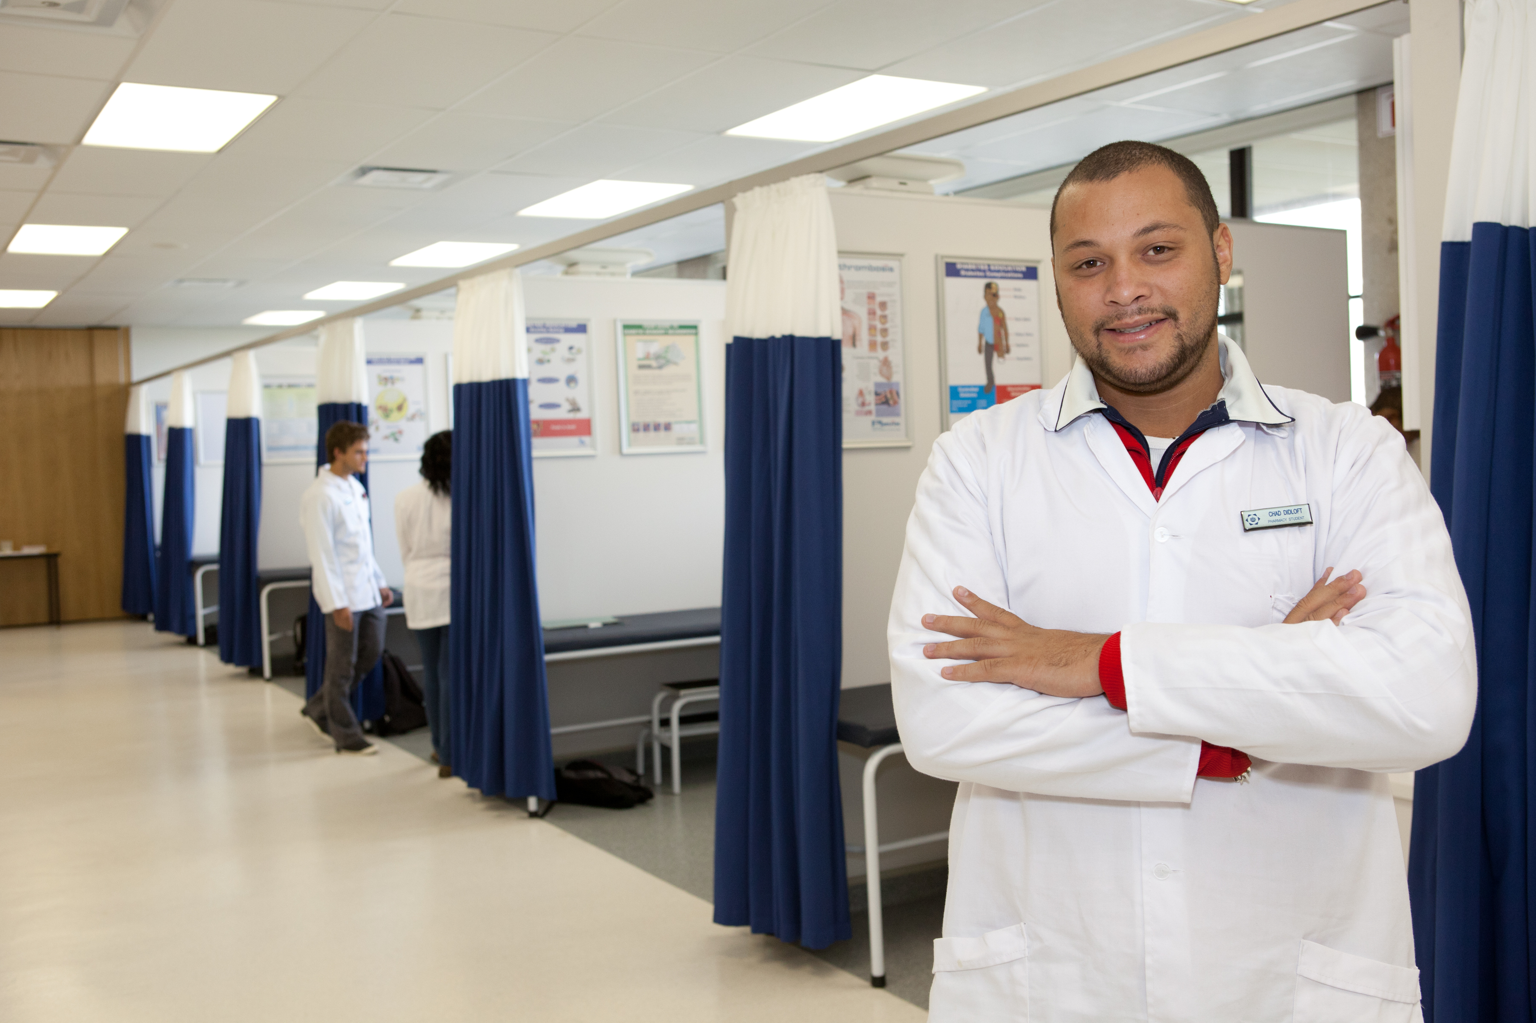
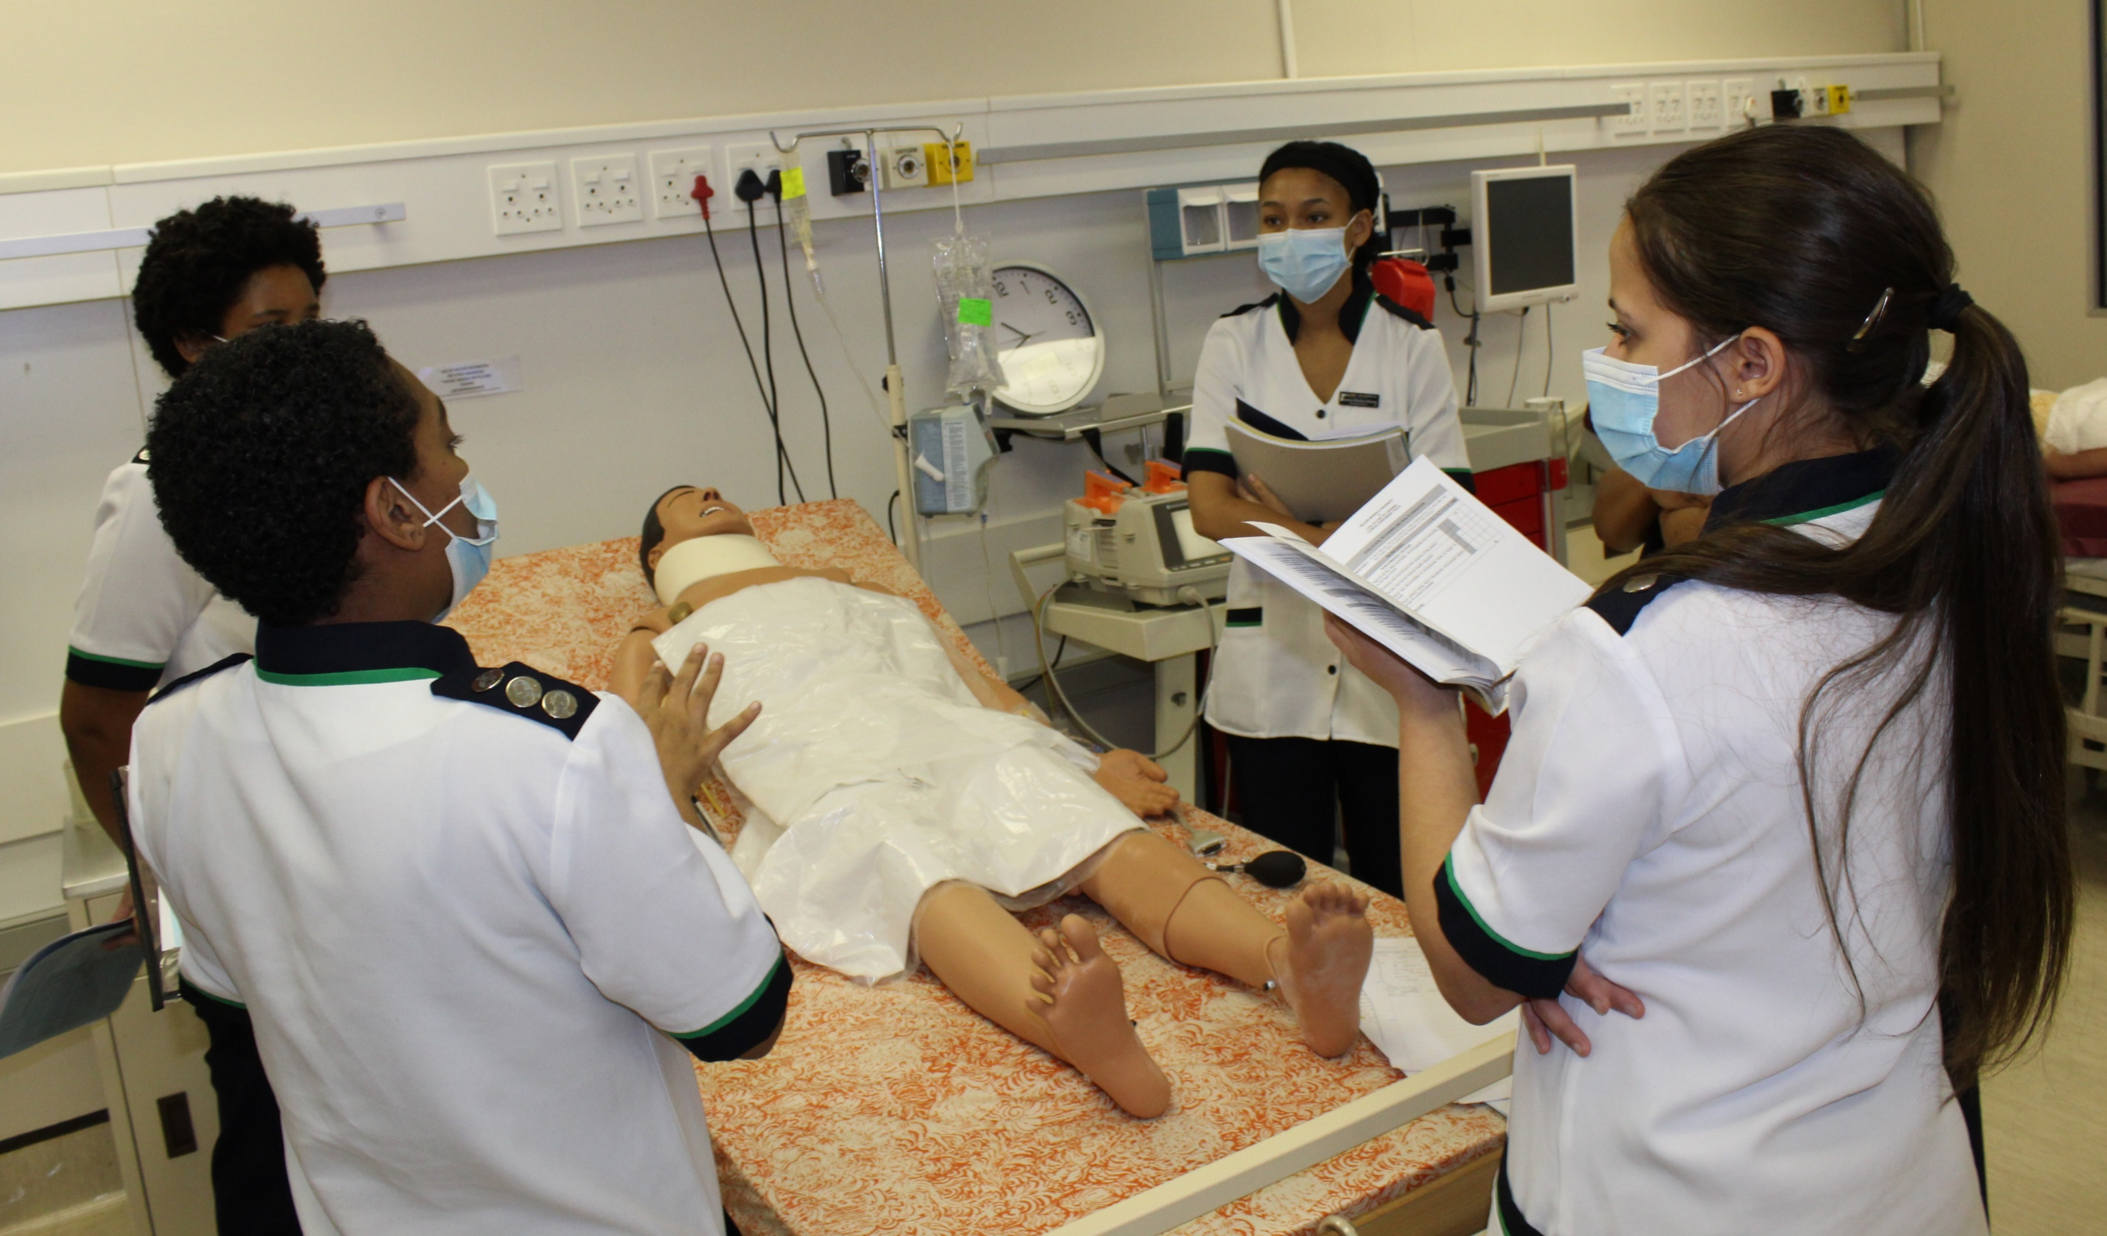
FACULTY OF HEALTH SCIENCES
HEALTH SCIENCE RESEARCH DIRECTORATE

Slide 2
Did you know?
We have a faculty based Biostatistician
Faculty of health sciences is the only faculty in the university that has a Director of Research
Dr Wilbert Sibanda (PhD Statistics and Operational research)
E-mail: Wilbert.sibanda@mandela.ac.za
provides Statistical Services for Researchers, assisting with designs, data collection, understanding of data, competently conducting statistical analysis and sound interpretation of results.
We have staff for Research support, engagement and management
Director of Research: Prof Joanne Naidoo
manages all Research processes within the Faculty
Associate lecturer: Ms Thembeka Sdinane
Thembeka.Sdinane@mandela.ac.za
coordinate and administer Research support, management and engagement activities
Assistant to the DoR

Slide 3
Faculty Admin Staff
Faculty Admin Manager
Administrative assistant
Faculty Admin Manager: Mrs Marilyn Afrikaner
Marilyn.Afrikaner@mandela.ac.za
All Masters and PhD Academic Matters
From Application processes to Graduation
Ms Birthlin Mouton
Birthlin.Mouton@mandela.ac.za
Provide administrative assistance to the Research Directorate
Manages PG Support teams platform

Slide 4
Additional support
Interprofessional Health Research
Library Support
IPHR Project Manager: Dr Wilma ten Ham-Baloyi
Wilma.tenham-Baloyi@mandela.ac.za
Systematic review expert
Workshop Planning
Faculty Librarian: Ms Nobuzwe Bavuma
Nobuzwe.Bavuma@mandela.ac.za
Offer library support to all HS student and staff

Slide 5
Getting your Proposal Approved
Once your proposal has been reviewed and approved by your department, it may be submitted to FPGSC
Submission to FPGSC
Documents required:
Proposal
Proposal Evaluation Form/ Department Feedback
RECH form signed by PI, PRP and HOD
By when should you submit?
FPGSC agenda closing date. Email Ms Thembeka.Sdinane@mandela.ac.za if you unsure of dates

Slide 6
FPGSC Review Process
Three months to work on the feedback, after which proposal has to be resubmitted
Feedback is provided to students within two weeks after the meeting
FPGSC Resolutions
Accepted with revisions: medium to high risk studies
PI to make revisions and submit documents to Liaison person for final approval
Liaison person approves changes, the proposal is referred to RECH. Secretariat makes the submission by the RECH agenda closing date
Accepted with revisions: Low risk studies
PI to make revisions and submit documents to Liaison person for final approval
Liaison person approves changes, secretary issue ethics letter
Resubmission:
PI to make revisions and resubmit proposal to Ms Sdinane by FPGSC agenda closing date

