Slide 1
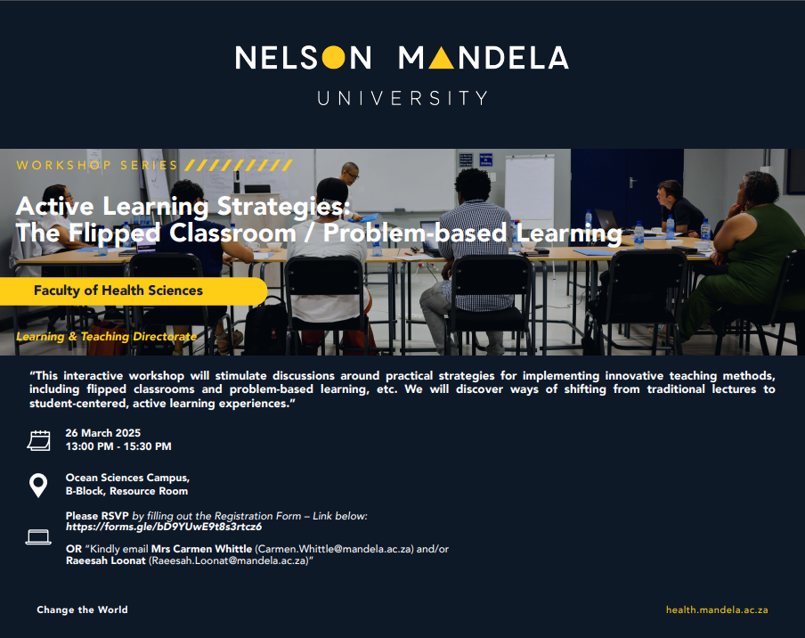
Welcome

Slide 2
Part 1:
Active Learning

Slide 3


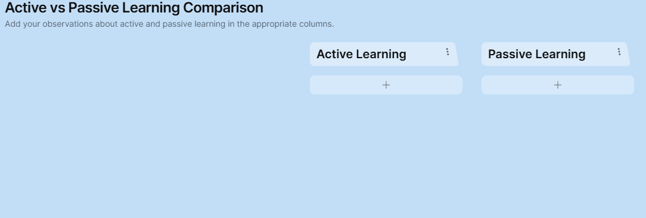
https://tinyurl.com/LearningActive
Notes:
https://padlet.com/raeesk/active-vs-passive-learning-comparison-dx5hzueptorqvret

Slide 4


Slide 5


Answer The Question
(Short Answer)
What Is Learning?

Slide 6


Log In
857 374 08
https://www.umu.com/ssu_40bf0365
Notes:
Thoughts About Learning?
What is Learning?
How does Learning Occur?

Slide 7


Slide 8
LT Theme: Quality Standards
5.
The importance of quality standards for LT and curricula design, especially for online LT.
(p2)
5.
Quality standards and enhancement will run through all our LT work, because, as a complex living system we subscribe to continuous reflection, improvement, and development.
(p4)

Slide 9
Problem Based Learning
Problem Posing
Simulations
Case Studies
Socratic Seminar
Practical Learning (WIL)

Slide 10
Part 2:
Flipping the Classroom

Slide 11






Resources
Watch The Video: Let’s Use Video to reinvent Education
Required Reading: The use of flipped classrooms in higher education: A scoping review
Web Resource: Universal Design for Learning (UDL) Guidelines
Quiz: https://tinyurl.com/ActiveLearningWorkshop
Practical: You are requested to bring along 1 (or more) ‘Traditional’ lessons / lectures that you would like to incorporate ‘Active Learning Strategies / Problem Based Learning’ using a flipped classroom approach.

Slide 12
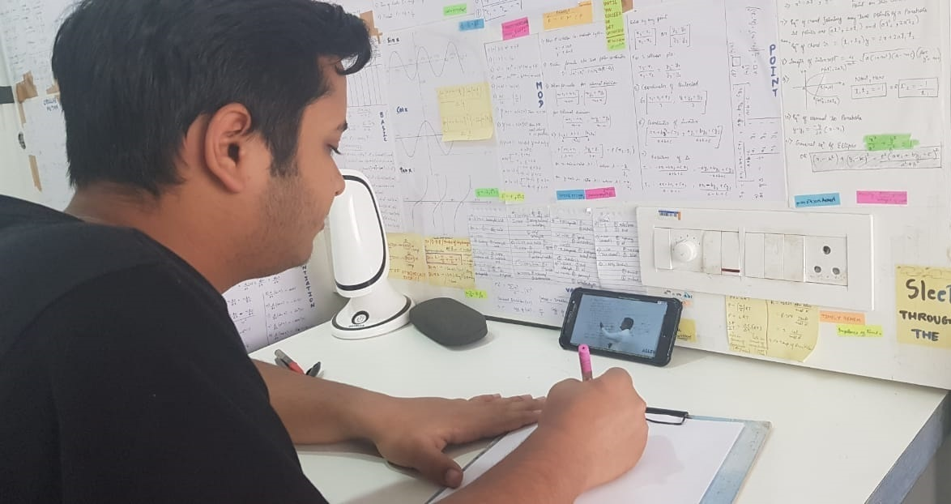

Slide 13
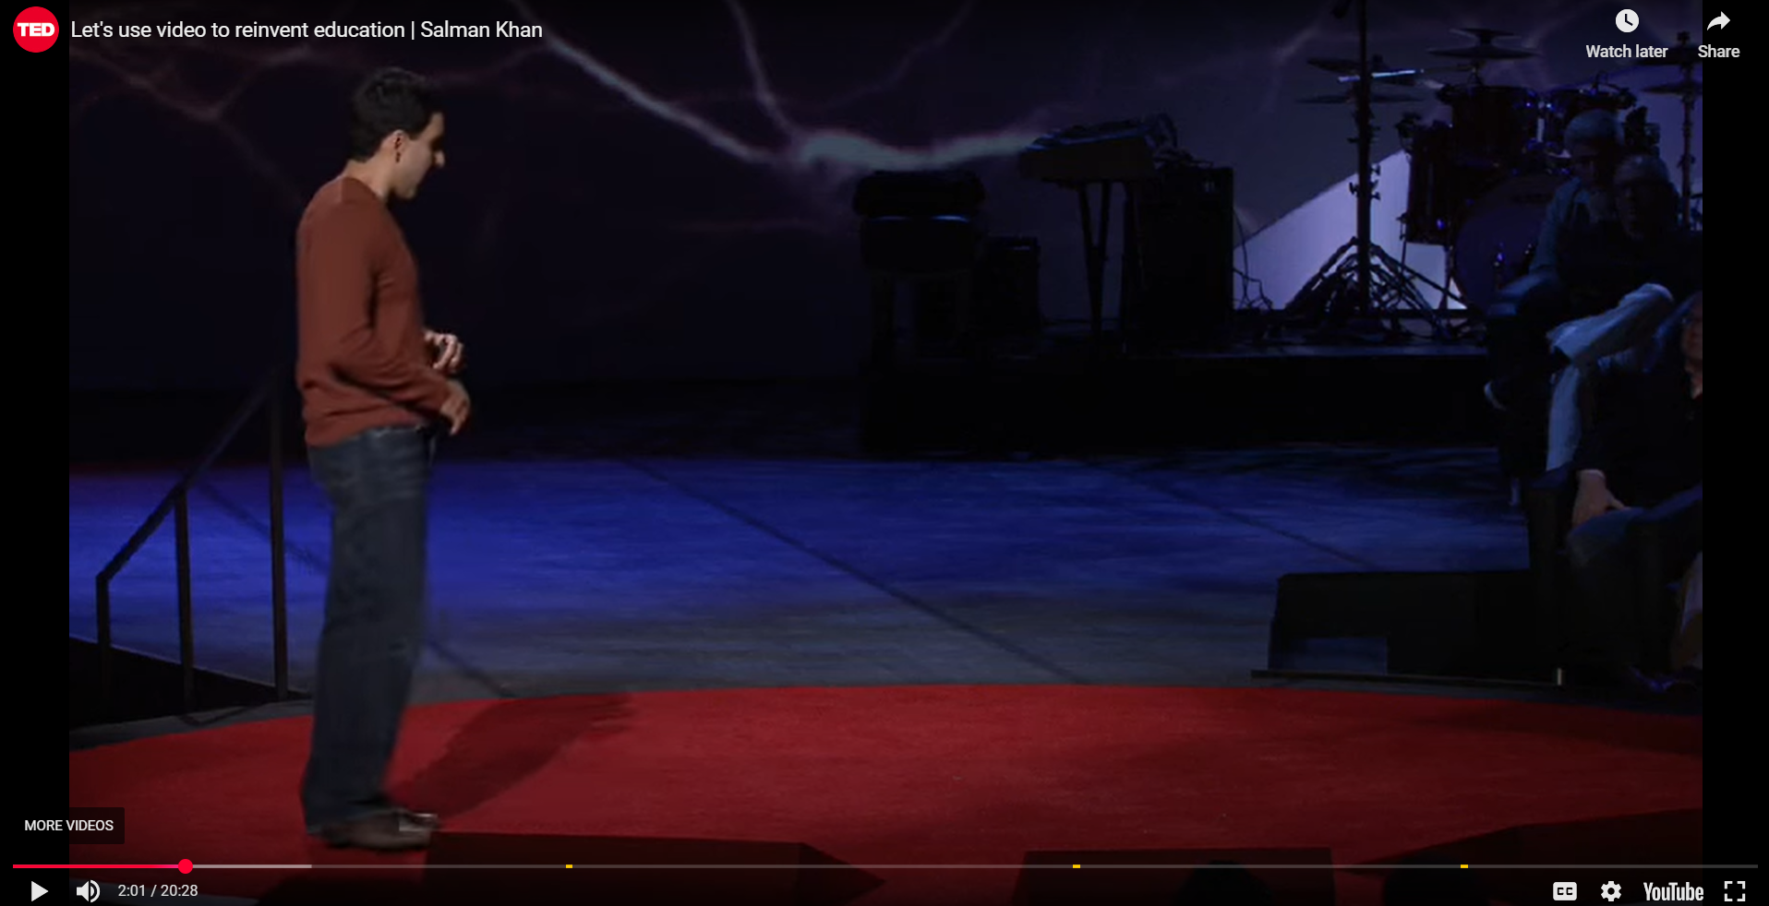
Watch The Video: Let’s Use Video to reinvent Education
https://www.youtube.com/embed/nTFEUsudhfs?rel=0?

Slide 14
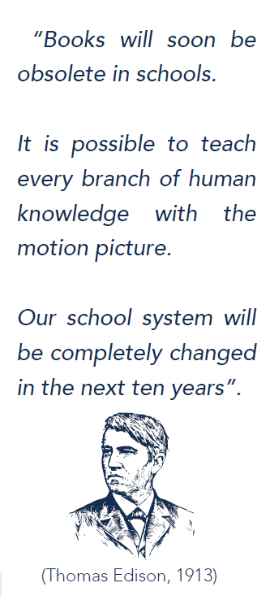

Slide 15

Learning
Design
Project
Management
Audio-visual
Logistic Support
Graphic design
Desktop
Publishing
Research
Multimedia
Development
Learning Analysis
Curriculum
Development
Change
Management
Relationship
Management

Slide 16

Design Smart From The Start.

Slide 17

Learner centered
Effective
Artistic
Realistic
Neuroscientific
Interesting
Need orientated
Grounded in theory
Dynamic
Evaluative
Scientific
Interactive
Goal orientated
Necessary

Slide 18
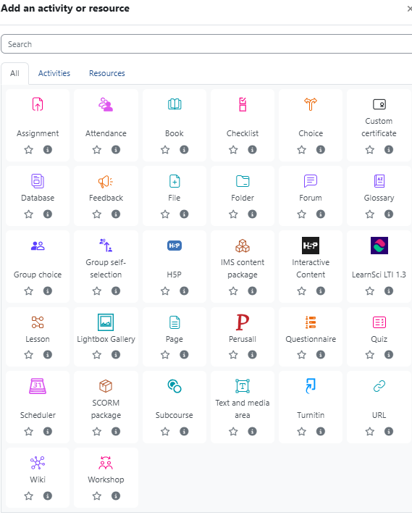

Slide 19
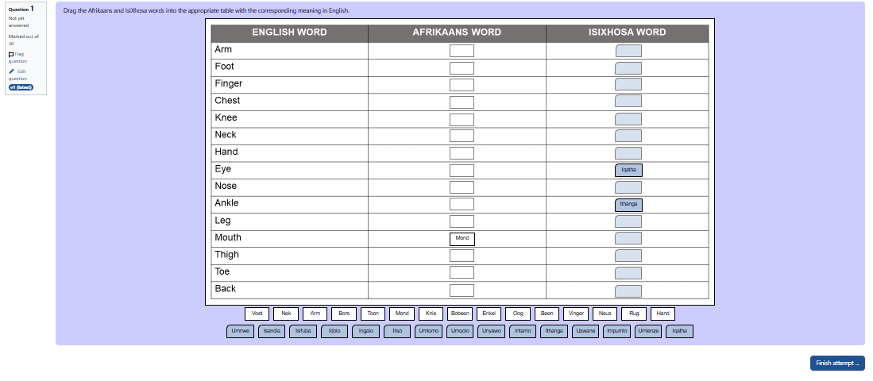

Slide 20
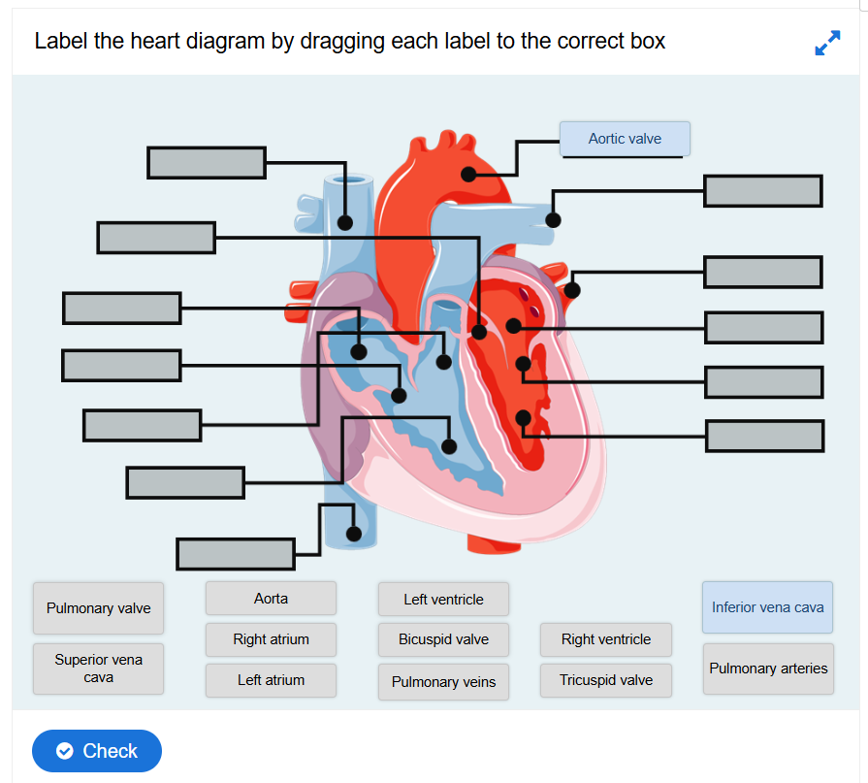

Slide 21

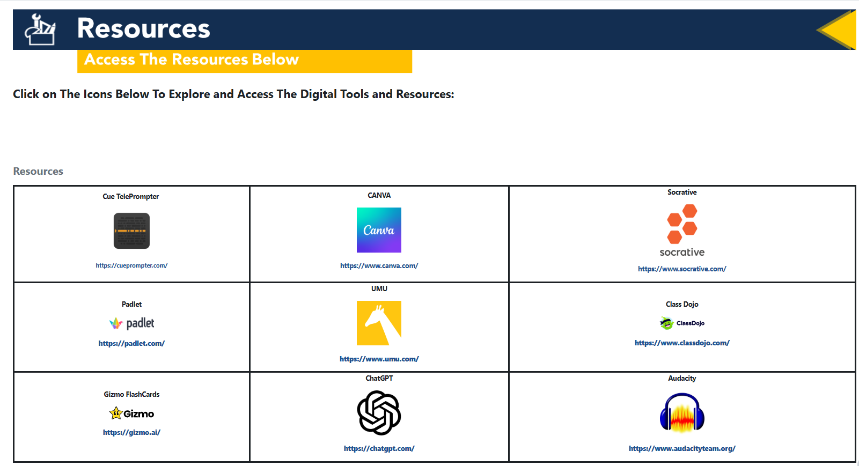

Slide 22
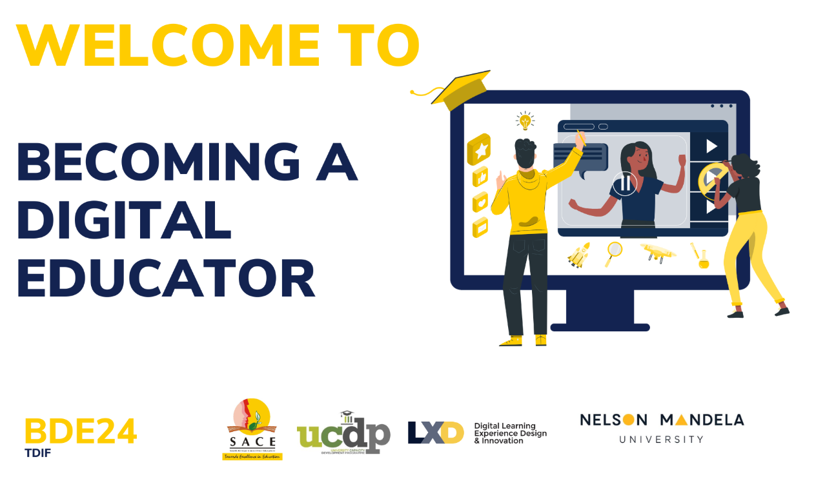

Slide 23


SIGN UP
Step 1: Access Course Site: Becoming A Digital Educator (2025)
The entire SLP is hosted and facilitated on the Nelson Mandela University FUNDA Learning Management System. You will need a Smartphone / Laptop and internet access to participate in this Online SLP.
Click or scan
the qr code
https://funda.mandela.ac.za/course/view.php?id=2402
Enrolment Key: FHSLovesLearning2025

Slide 24
Part 3:
Philosophies of Education

Slide 25

Quick Question
If you are not making design decisions based on evidence,
then what are design decisions based on?

Slide 26
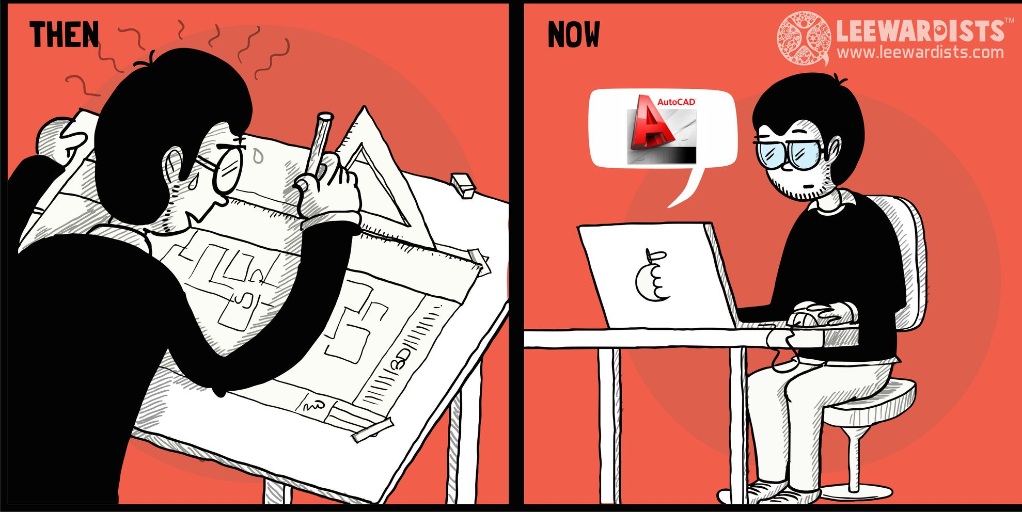
Protruding Research tells us that:
Students live, work, play and without exception, learn, in a manner that is fundamentally different from those of previous generations. Students also have different learning needs, and different learning goals.
(Binkley et al., 2012; Garrison, 2016).
Notes:
She is a second year university student …
Who can guess what she is doing?
She Shares a universal “problem” with millions of students all over the world.

Slide 27
WHAT ARE YOUR THOUGHTS ON THE IMPORTANCE OF UNDERSTANDING LEARNING THEORIES AND HAVING A THEORIST/S THAT GUIDES YOUR THINKING AND TEACHING?

Slide 28
Importance
Frameworks for instruction
Adapting to diverse learners
Promoting effective curriculum development
Understanding the learning process

Slide 29
Informed decision-making
Effective classroom management
Motivation and engagement
Using technology effectively
Enhancing teaching practices

Slide 30
Improved student outcomes
Professional growth
Creating inclusive environments
Key benefits

Slide 31
Theories: categories and principles
Behaviourism
Focuses on observable behaviours and how they are shaped by external stimuli. Learning is viewed as a change in behaviour resulting from experiences.
Key theorists:
  Ivan Pavlov (classical conditioning)
  B.F. Skinner (operant conditioning)
  Edward Thorndike
Emphasis:
  Reinforcement, and the role of the environment in shaping behaviour.

Slide 32
Cognitivism
Focuses on internal mental processes such as thinking, memory, and problem-solving. Learning is viewed as an active process: acquiring, organising, and storing information.
Key Theorists:
  Jean Piaget (cognitive development)
  Jerome Bruner
  David Ausubel
Emphasis:
  Mental processes, information processing, and how learners construct meaning.

Slide 33
Constructivism
Emphasises that learners actively construct their own knowledge based on their experiences. Learning is viewed as a process of building upon existing knowledge.
Key Theorists:
  Lev Vygotsky (social constructivism)
  Jean Piaget (cognitive constructivism)
Emphasis:
  Active learning, social interaction, and the importance of context in learning.

Slide 34
Humanism
Focuses on the individual's potential for growth, self-actualisation, and personal development. Learning is viewed as a process of becoming a self-directed and autonomous learner.
Key Theorists:
  Abraham Maslow
  Carl Rogers
Emphasis:
  Motivation, self-esteem, and the importance of creating a supportive learning environment.

Slide 35
Connectivism
Recognises the impact of technology and networks on learning. Learning is viewed as a process of forming connections and navigating information in a digital age.
Key Theorists:
  George Siemens
  Stephen Downes.
Emphasis:
  distributed learning, networks, and the ability to learn and adapt in a constantly changing environment.

Slide 36
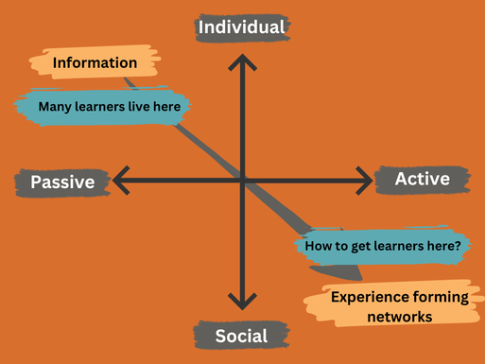
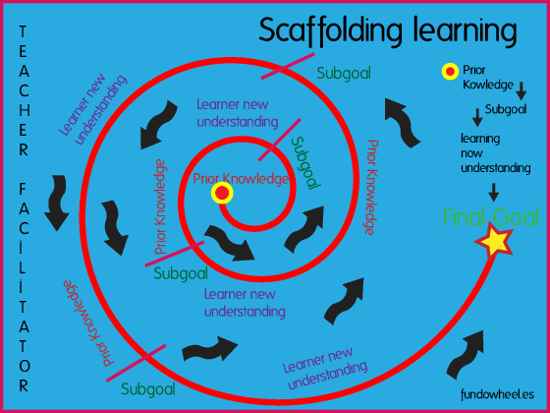
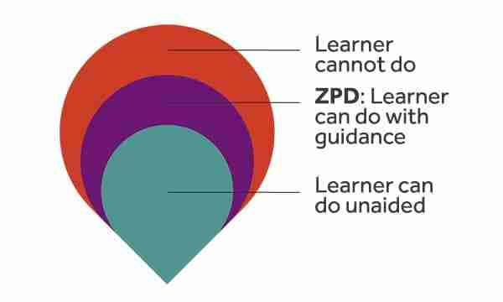
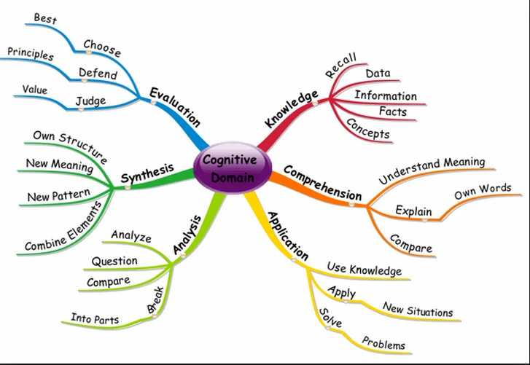
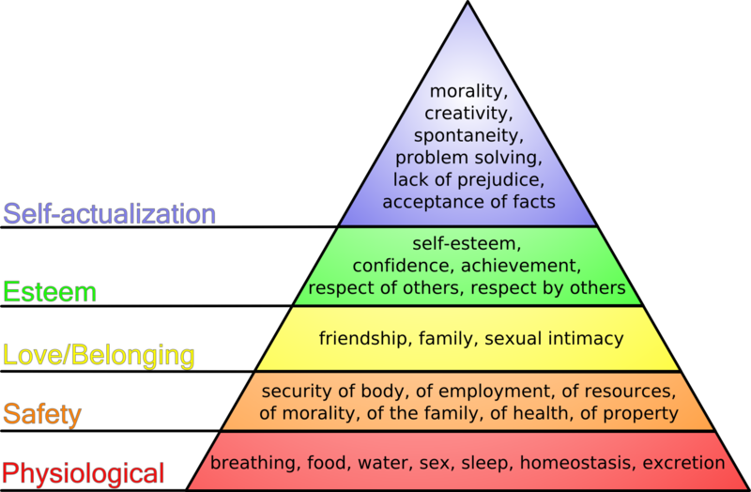
Behaviourism
This Photo by Unknown Author is licensed under CC BY-SA-NC
Connectivism
Constructivism
This Photo by Unknown Author is licensed under CC BY-SA-NC
Humanism
This Photo by Unknown Author is licensed under CC BY-NC
This Photo by Unknown Author is licensed under CC BY
This Photo by Unknown Author is licensed under CC BY-SA-NC
Cognitivism

Slide 37


Carol S. Dweck: Mindset theory
People's beliefs about their abilities—their "mindset"—significantly impacts their motivation and success.
    Fixed mindset: The belief that abilities are static and unchangeable.
    Growth mindset: The belief that abilities can be developed through effort, learning, and perseverance.
  Her work demonstrates that individuals with a growth mindset are more likely to embrace challenges, persist through setbacks, and achieve greater success.
This Photo by Unknown Author is licensed under CC BY

Slide 38
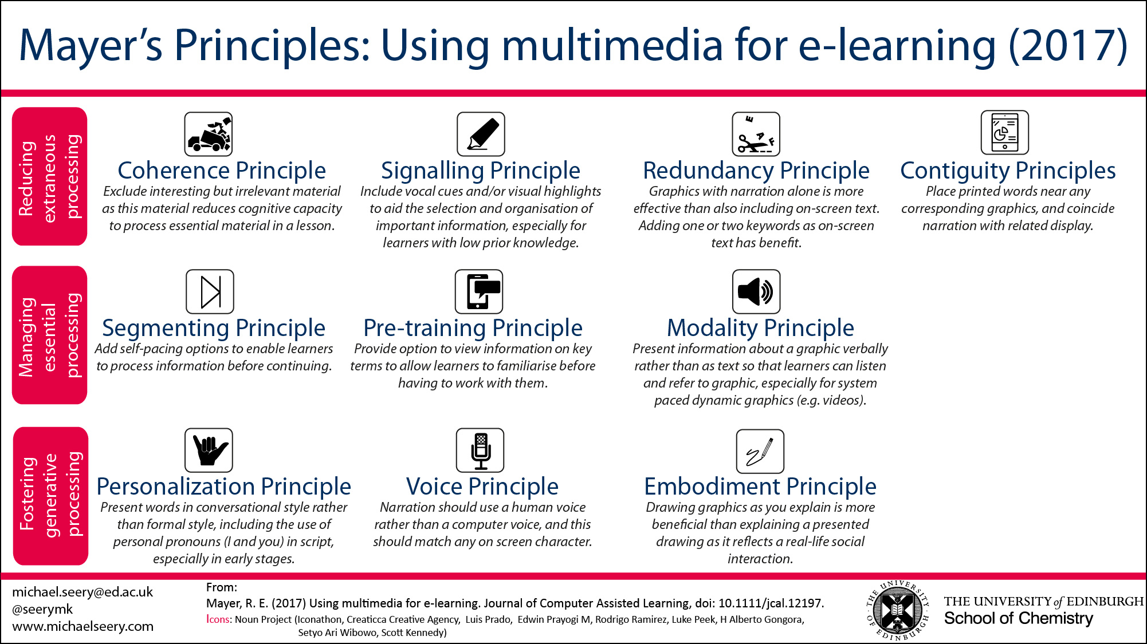
(Mayer, R. E., 2021)

Slide 39
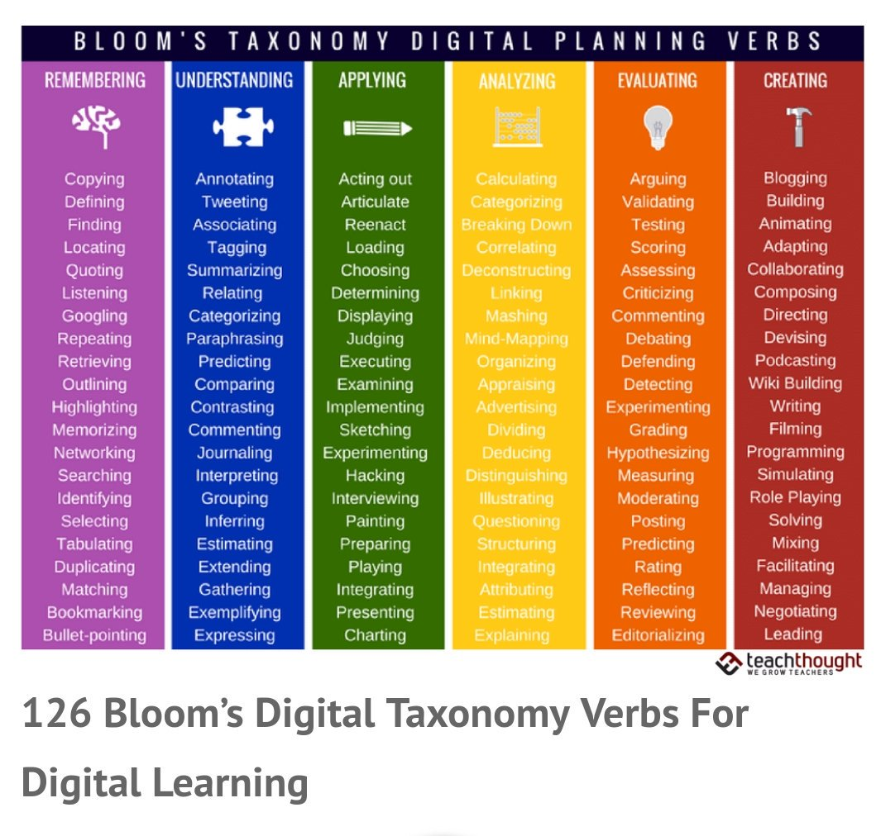
(Churches, A., (2010)

Slide 40
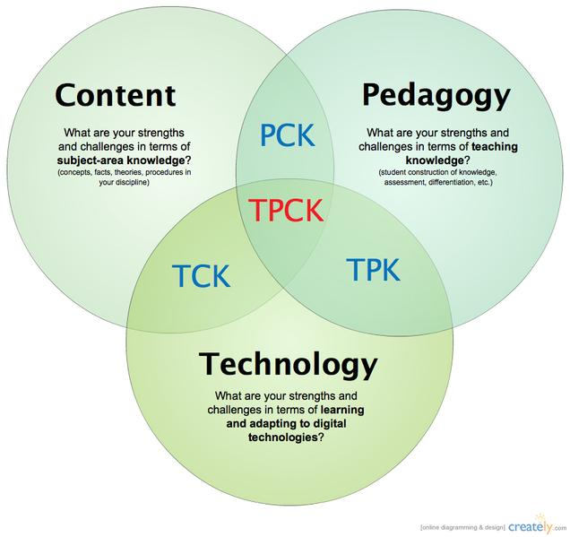
TPCK
(Koehler, M. J., & Mishra, P., 2014)

Slide 41
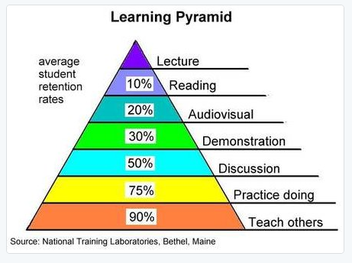
TPCK
(Koehler, M. J., & Mishra, P., 2014)

Slide 42
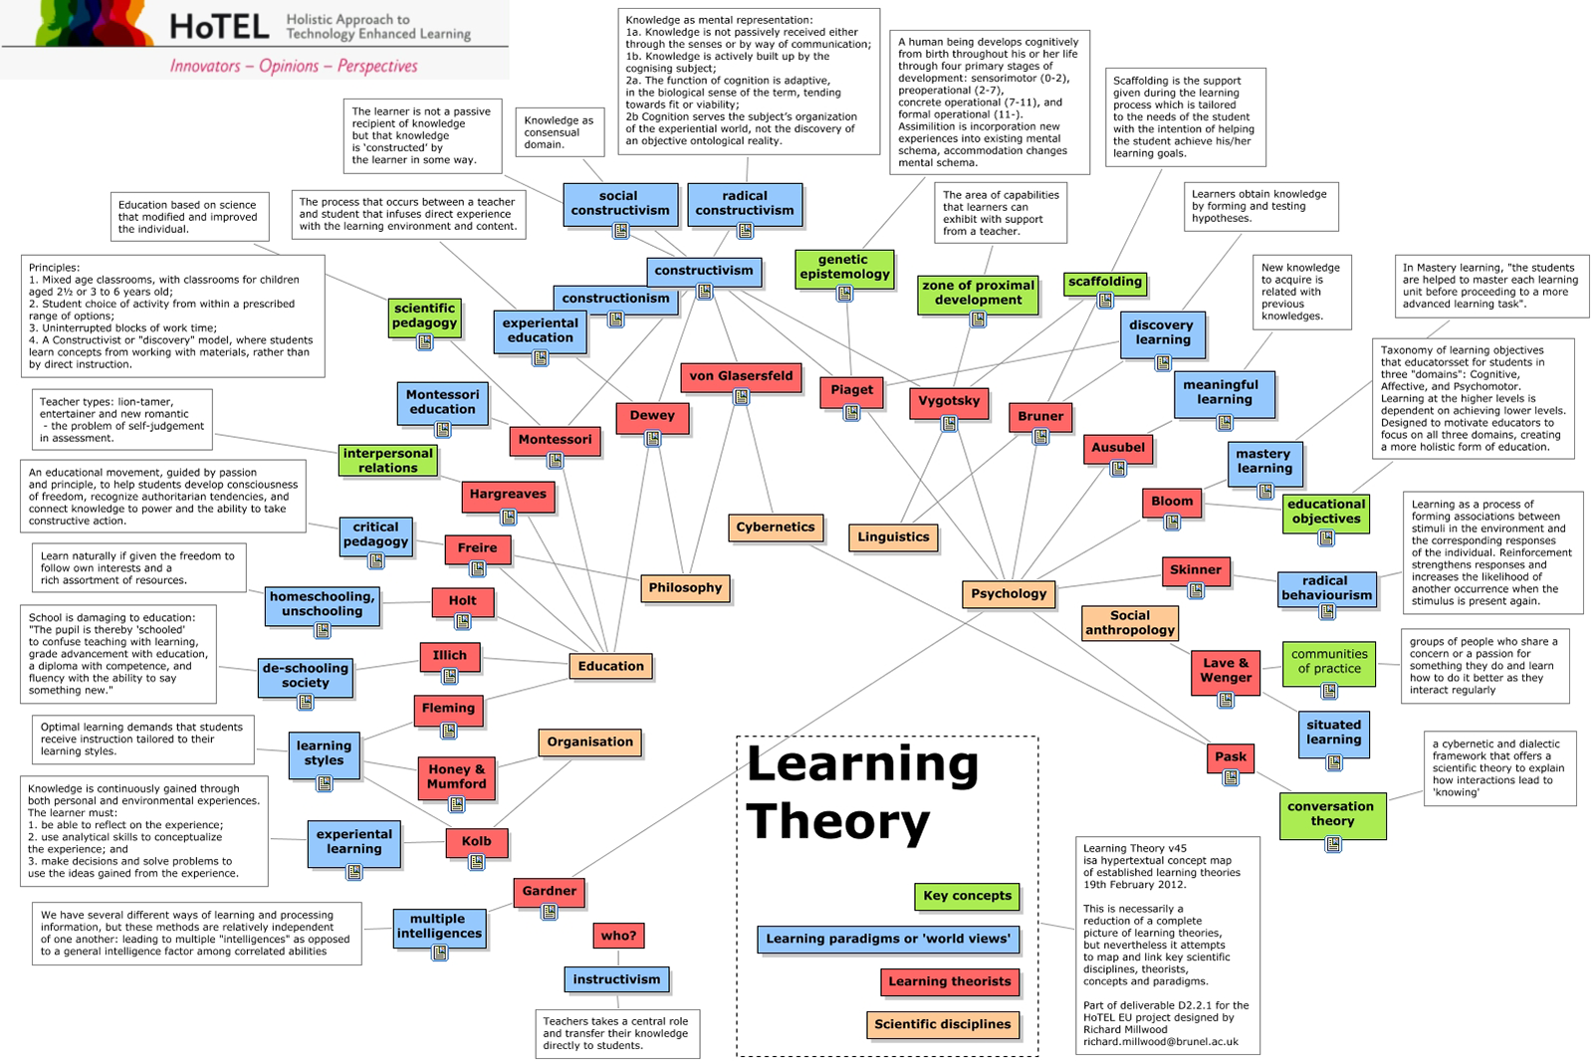
Key Theories
(Millwood, R., n.d)

Slide 43
Part 4:
Practical Session

Slide 44
LT Theme
4, 3.
We need a bold generation of lecturers who can let go of control, be innovative and take risks.
(p6)

Slide 45

Any Questions?

Slide 46

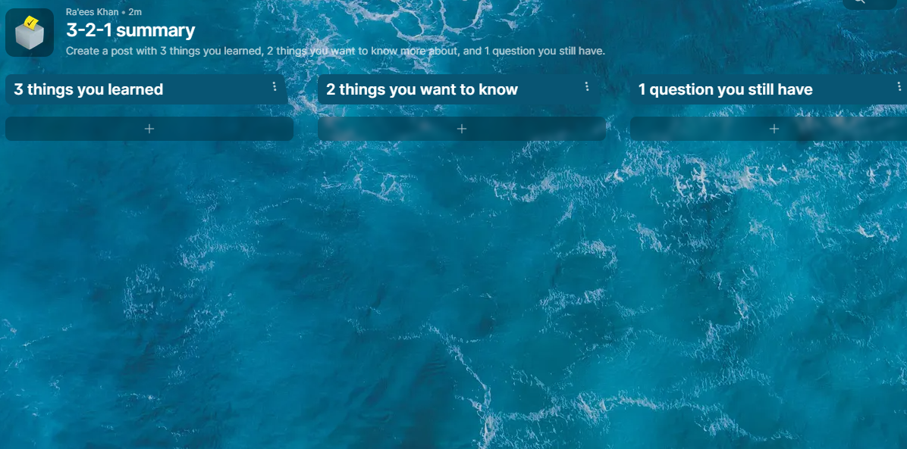
https://tinyurl.com/summary321
Notes:
https://padlet.com/raeesk/active-vs-passive-learning-comparison-dx5hzueptorqvret

Slide 47

“The fundamental question is not about technology, it remains…
How can we improve the Quality of Education?
Perhaps, In this case, through the use of technology.”
-Ra’ees Khan

Slide 48


Feedback
Please be kind enough to take a minute and rate this workshop and provide a little feedback to help us gain a better understanding of your experience.
Let us know what you really enjoyed and what we can do better for you.
Click on the link to provide feedback
+- (2mins)
https://forms.office.com/r/nFZfLaRgHv

Slide 49

Goals of this Session:
Part 1 – Active Learning
Cause an ontological shift in your thinking, philosophy and ultimately your practice
Modeling an active learning methodology
To survey the range philosophies related to learning
Part 2 – Flipping the Classroom
Equip you with new tools
Modeling a flipped classroom approach
To provide useful resources
Part 3 – Philosophies of Education
Ground practice with theory (praxis)
To discuss underlying educational theories and philosophies
Part 4 – Practical Session
Empower you to explore new ways of teaching & enabling learning
Enable and support the design of an active / problem-based lesson using a flipped approach
Providing a platform for collaboration & resource sharing
Notes:
Equip you with new tools
Cause an Ontological Shift in your thinking, philosophy and ultimately your practice
Enable you to Explore New Ways of Teaching – Enabling Learning

Slide 50

References
Beetham, & Sharpe. (2007). Design for Learning: Rethinking Pedagogy for the digital age. London: Routledge.
Beetham, H., & Sharpe, R. (2013). Rethinking pedagogy for a digital age: Designing for 21st century learning: Routledge.
Binkley, M., Erstad, O., Herman, J., Raizen, S., Ripley, M., Miller-Ricci, M., & Rumble, M. (2012). Defining twenty-first century skills Assessment and teaching of 21st century skills (pp. 17-66): Springer
Churches, A. (2010). Bloom's digital taxonomy.
Conole, & Wills. (2013). Representing learning designs–making design explicit and shareable. Educational Media International, 50(1), 24-38.
Garrison, D. R. (2016). E-learning in the 21st Century: A Community of Inquiry Framework for Research and Practice: Routledge.
Khan, R. (2017) 21st Century Learning Design Practices And Its Value In Enhancing Learning Experiences And Cultivating 21st Century Skills: A Developing Context Perspective For The Future Of Education. University of Johannesburg
Khan, R (2019) Educational practitioners’ tacit knowledge of Learning Design as reflected in multimedia instructional video artefacts. University of Johannesburg
Koehler, M. J., & Mishra, P. (2014). Introducing tpck. In Handbook of technological pedagogical content knowledge (TPCK) for educators (pp. 13-40). Routledge.
Mayer, R. E. (2021). Evidence-Based Principles for How to Design Effective Instructional Videos. Journal of Applied Research in Memory and Cognition.
Merrill, M. D., Drake, L., Lacy, M. J., Pratt, J., & Group, I. R. (1996). Reclaiming instructional design. Educational Technology, 5-7.
Reiser, R. A., & Dempsey, J. V. (2012). Trends and issues in instructional design and technology: Pearson Boston, MA.
Rose, D. H., & Meyer, A. (2002). Teaching every student in the digital age: Universal design for learning: ERIC.
Tiernan, P. (2015). An inquiry into the current and future uses of digital video in University teaching. Education and Information Technologies, 20(1), 75-90.

Slide 51


Get In Touch
Missionvale Campus
Building 517
Office 0113
Raeesk@mandela.ac.za

Slide 52


Slide 53
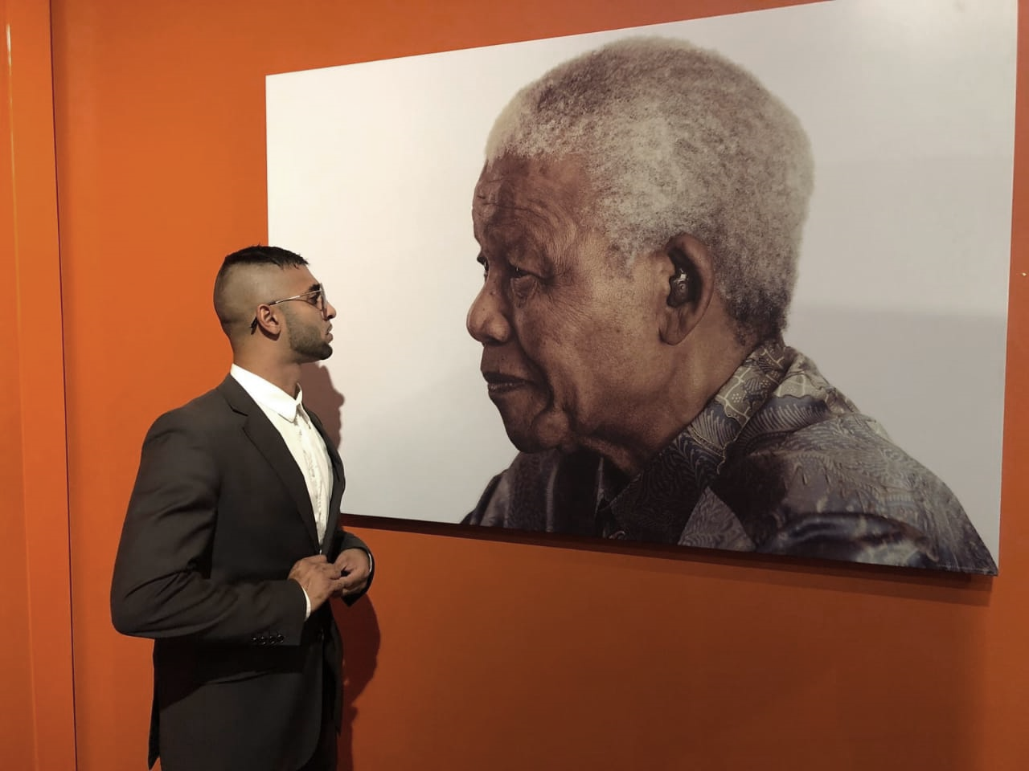
“Sometimes it falls upon a generation to be great.
You can be that generation.
Let your Greatness blossom.”

Slide 54
LT Theme: Scholarship
5, f.
Professionalisation of teaching as a scholarly endeavor and continuously working on how to provide meaningful LT development experiences for academics and how to ensure that all academics engage in this.
(p6)

Slide 55

"Instructional Design is defined as “a systematic process that is employed to develop education and training programs in a consistent and reliable fashion”. Reiser and Dempsey (2012)
“Instructional design is a technology for the development of learning experiences and environments which promote the acquisition of specific knowledge and skill by students.” Merrill et al. (1996)
“Design models demonstrate (in different ways) that design of learning environments, materials, and systems is a conscious set of decisions centred around a variety of factors (e.g. learning goals and objectives, learners characteristics, media characteristics, message design, etc Rose and Meyer (2002)
“A methodology for enabling teachers/designers to make more informed decisions in how they go about designing learning activities and interventions, which is pedagogically informed and makes effective use of appropriate resources and technologies. This includes the design of resources and individual learning activities right up to curriculum-level design.” Conole and Wills (2013)
“The process by which teachers – and others involved in the support of learning – arrive at a plan or structure or design for a learning situation” (Beetham & Sharpe, 2007).
“A set of practices carried out by learning professionals… defined as designing, planning and orchestrating learning activities, which involve the use of technology, as part of a learning session or programme” (Beetham, 2008).

Slide 56
X
"Instructional Design is defined as “a systematic process that is employed to develop education and training programs in a consistent and reliable fashion”. Reiser and Dempsey (2012)
“Instructional design is a technology for the development of learning experiences and environments which promote the acquisition of specific knowledge and skill by students.” Merrill et al. (1996)
“Design models demonstrate (in different ways) that design of learning environments, materials, and systems is a conscious set of decisions centred around a variety of factors (e.g. learning goals and objectives, learners characteristics, media characteristics, message design, etc Rose and Meyer (2002)
“A methodology for enabling teachers/designers to make more informed decisions in how they go about designing learning activities and interventions, which is pedagogically informed and makes effective use of appropriate resources and technologies. This includes the design of resources and individual learning activities right up to curriculum-level design.” Conole and Wills (2013)
“The process by which teachers – and others involved in the support of learning – arrive at a plan or structure or design for a learning situation” (Beetham & Sharpe, 2007).
“A set of practices carried out by learning professionals… defined as designing, planning and orchestrating learning activities, which involve the use of technology, as part of a learning session or programme” (Beetham, 2008).

Slide 57




Slide 58
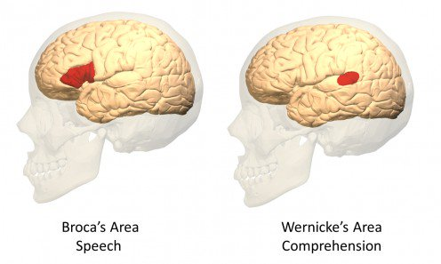

Slide 59
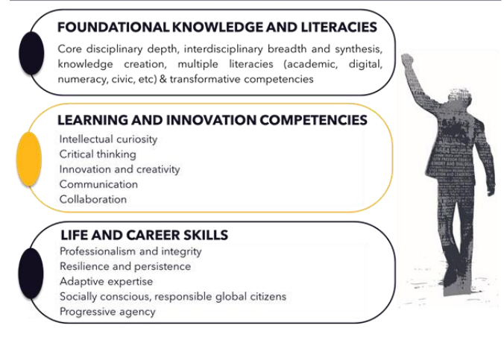
LT Theme: Graduate Attributes
2, e.
The need to focus on the graduate attributes in designing curricula and learning experiences in and out of the class.
(p4)

Slide 60
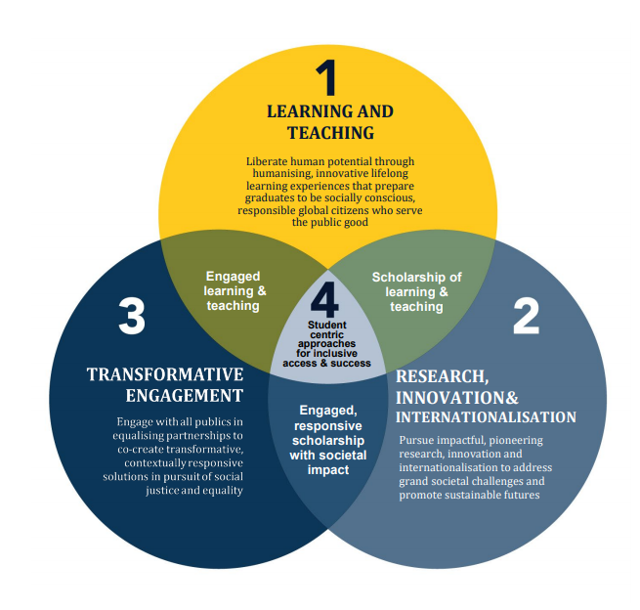
Strategic Focus Areas

