Slide 1





Dr Teri-Lynne Fogarty & Ms. Celeste Naudé
Pharmacy Department
Notes:
Explain what our presentation is on, not implemented in class, student developing game that could be used
Traditional teaching methods in pharmacy education often face challenges in engaging students and promoting active learning. Game-based learning (GBL) has emerged as a promising strategy to enhance student involvement and knowledge retention. This presentation introduces a module concept where final-year Bachelor of Pharmacy (BPharm) students are tasked with utilising a game development framework to create games that enhance the teaching of a specific topic within the BPharm curriculum.
This is a small group project and we have between 10 and 25 students per year. Select the module from a list of potential projects.
One of the ways we introduce the module to them is by showing them this video:

Slide 2
introduction
Learning that is facilitated by the use of a game
Active learning experience within a game framework, which has specific learning objectives and measurable outcomes.
Learning outcomes can range from simple memorisation and recall to higher level learning outcomes such as evaluation or creativity
Can be intrinsic or supplemental
Played face-to-face with physical objects or online
Notes:
Whitton N. (2012) Games-Based Learning. In: Seel N.M. (eds) Encyclopedia of the Sciences of Learning. Springer, Boston, MA. https://doi.org/10.1007/978-1-4419-1428-6_437

Slide 3

Background
Boosts learner engagement
Inspires critical thinking
Better student outcomes

Slide 4
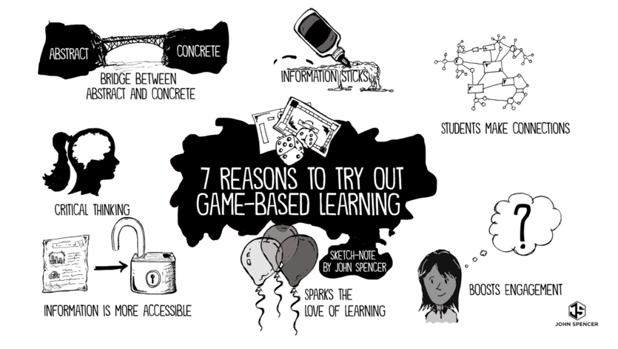
Background
01
Boosts learner engagement
Inspires critical thinking
Better student outcomes
Notes:
Intro video

Slide 5
Game-based learning (gbl)
The main characteristics of game-based learning are:
  The learning process takes place through different and attractive scenarios.
  The learning process is based on overcoming different challenges.
  The learning experience is positive and interesting.

Slide 6
Gamification
Use of different motivating elements that foster competition between users
Integration of game elements into conventional learning activities in order to increase engagement and motivation.
Examples of gamification elements:
  point systems
  leaderboards
  badges

Slide 7
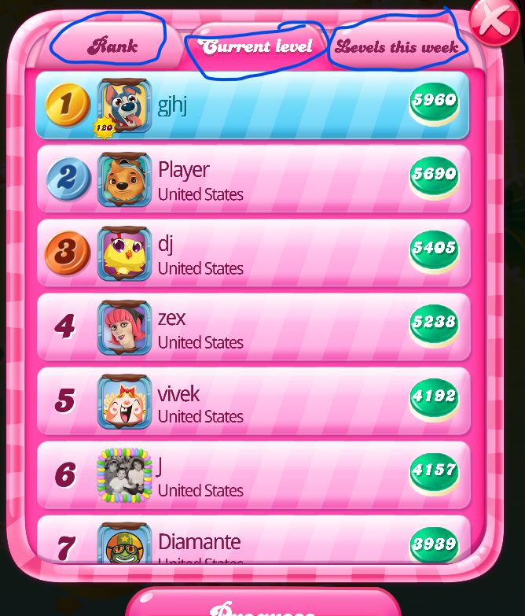
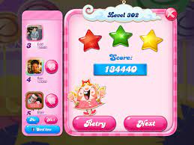
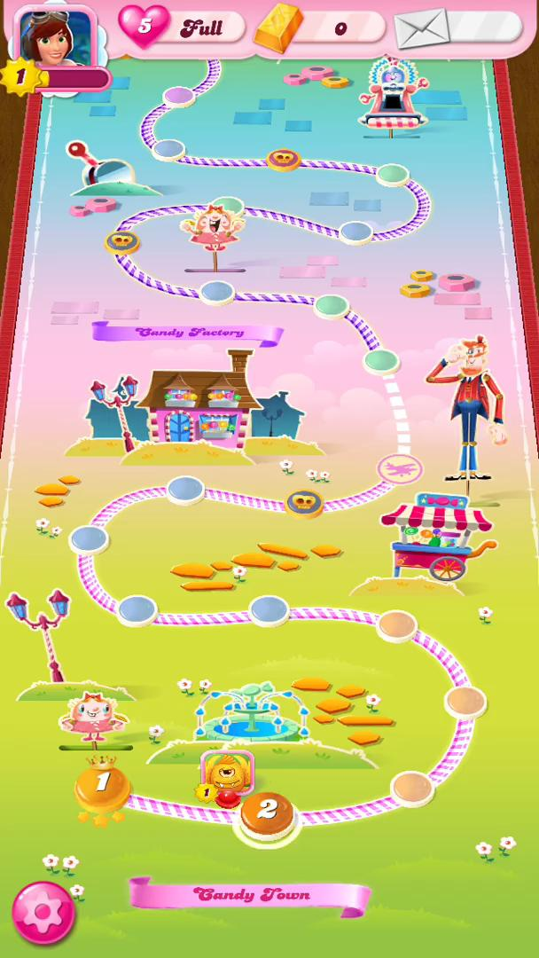
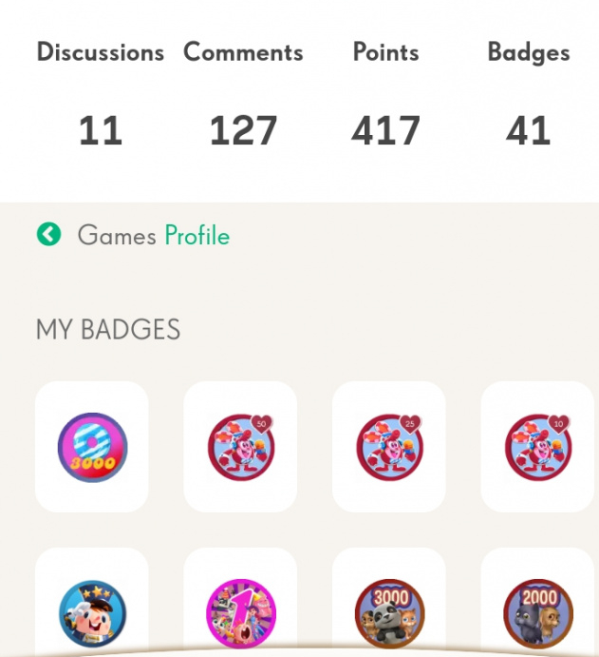
Gamification
Leaderboard
Points
Progress
Badges

Slide 8
Gbl & gamification
Improve student commitment and engagement to make the learning experience more positive and enhance memory and retention.
In summary, students are won over by the techniques used in game-based learning and captivated by the contents

Slide 9
Game design elements
Game-based learning is not just creating games for students to play, it is designing learning activities that can incrementally introduce concepts, and guide users towards an end goal
Principles of games that engage learners are:
  Problem-based
  Involve active learning
  Provide informative feedback
  Be progressive

Slide 10
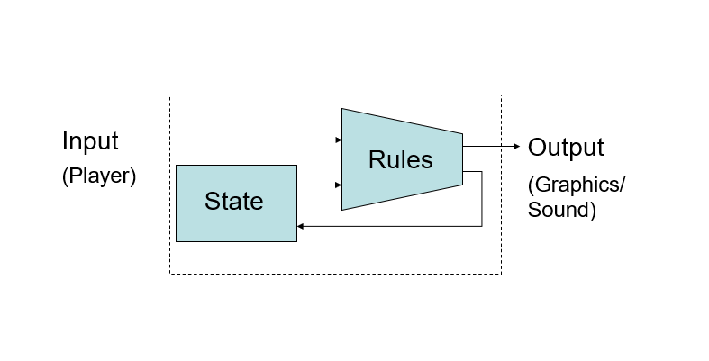
Games are state machines

Slide 11
A design vocabulary
Code
Process
Response
Rules
Game
“Session”
“Fun”

Slide 12
A design vocabulary
Mechanics
Code
Process
Response
Rules
Game
“Session”
“Fun”

Slide 13
A design vocabulary
Mechanics
Dynamics
Code
Process
Response
Rules
Game
“Session”
“Fun”

Slide 14
A design vocabulary
Mechanics
Dynamics
Aesthetics
Code
Process
Response
Rules
Game
“Session”
“Fun”

Slide 15
DEFINITIONS
Mechanics: The rules and concepts that formally specify the game-as-system.
Dynamics: The run-time behaviour of the game-as-system.
Aesthetics: The desirable emotional responses evoked by the game dynamics.

Slide 16
EIGHT KINDS OF FUN
5. Fellowship
  Game as social framework
  6. Discovery
  Game as uncharted territory
7. Expression
Game as self-discovery
8. Submission
  Game as pastime
1. Sensation
  Game as sense-pleasure
2. Fantasy
  Game as make-believe
3. Narrative
  Game as drama
4. Challenge
  Game as obstacle course

Slide 17


CLARIFYING AESTHETICS
Charades is “fun.”
Candy crush is “fun.”

Slide 18
CLARIFYING AESTHETICS
Charades: Fellowship, Expression, Challenge
Candy crush: Challenge, Sensation, Competition
A game can have multiple aesthetics.

Slide 19
MECHANICS VS. DYNAMICS
There’s a grey area.
Some behaviors are direct consequences of rules
Others are indirect.
“Dynamics” are usually indirect
Dynamics emerge from mechanics
    E.g., a time limit (mechanic) results in time pressure (dynamic)
    Other ways of using a time limit – depleting resource or “pace creating” character chasing the player down.
Notes:
Slides 9 to 26
(Hunicke et al., 2004)

Slide 20
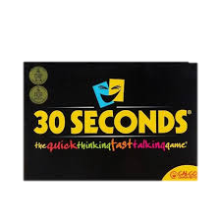

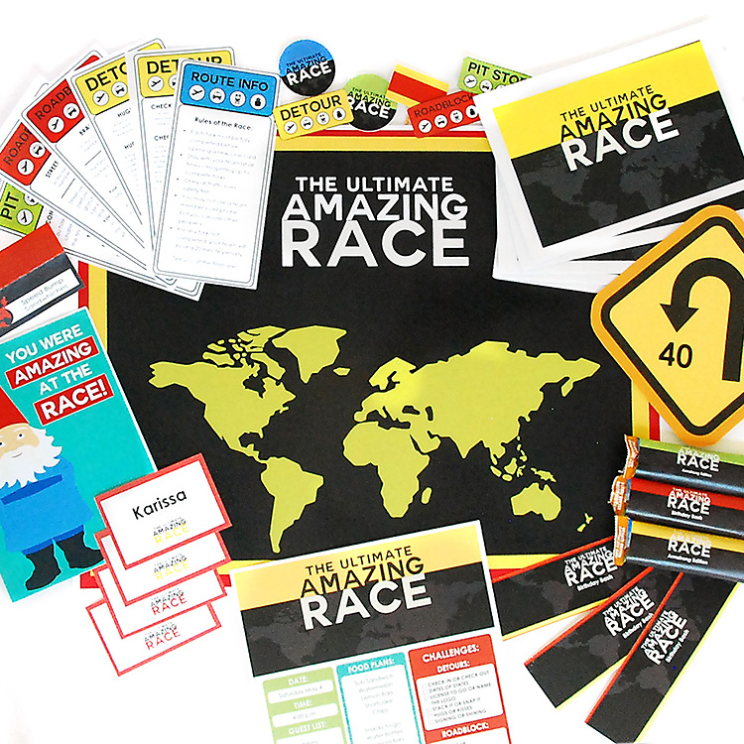
Examples of games integrated into module
30 Seconds
PT programme
Who wants to be a millionaire
Amazing Race
Notes:
30 sec PT_ Scope and BPHARM2 of practice terminology (professional jargon)
GBL and first years
GBL- QR codes (adaptive version during protests)

Slide 21

Who wants to be a millionaire

Slide 22
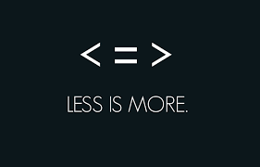
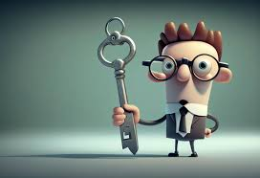

Tips from our experience
Notes:
In game design, things we have learnt
Monopoly- complex rules not to overshadow learning, Learning tool not in place of learning (facilitates teaching)
The simpler the more engaging (as long as its not boring)
Culture and exposure to board games
Teaches problem solving, critical thinking and team work
FUN is key, effectiveness relies on ENGAGEMENT
Digital games (Lia slides)_ option, 2 digital, more tangible

Slide 23
TYPES OF GAMES
board games
card games
word games
video games
simulations
role-playing games
puzzles
Notes:
In game design, things we have learnt
Monopoly- complex rules not to overshadow learning, Learning tool not in place of learning (facilitates teaching)
The simpler the more engaging (as long as its not boring)
Culture and exposure to board games
Teaches problem solving, critical thinking and team work
FUN is key, effectiveness relies on ENGAGEMENT
Digital games (Lia slides)_ option, 2 digital, more tangible

Slide 24
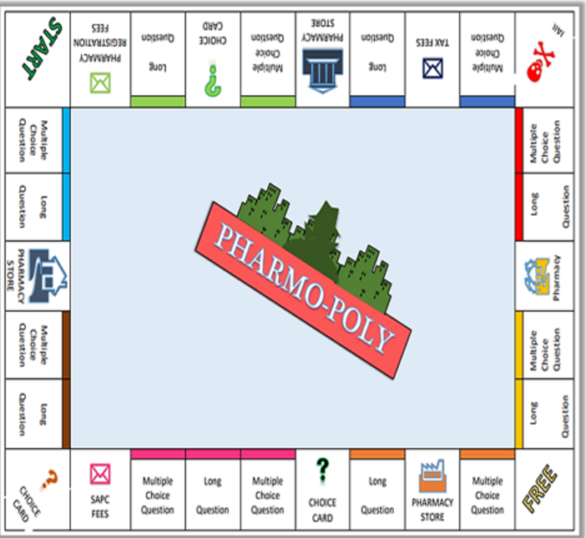
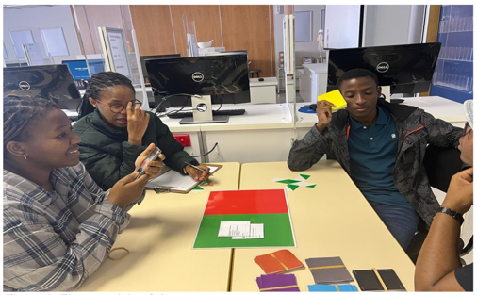
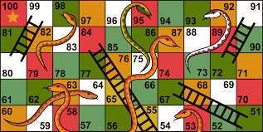
Examples of student projects (2022)
Pharmacodynamics:
Enhancing knowledge of mechanism of action
Enhancing clinical knowledge of asthma
Revise and understand antibiotic classes
Pharmo-poly
Asthma quiz game
Antibiotic Snakes & Ladders
Notes:
Pharmo-poly: Mhlongo B, Raath C, Moropene L, Moodley M (based on Monopoly).
Asthma Quiz: Masipa M, Masophi A, Mofoka Z, Ngumbela L. (based on Flash cards, Time element (30 seconds), point based on level of difficulty
Antibiotic classes: Sifanelo S, Myeza M, Pasha T, Magwenyana S. (based on Snakes and Ladders)

Slide 25
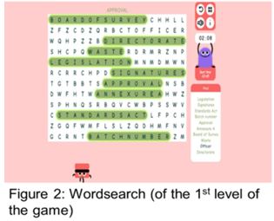

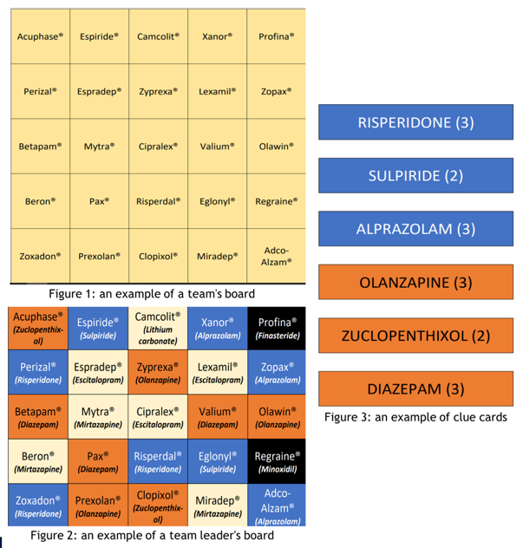
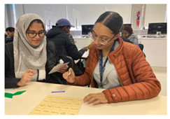
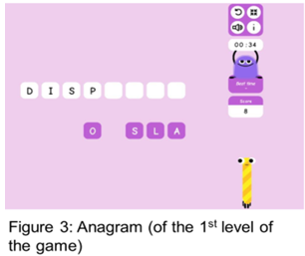


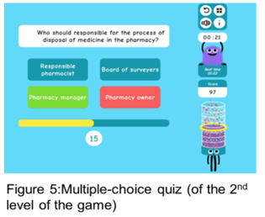
Examples of student projects (2022)
Tradenames of SA medicine
How to dispose of medicine waste effectively
Tradenames
EduCandy
Notes:
Tradenames: Chan J, Jooste K, Vaughn A, Witbooi C. (based on game called Code Names) critical error = out (black box)
EduCandy Studio: Gumede F, Magubane S, Mbatha K, Motlogelwa , Mgubasi M. (Based on digital word games)

Slide 26
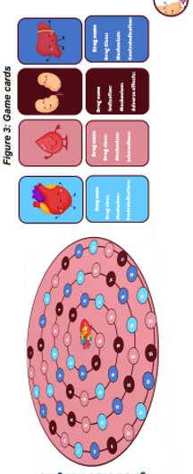
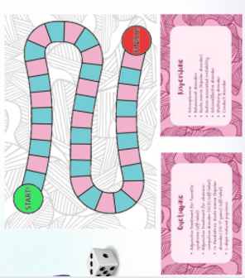

Examples of student projects (2023)
Revision of cardiovascular Care
Anti-psychotics in public sector
OTC pain medicine directions for use
PRx
Cardio-quest
Psych-alike
Notes:
Cardio-quest: Daniels N, Maluleke S, Ngocobo T
Psych-alike: Crouse M, Smith M, Anderson T.
OTC pain: Makonza T, Nonxube A, Nombuso N, Pakati L (Based on Heads-Up, blind mans bluff)

Slide 27
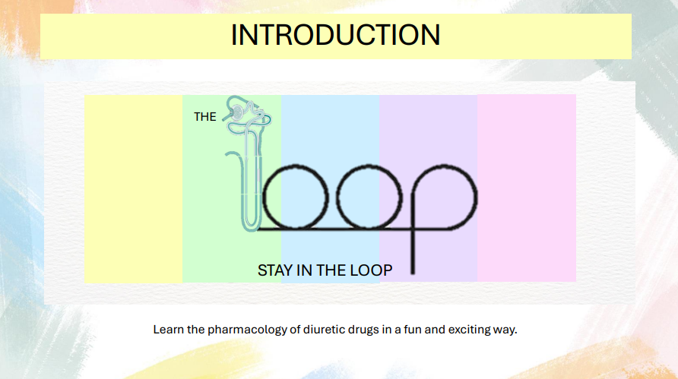
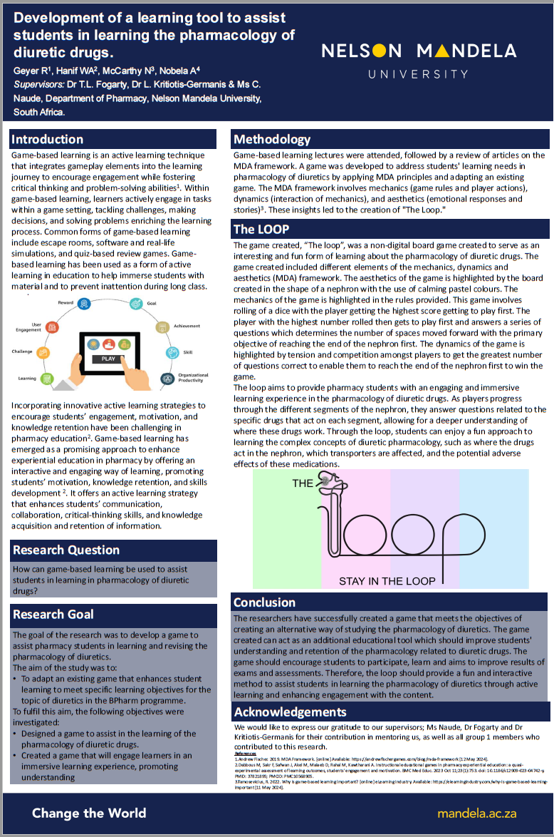
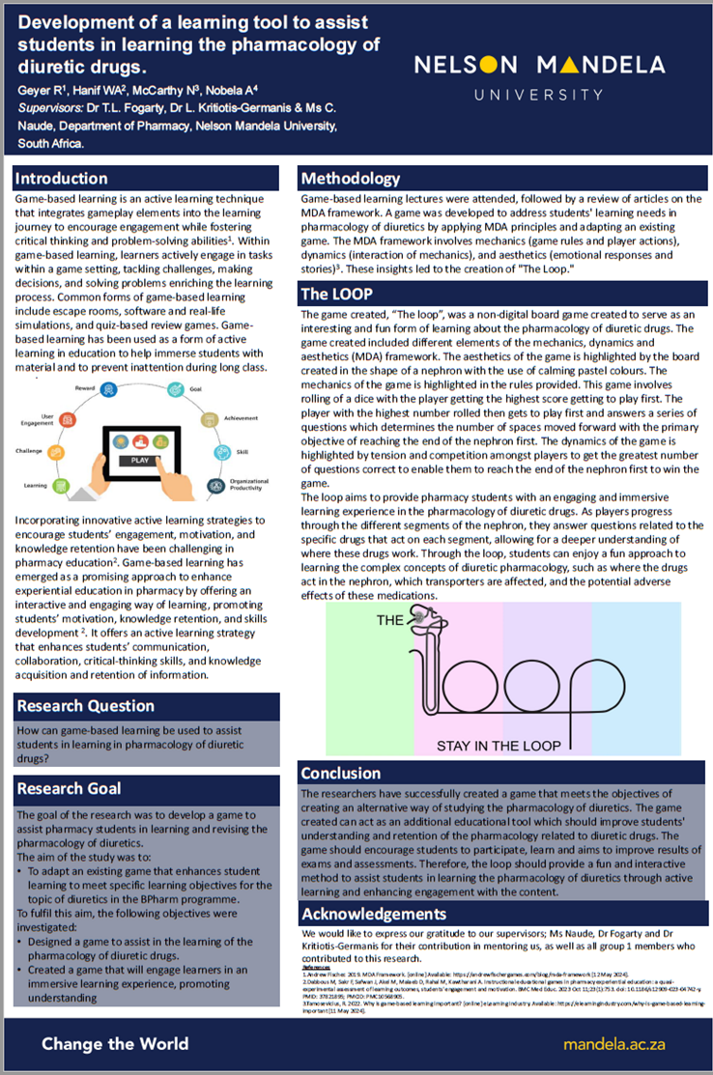
Examples of student projects (2024)
Notes:
The LOOP: Geyer R, Hanif WA, McCarthy N, Nobela A

Slide 28
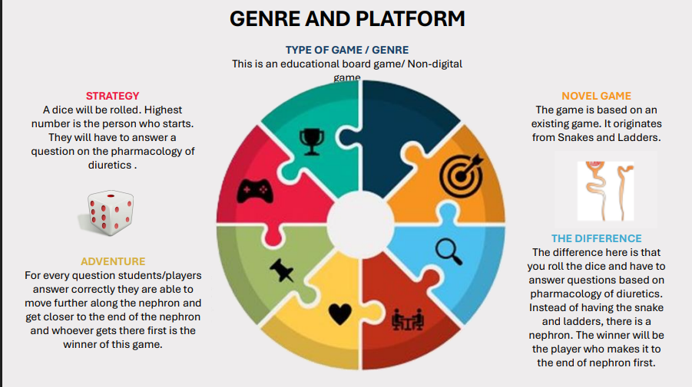
Examples of student projects (2024)
Notes:
The LOOP: Geyer R, Hanif WA, McCarthy N, Nobela A

Slide 29
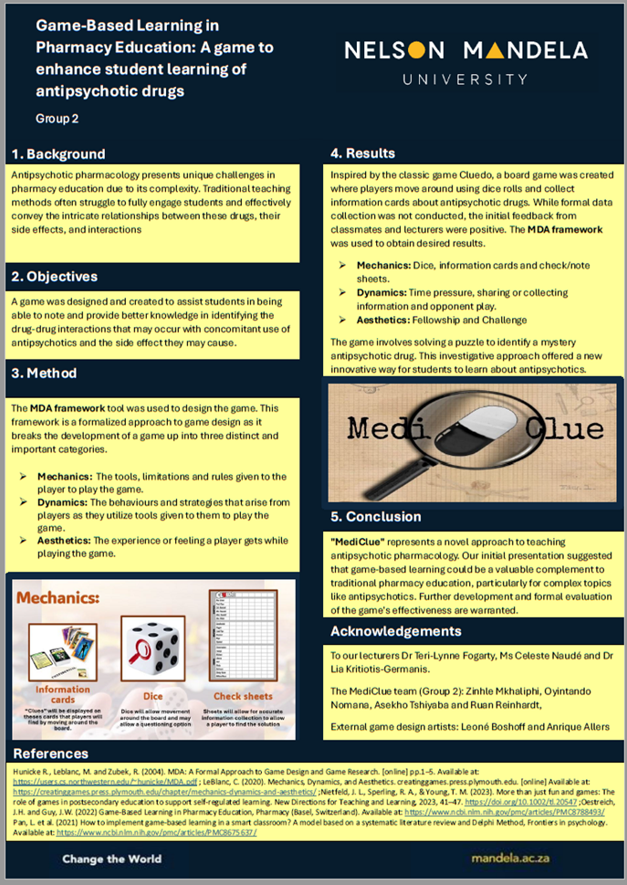

Examples of student projects (2024)
Notes:
Group 2 Ruan Reinhart, Oyintando Nomana, Aseko Tshiyaba, Zinthle Mkhaliphi

Slide 30
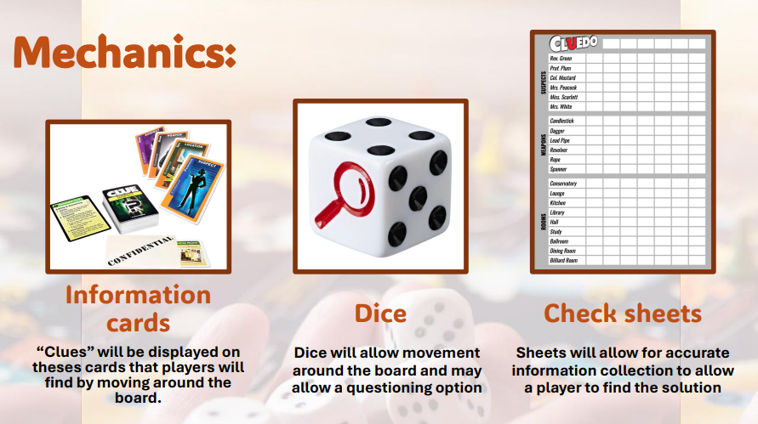
Examples of student projects (2024)
Notes:
Group 2 Ruan Reinhart, Oyintando Nomana, Aseko Tshiyaba, Zinthle Mkhaliphi

Slide 31
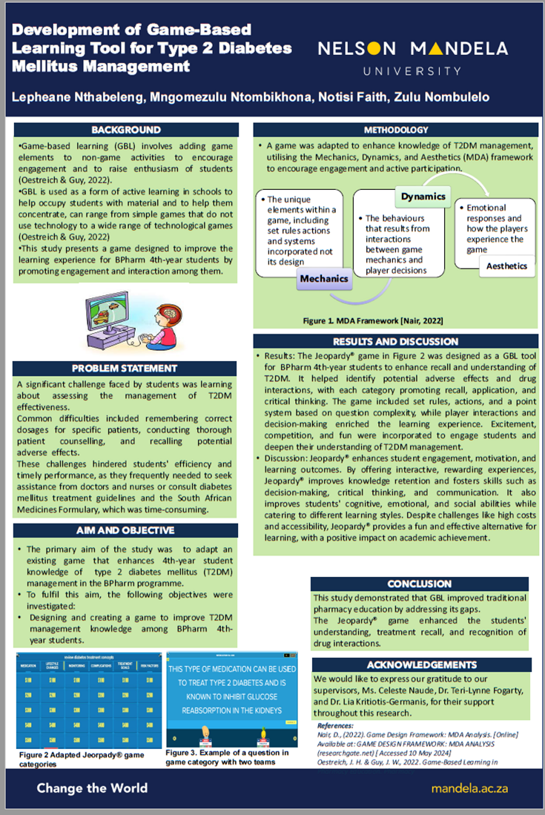
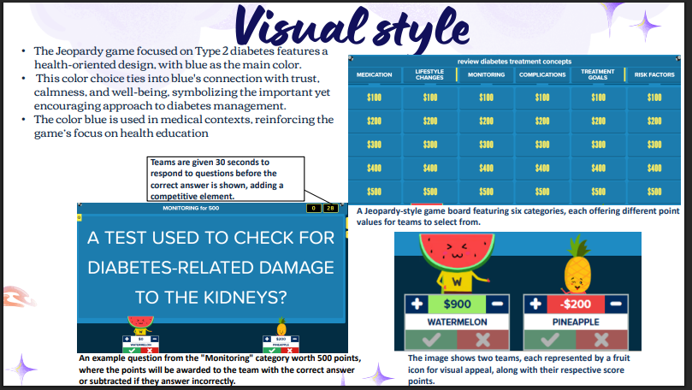
Examples of student projects (2024)
Notes:
NTHABELENG L, NTOMBIKHONA M, NOTISI F, ZULU N

Slide 32
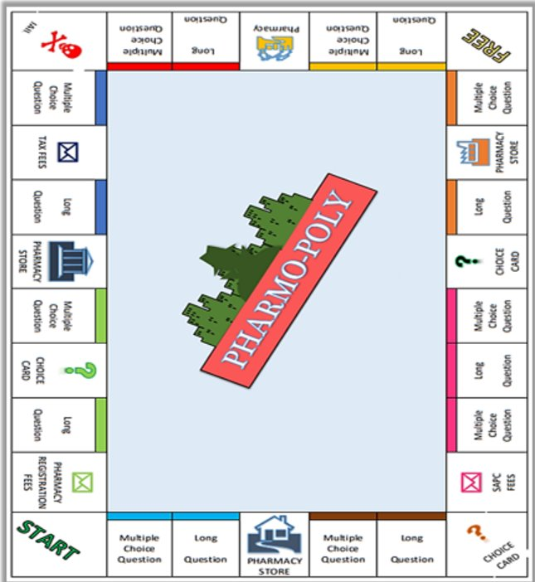
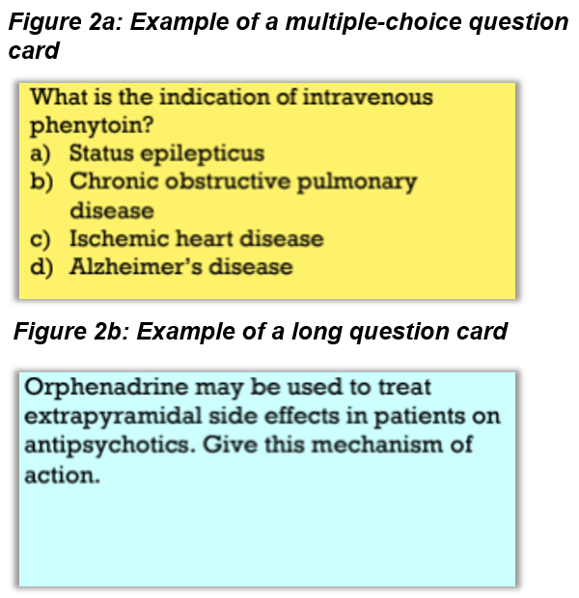
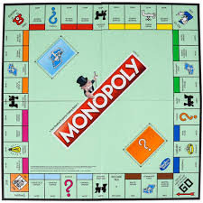
Specific examples
SAPC fees
Pharmacy Registration fees
Small Independent : House
Large Corporate : Hotel
MCQ vs Long Questions

Slide 33
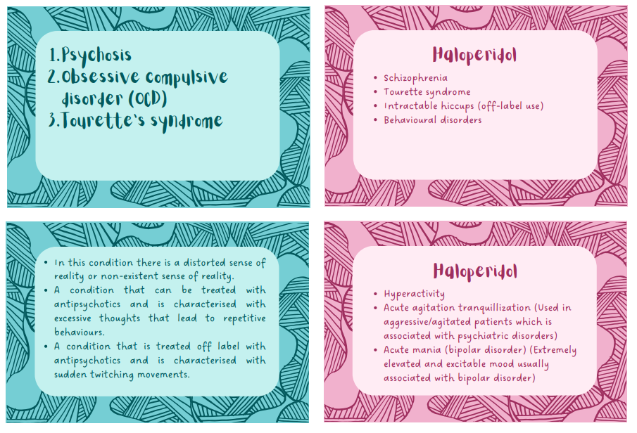
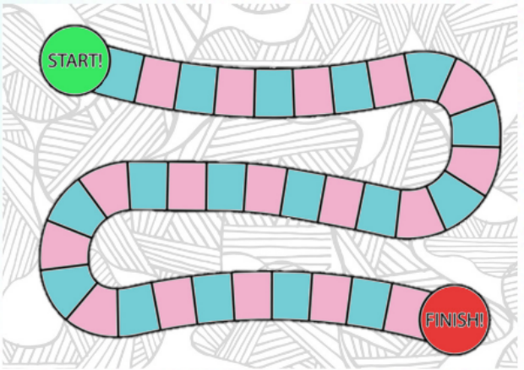
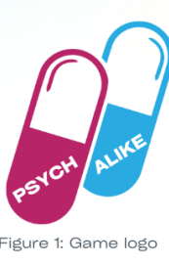
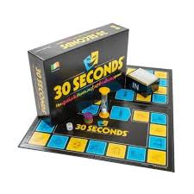
Specific examples
Inspired by:

Slide 34
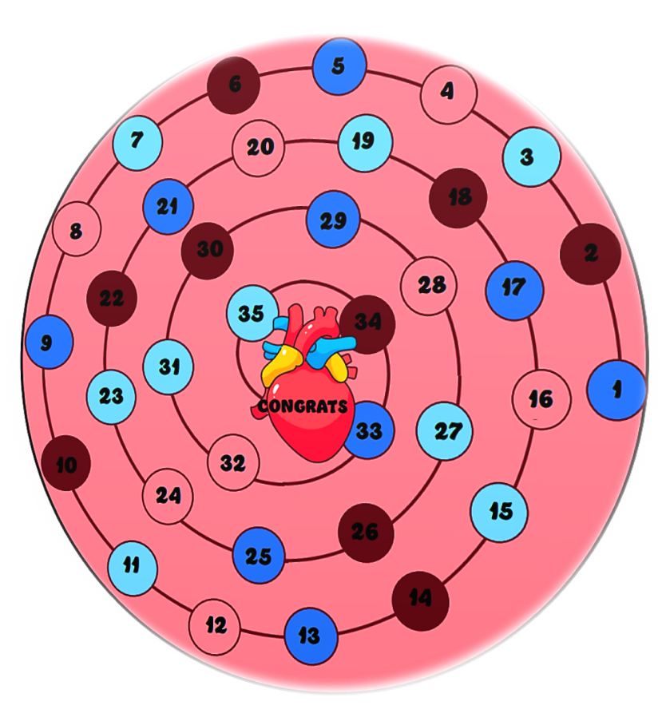
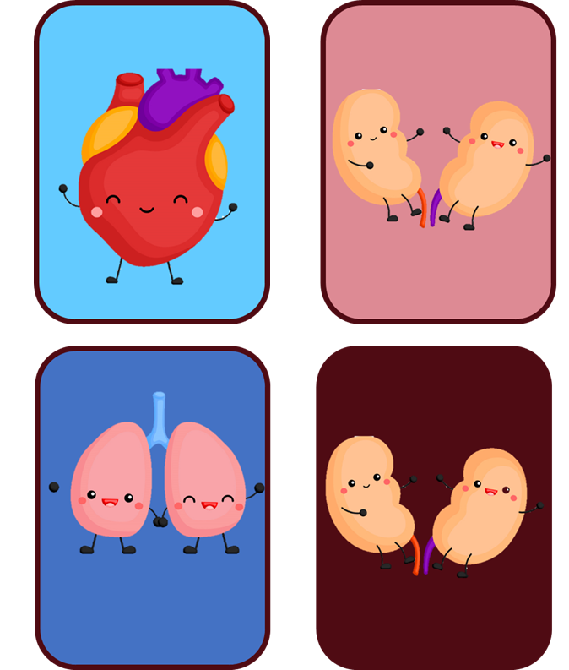
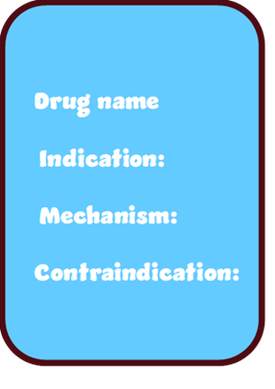
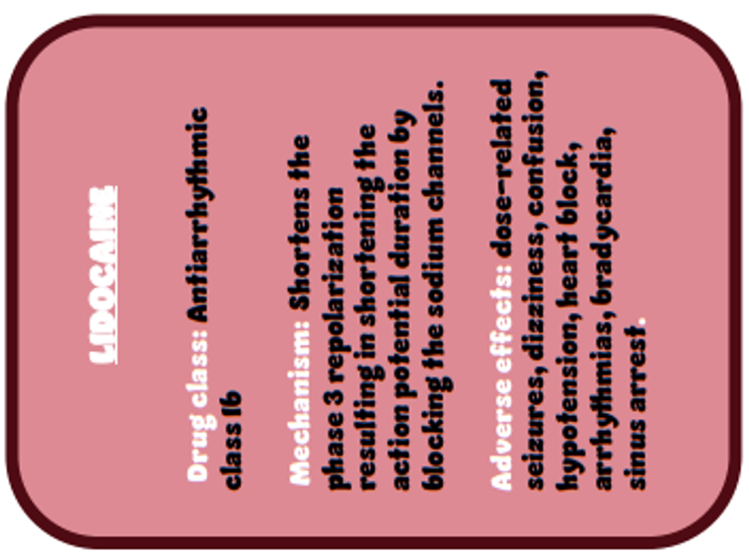



Specific examples
LIDOCAINE
Notes:
Code names, Digital (edu candy studio), 30 sec, heads up

Slide 35

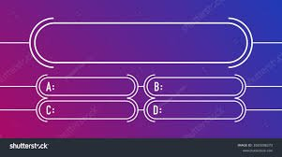
Thank you for your attention
Questions?
Comments?
Thoughts?
Ideas?

Slide 36
Acknowledgement to game designers
Pharmo-poly: Mhlongo B, Raath C, Moropene L, Moodley M.
Asthma Quiz: Masipa M, Masophi A, Mofoka Z, Ngumbela L.
Antibiotic classes: Sifanelo S, Myeza M, Pasha T, Magwenyana S.
Tradenames: Chan J, Jooste K, Vaughn A, Witbooi C.
EduCandy Studio: Gumede F, Magubane S, Mbatha K, Motlogelwa , Mgubasi M.
Cardio-quest: Daniels N, Maluleke S, Ngocobo T
Psych-alike: Crouse M, Smith M, Anderson T.
OTC pain medicine: Makonza T, Nonxube A, Nombuso N, Pakati L
The LOOP: Geyer R, Hanif WA, McCarthy N, Nobela A
MediCLUE: Ruan Reinhart, Oyintando Nomana, Aseko Tshiyaba, Zinthle Mkhaliphi
Diabetic Jeopardy: Nthabeleng L, Ntombikhona M, Notisi F, Zulu N

